Slide 1



WELL COME TO OUR CLASS 8
MYAN SECONDARY SCHOOL

Slide 2

Tuesday, March 29th ,2022
Unit 11: Science and Technology
Lesson 5: Skills 1

Slide 3
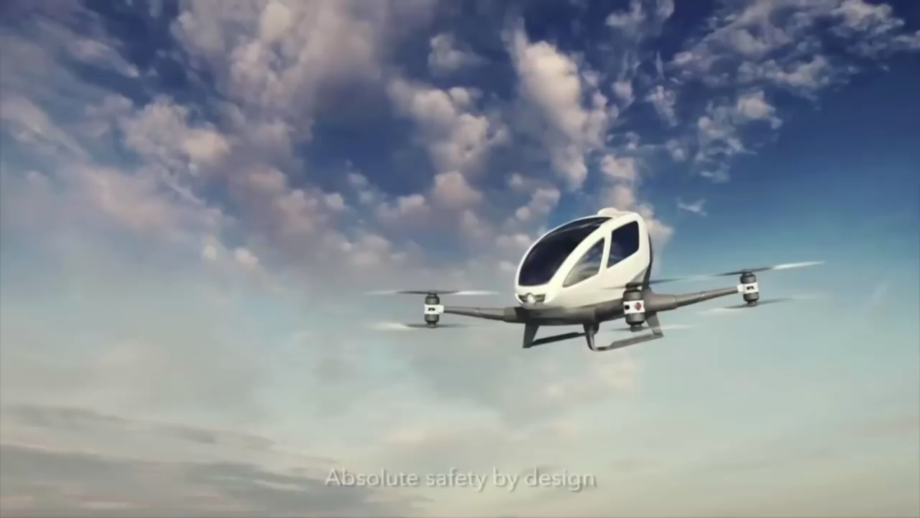
What is the video about?
Life in the future

Slide 4
Vocabulary
- Reality (n):
Thực tế
- Incurable (adj):
Nan y, không chữa được
- Cure (v):
Điều trị
- Anti – ageing (adj):
Chống lão hóa
- Advance (n):
Sự tiến bộ

Slide 5
Ex1: Quickly read the passages. Match the headings with the passages
1. Can we live longer?
2. Can we live there?
3. Future home prediction
A...................................................
Travelling to Mars might become a reality sooner than you think. Scientists are planning to send people (not animals!) to explore Mars in the near future. They believe it’s the only way to find out if there is, or ever has been , life on this planet. They will explore the possibility of living there. So people may go there to live one day!
B...................................................
Scientists say that in the future people will live longer. Incurable diseases will be cured and ‘bad’ genes will probably be replaced. With healthier lifestyles and better medical care the average person will live to be 100 instead of 70 (for men) or 75 (for women) like today. Anti-ageing pills will also be invented to help people live longer.
C...................................................
Future homes will be located on the ocean, in the air, or underground. These homes will have advanced energy saving devices such as solar panels, solar windows, and smart home technology. Future homes will take advantage of robots to do chores such as cleaning, cooking, washing, and organising everything for their owners.

Slide 6
Ex2: Quickly read the passages. Underline the words/phrases
A reality
possibility
Anti-ageing pills
explore
replaced
Energy saving devices
2. Can we live there?
A...................................................
Travelling to Mars might become a reality sooner than you think. Scientists are planning to send people (not animals!) to explore Mars in the near future. They believe it’s the only way to find out if there is, or ever has been , life on this planet. They will explore the possibility of living there. So people may go there to live one day!
1. Can we live longer?
B...................................................
Scientists say that in the future people will live longer. Incurable diseases will be cured and ‘bad’ genes will probably be replaced. With healthier lifestyles and better medical care the average person will live to be 100 instead of 70 (for men) or 75 (for women) like today. Anti-ageing pills will also be invented to help people live longer.
3. Future home prediction
C...................................................
Future homes will be located on the ocean, in the air, or underground. These homes will have advanced energy saving devices such as solar panels, solar windows, and smart home technology. Future homes will take advantage of robots to do chores such as cleaning, cooking, washing, and organising everything for their owners.

Slide 7
Ex 2: Matching
A
B
a. Examine carefully to find out more about something.
1. A reality
2. explore
b. Used instead of something else
3. possibility
c. Equipment that helps save energy
d. A thing that actually exists or happens
4. replaced
5. anti-ageing pills
e. Something that is likely to happen
6. Energy saving devices
f. Medicine that can prevent ageing

Slide 8
Ex 3: Answer the questions
1.Why are scientists planning to send people to Mars?
2. How will anti-ageing pills help people?
3. How long does an average person live now?
4. What are some energy saving devices?
5. What will home robots do in the future?

Slide 9
Lucky number
1
2
3
4
5
6

Slide 10
1.Why are scientists planning to send people to Mars?
➔ Because they want to explore the possibility of living there.

Slide 11
2. How will anti – ageing pills help people?
➔ They help people live longer.

Slide 12
3. How long does an average person live now?
➔ 70 ( for men ) or 75 ( for women).

Slide 13
4. What are some energy saving devices?
➔ They are solar panels and solar windows.

Slide 14
5. What will home robots do in the future
➔ In the future, robots do chores such as cleaning, cooking, washing and organising everything.

Slide 15
Lucky number

Slide 16
Ex 3: Answer the questions
1.Why are scientists planning to send people to Mars?
➔ Because they want to explore the possibility of living there.
2. How will anti-ageing pills help people?
➔ They help people live longer.
3. How long does an average person live now?
➔ 70 ( for men ) or 75 ( for women).
4. What are some energy saving devices?
➔ They are solar panels and solar windows.
5. What will home robots do in the future?
➔ In the future, robots do chores such as cleaning, cooking, washing and organising everything.

Slide 17
Ex 4: Think and Make notes
Advances | Advantages | Disadvantages
Robots
Nuclear energy
Nutrition pills
Smart phones
Space travel
do a lot of things
unemployment
convenient, clean…
expensive, unsafe
help people live longer
expensive
convenient, entertaining
environmentally unfriendly
exciting
expensive, dangerous

Slide 18
Ex 5: Work in groups. Express your agreement and disagreement about how scientific advaces can help us solve problems in the future
Example:
A: I think robots will help us do many boring or difficult jobs.
B: Yes. But at the same time, they may bring a lot of unemployment
C: And they’ll make us lazy and inactive.
1. Smart phones
A: I think smart phones can replace your traditional camera, voice recorder, dairy, maps, calendar, Calculator, traditional watch...
B: Yes. They provide very easy communication. But they can cause severe health effects.
C: And your privacy at risk, insecurity and unsafety to public.
2. Space travel
A: I think space travel can help people to know more about the universe.
B: Yes. They will pave the way for advanced technology, and creates numerous jobs. But, at the same time, it can endanger the lives of astronauts.
C: And it can leads to pollution in space.

Slide 19
HOMEWORK
Learn by heart vocabulary.
Do exercises (workbook).
Prepare: Unit 11 – Skills 2

