Slide 1

12
LIFE ON OTHER PLANETS

Slide 2



New lesson
UNIT 12: LIFE ON OTHER PLANETS
LESSON 4: SKILLS 1

Slide 3
Period 87 UNIT 12: LIFE ON OTHER PLANETS
LESSON 4: SKILLS 1

Slide 4
Vocabulary
surface (n)
Bề mặt
Atmosphere (n)
khí quyển, không khí
Oxygen (n)
khí ôxy
experience (n)
trải nghiệm
Accommodate (v):
cung cấp nơi ăn , chốn ở
trace (n)
dấu vết
similarity (n)
tương tự

Slide 5
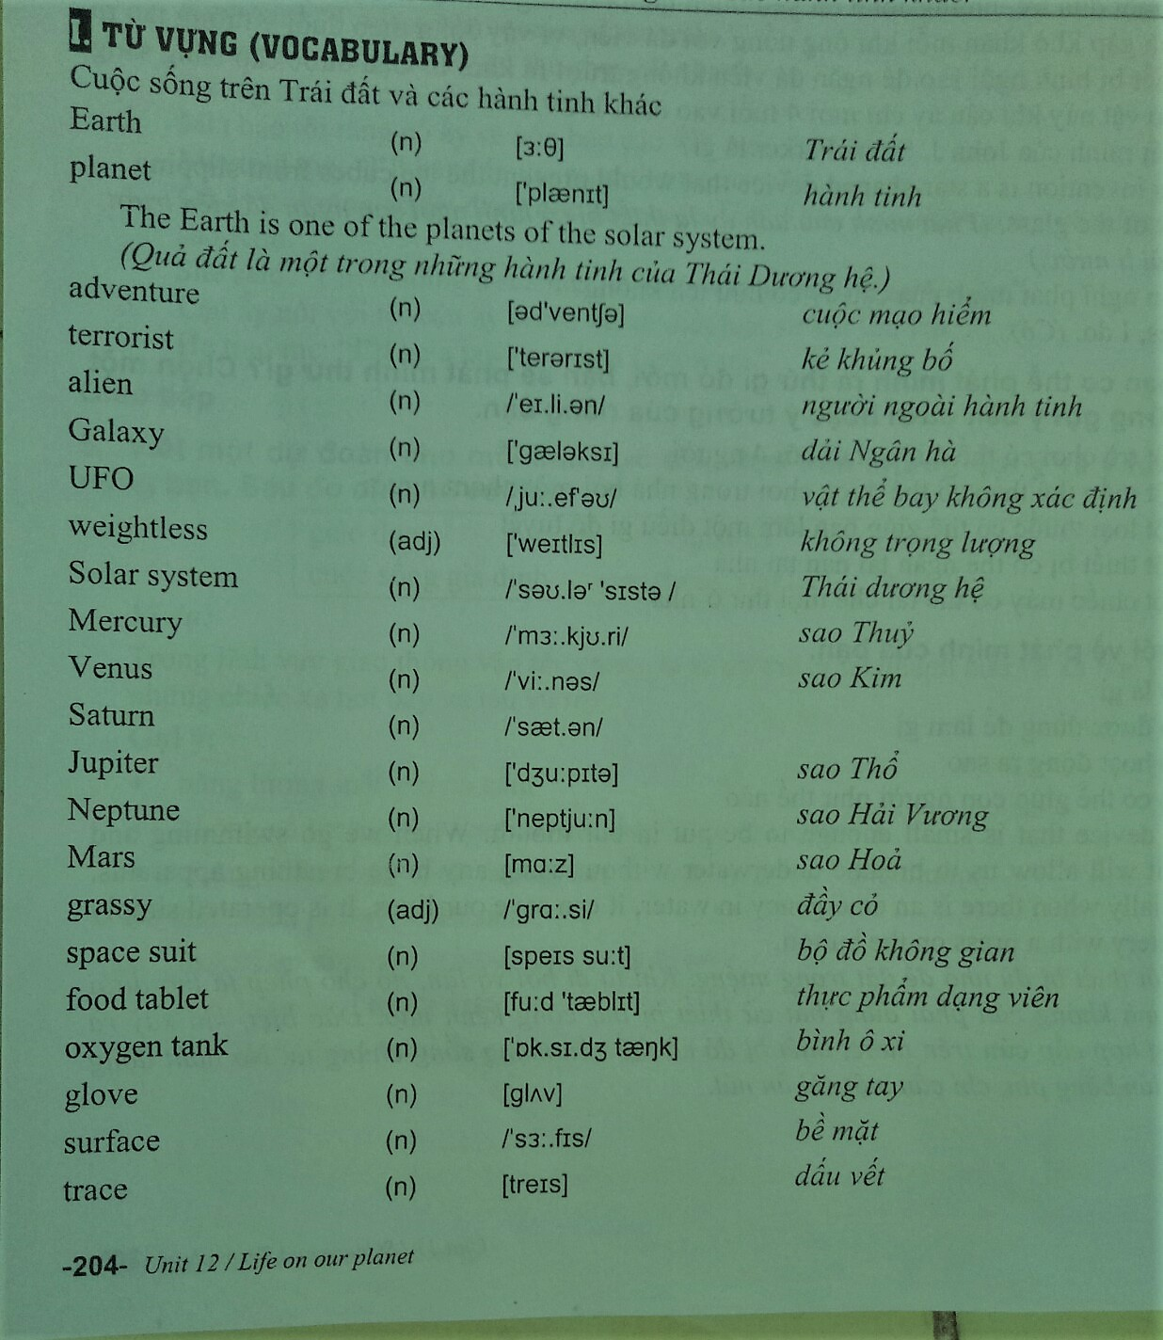

Slide 7
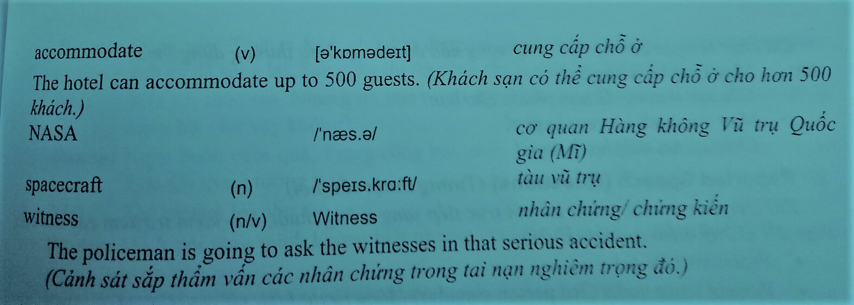

Slide 8


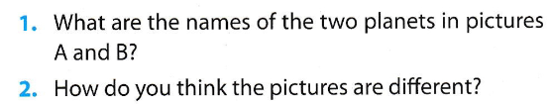

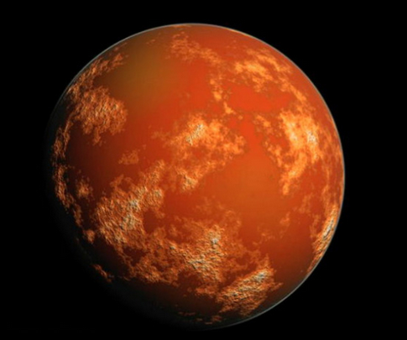
All Call
Student Demo

Slide 9
1. Mars is called the Red Planet because of its reddish surface. There have been many explorations to Mars by humans since the mid-20th century. Scientists hope that we can find another planet to accommodate human life.
2. There are major reasons why the climate on Mars is unsuitable for human life. Temperatures on Mars can be as low as -87 degrees Celsius and rarely get above 0 degrees Celsius. But the bigger problem is the lack of oxygen. 95% of the atmosphere is carbon dioxide (C0₂), and this is poisonous to breathe. Moreover, there is no water on Mars even though scientists have found traces of it.
3. However, as early as the mid-19th century, scientists discovered that Mars had some similarities to Earth. A day on Mars is 24 hours, 39 minutes and 35 seconds, almost the same as a day on Earth. Mars also experiences seasons just as Earth does. However, the seasons are twice as long because a year on Mars lasts about twice as long as an Earth year.
All Call
Student Demo

Slide 10





poisonous
twice
experiences
traces
surface
climate
accommodate
All Call
Student Demo

Slide 11

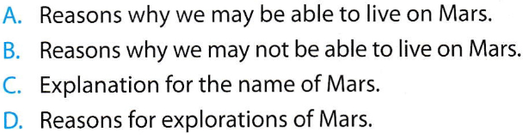
1 – C | 2 – B | 3 – A
All Call
Student Demo

Slide 12
It is also called the Red Planet.
The lowest temperature is -87 degrees Celsius and the highest may be a bit higher than zero.
Because 95% of the atmosphere is carbon dioxide.
A day on Mars is a bit longer.
It is twice as long as a year on Earth.
All Call
Student Demo

Slide 13

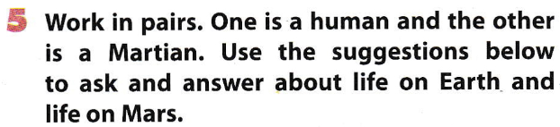
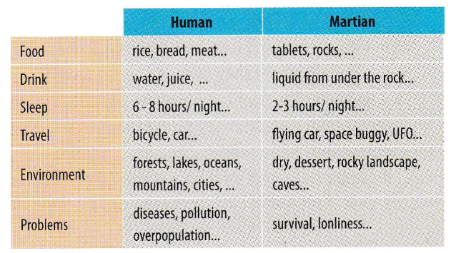
All Call
Pair
Student Demo

Slide 14
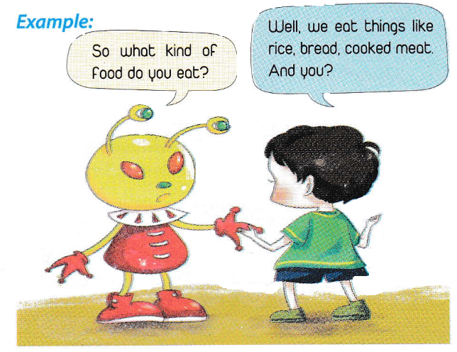
All Call
Pair
Student Demo

Slide 15
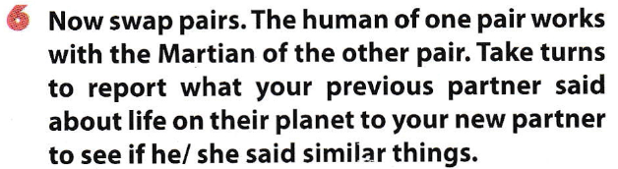
New human: What kind of food did the human say she ate?
New Martian: She said that she ate rice, bread, meat and fruit and vegetables.
New human: Yes, that’s right!
All Call
Pair
Student Demo

Slide 16
Homework
Learn by heart the new words.
Speak with your friends
Prepare for the next..

Slide 17


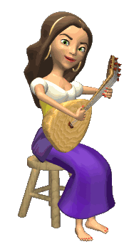

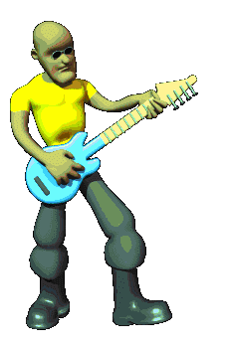
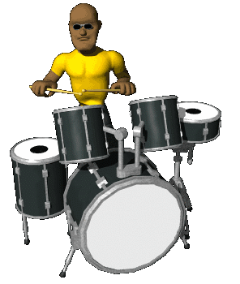





THANK YOU FOR ATTENTION!
GOOD BYE!
the end

