Slide 1

Unit 2: HEALTH
Lesson 1.2: Grammar
Page 13

Slide 2
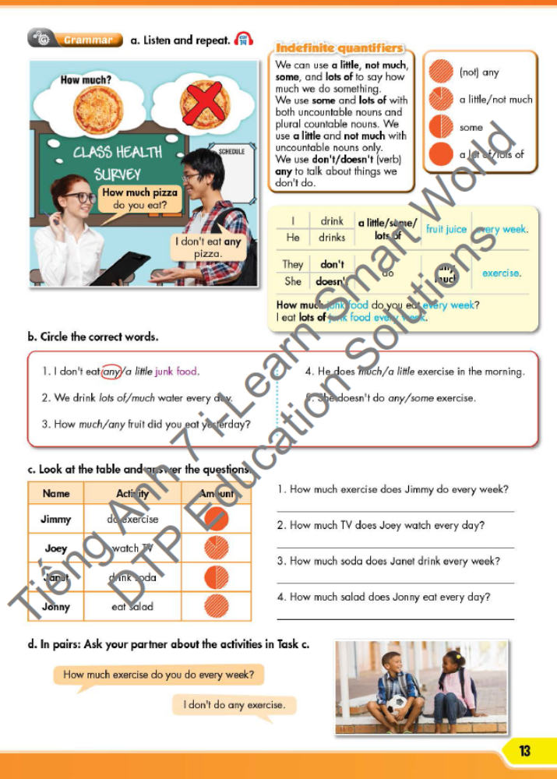

LESSSON OUTLINE
Presentation
Practice
Production
Wrap-up

Slide 3

By the end of this lesson, students will be able to…
use indefinite quantifiers.

Slide 4

WARM UP

Slide 5
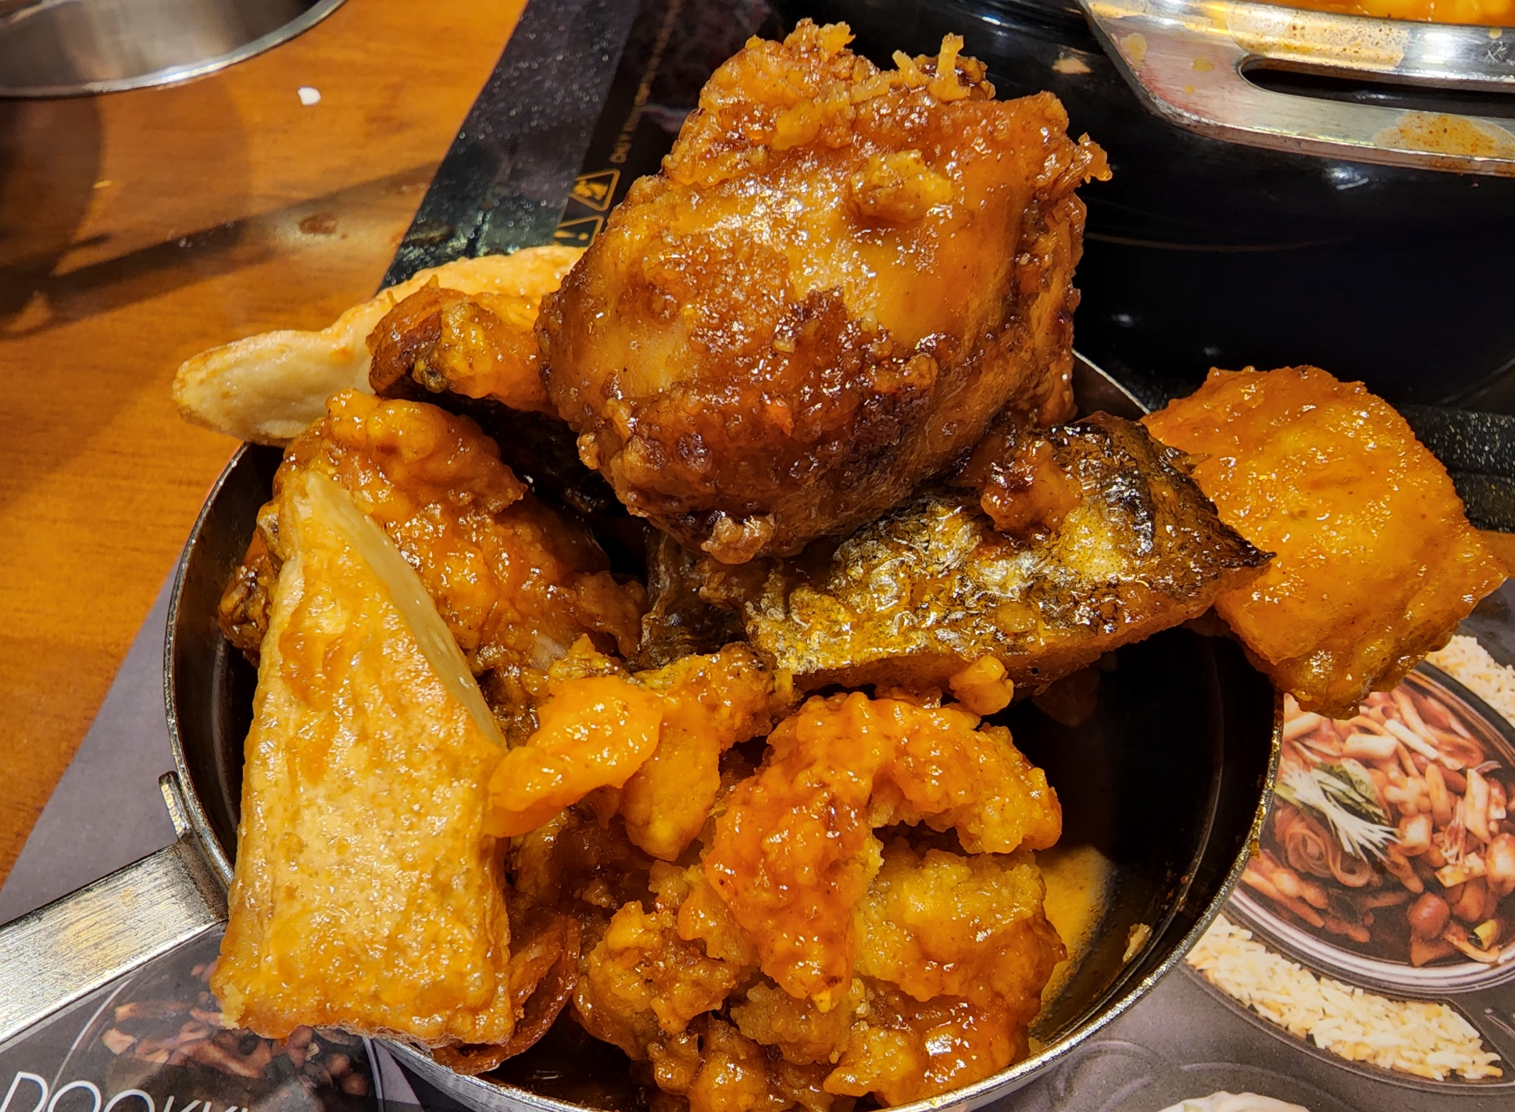
What kinds of food can you see in the photo?
chicken
fish
Click here for the answers.

Slide 6
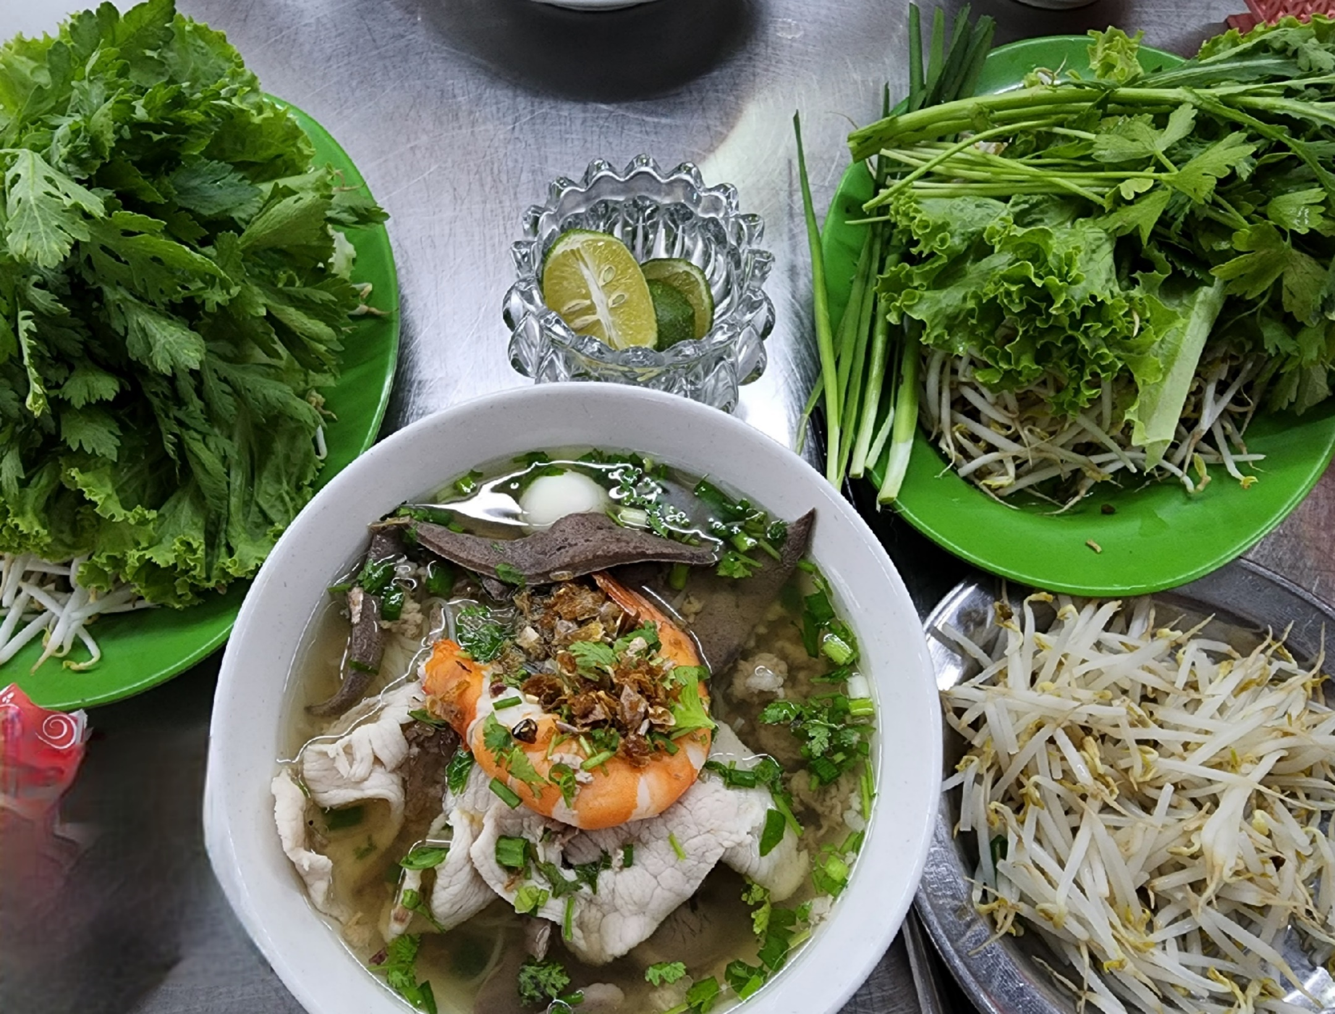
What kinds of food can you see in the photo?
limes
vegetables
quail egg
shrimp
pork
Click here for the answers.

Slide 7
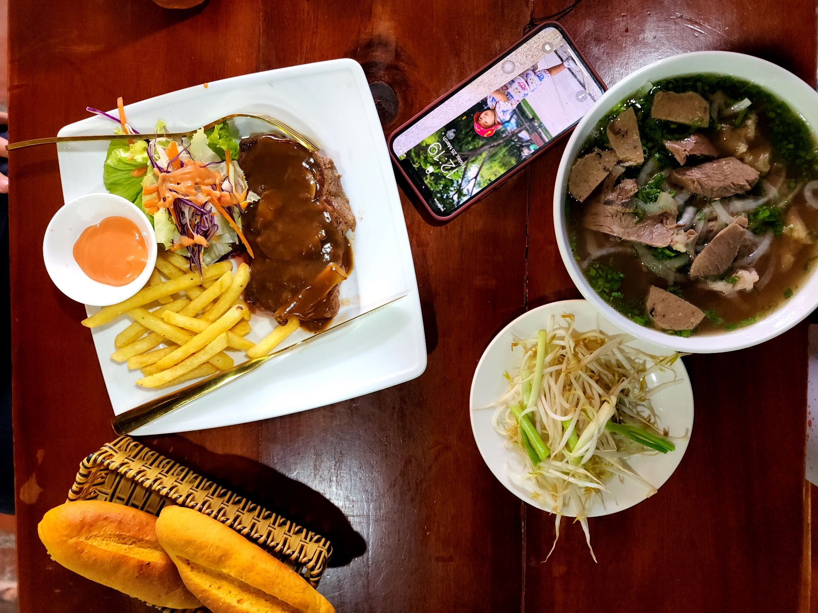
What kinds of food can you see in the photo?
bread
beef
French fries
Click here for the answers.

Slide 8

PRESENTATION

Slide 9
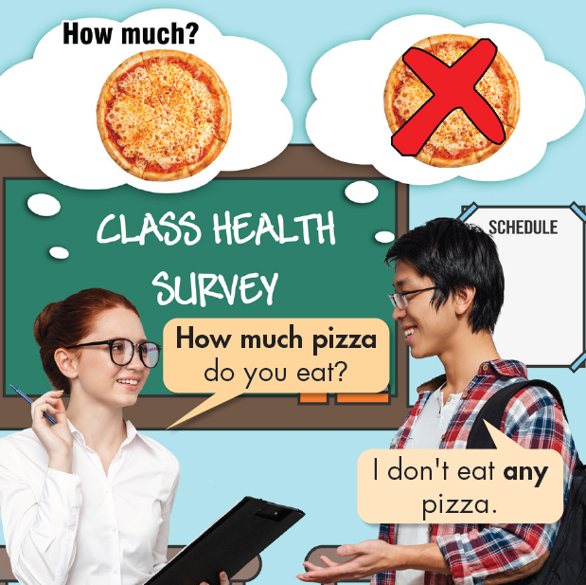

Look, listen and read.
(Click here to hear the sound)
I don’t eat any pizza. = I eat no pizza.

Slide 10
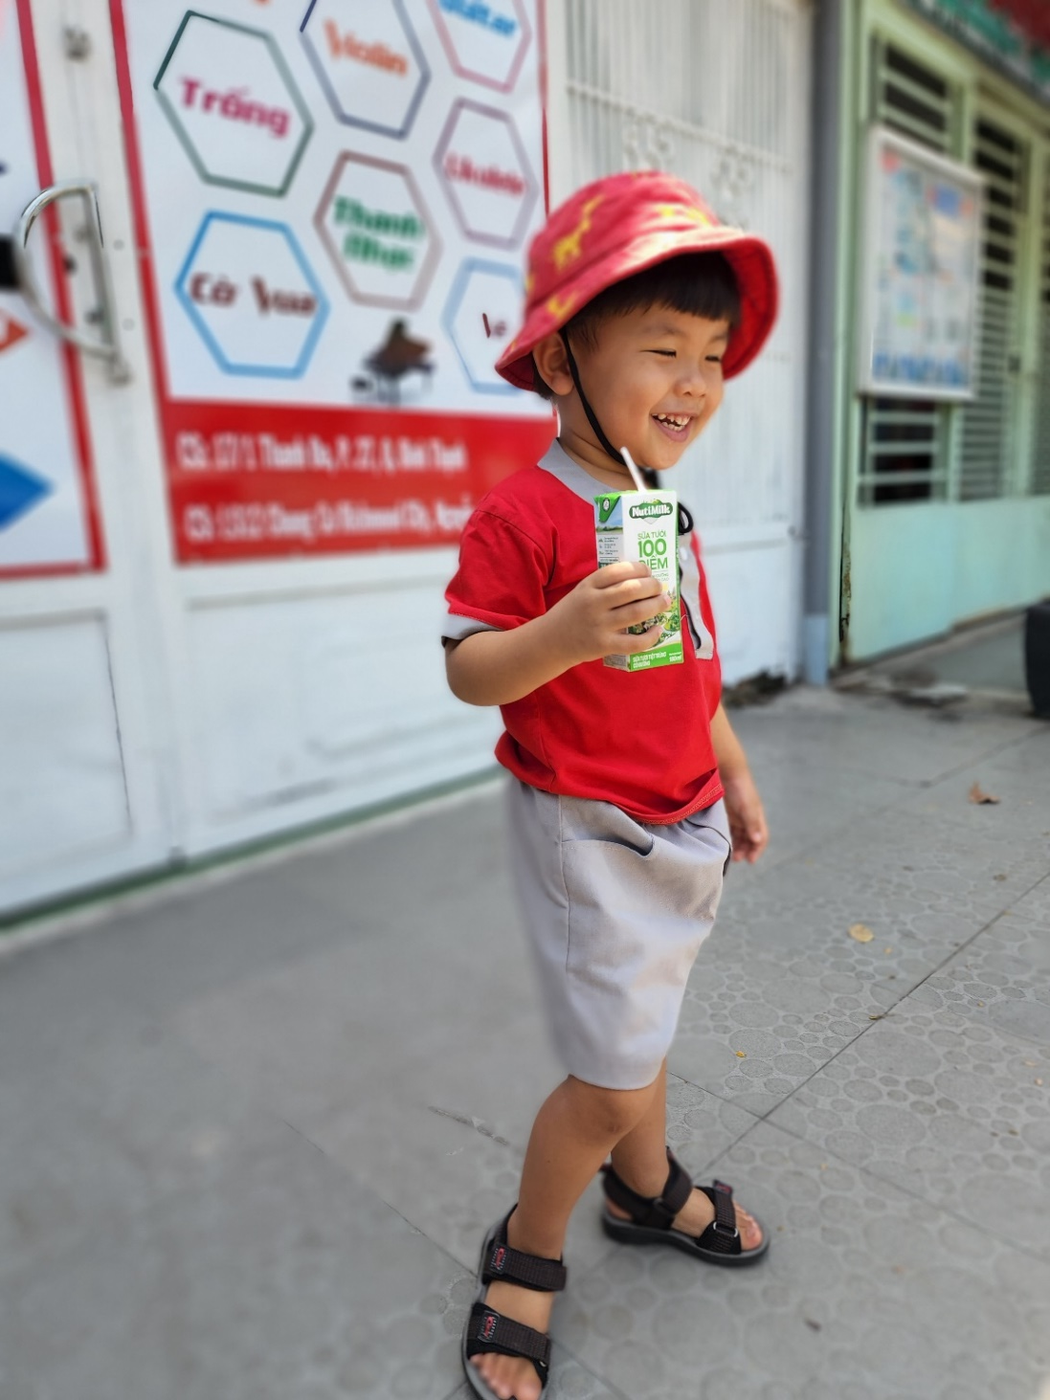
Look and read.
Yes. I drink lots of milk.
Do you drink any milk?

Slide 11
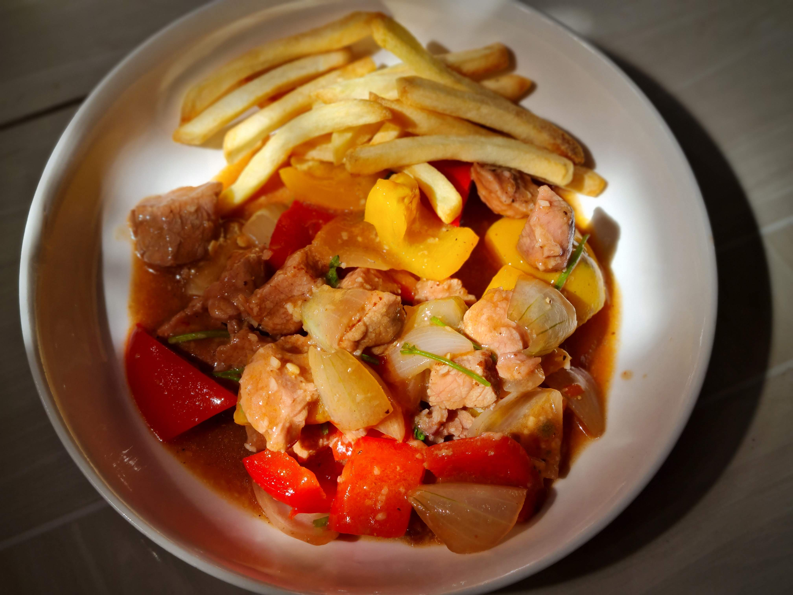
Look and read.
Are there any French fries?
Yes. There are some French fries.
Is there any beef?
Yes. There’s lots of beef.

Slide 12
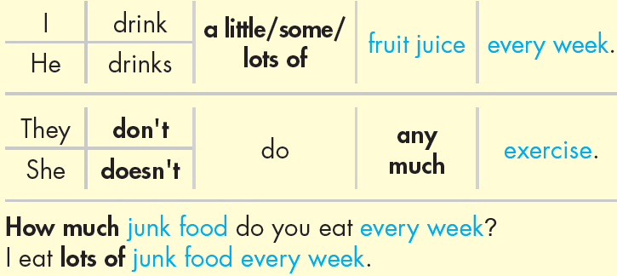
INDEFINITE QUANTIFIERS
- Use a little, not much, some, and lots of to say how much we do something.
- Use some and lots of with both uncountable nouns and plural countable nouns. We use a little and not much with uncountable nouns only.
- Use don't/doesn't (verb) + any to talk about things we don't do.

Slide 13

PRACTICE

Slide 14
Circle the correct words.
1. I don't eat any / a little junk food.
2. We drink lots of / much water every day.
3. How much / any fruit did you eat yesterday?
4. He does much / a little exercise in the morning.
5. She doesn't do any/some exercise.
Click here for the answers.

Slide 15




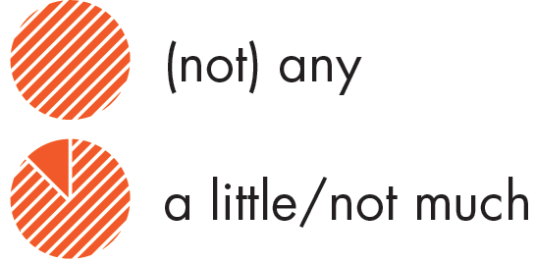
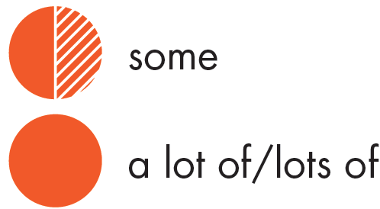
c. Look at the table and answer the questions.
Name Activity Amount
Jimmy do exercise
Joey watch TV
Janet drink soda
Jonny eat salad
1. How much exercise does Jimmy do every week?
_______________________________________
2. How much TV does Joey watch every day?
_______________________________________
3. How much soda does Janet drink every week?
_______________________________________
4. How much salad does Jonny eat every day?
__________________________________
Jimmy does lots of / a lot of exercise every week.
Joey doesn’t watch much TV. / Joey watches a little TV.
Janet drinks some soda.
Jonny doesn’t eat any salad.
Click here for the answers.

Slide 16
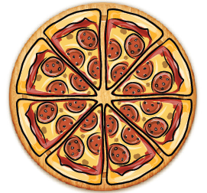
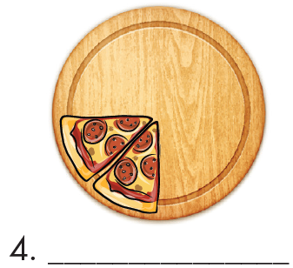
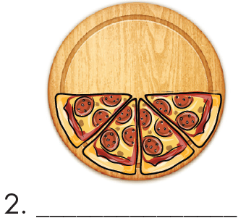
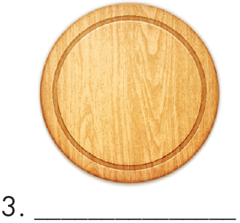
Extra Practice WB, page 9
Fill in the blanks, using the words in the box.
1. a lot of / lots of
some
(not) any
a little
Click here for the answers.

Slide 17
b. Look at the table and write sentences using indefinite quantifiers.
Name Activity Amount
Joe eat junk food
Julie do exercise
Bill watch TV
Kim drink fruit juice
James play sports
1. How much fruit juice does Kim drink?
__________________________________
2. How much junk food does Joe eat?
__________________________________3. How much exercise does Julie do?
__________________________________4. How much TV does Bill watch?
__________________________________
5. How much sport does James play?
__________________________________
Kim drinks a little fruit juice.
Kim doesn’t drink much fruit juice.
Joe eats lots of / a lot of junk food.
Julie does some exercise.
Bill doesn’t watch any TV.
James plays a lot of / lots of sports.
Click here for the answers.

Slide 18
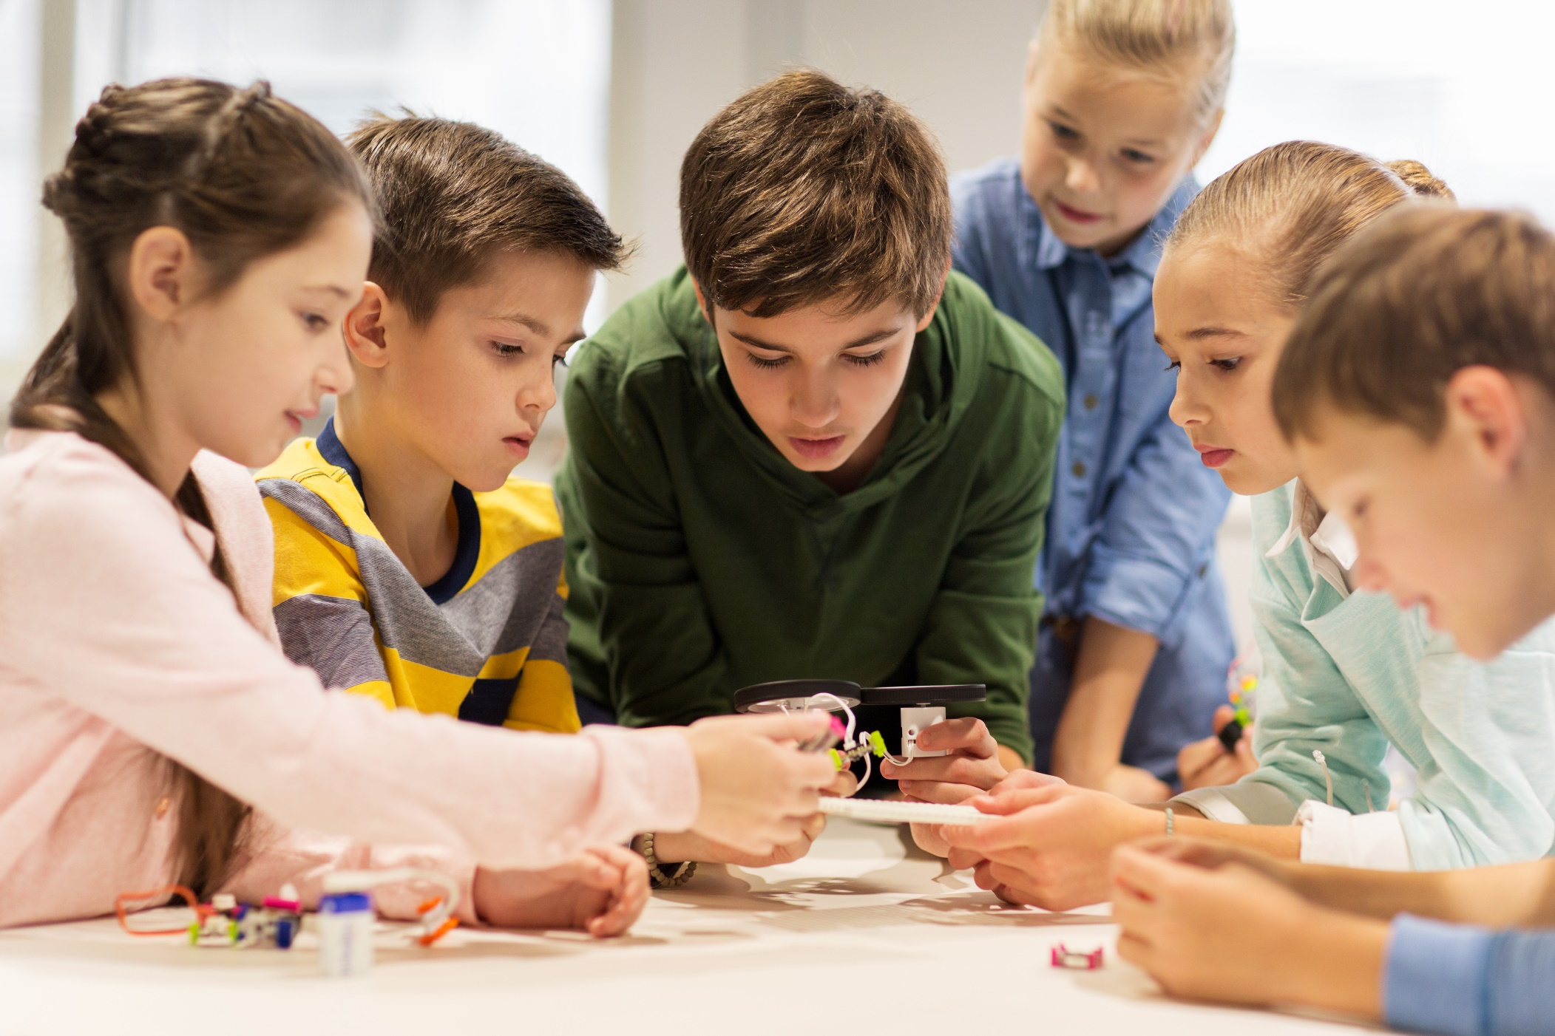
PRODUCTION

Slide 19

d. Work in pairs.
Ask your partner, using the activities in task c, student’s book page 13 (do exercise, watch TV, drink soda and eat salad)
How much exercise do you do every week?
I don’t do any exercise.

Slide 20
Work in groups: Talk about many types of food that you eat, using the grammar points:
  some
  (not) any
  lots of / a lot of
Both count nouns & non-count nouns
  come before
  a little
  not much
  come before
non-count nouns
Ex: I always eat a little rice but lots of fish.
I don’t drink much bubble (milk) tea.

Slide 21

CONSOLIDATION

Slide 22
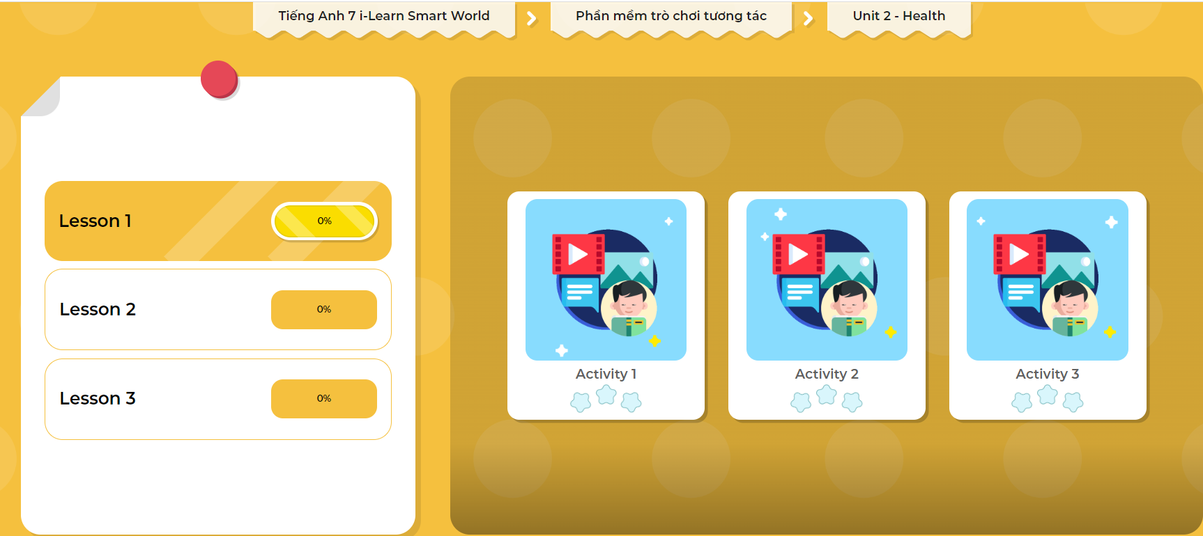
LET’S PLAY!
Click here to play the games

Slide 23

WRAP-UP

Slide 24
Today’s lesson
  some
  (not) any
  lots of / a lot of
Both count nouns & non-count nouns
  come before
  a little
  not much
  come before
non-count nouns

Slide 25
Homework
Practice the grammar points (not any, much, lots of / a lot of, some, a little) at home by making as many examples about them as you can.
Do the Writing exercise on page 9 WB
Complete the grammar notes in Tiếng Anh 7 i-Learn Smart World Notebook on page 9
Prepare the next lesson (page 14 SB)
Play consolidation games in Tiếng Anh 7 i-Learn Smart World on www.eduhome.com.vn

Slide 26
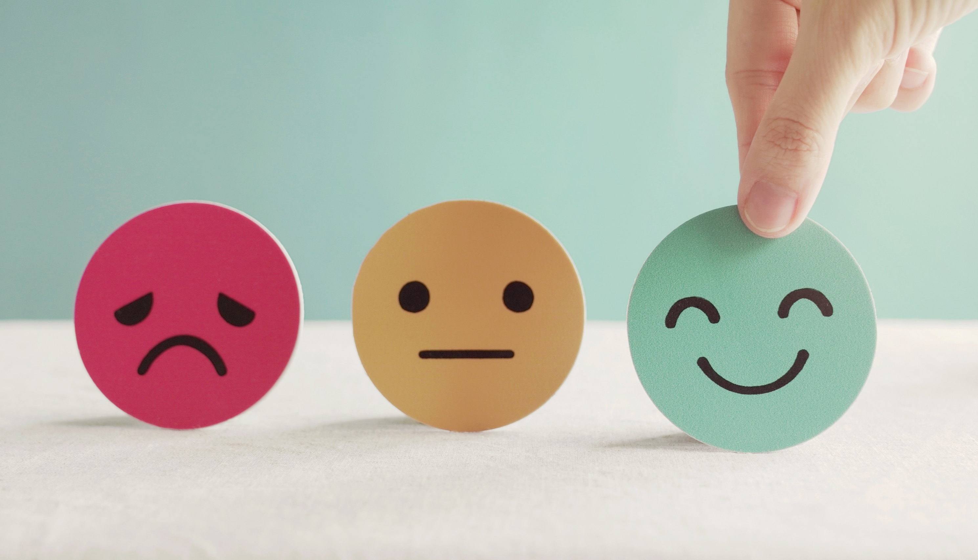
Lesson 3
Stay positive and have a nice day!

