Slide 1



Slide 2
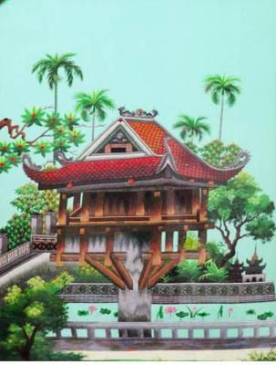
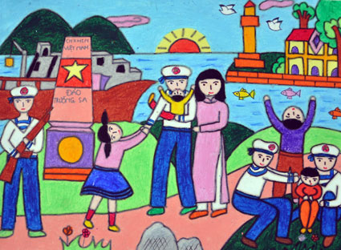
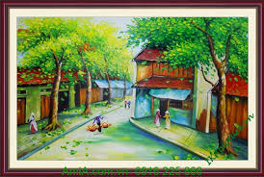
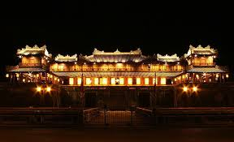
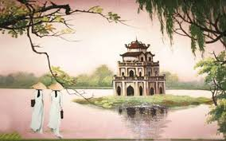
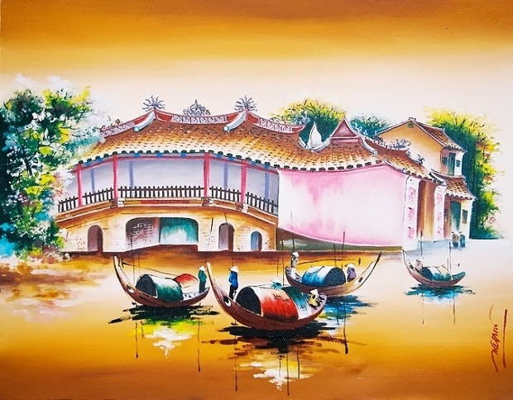
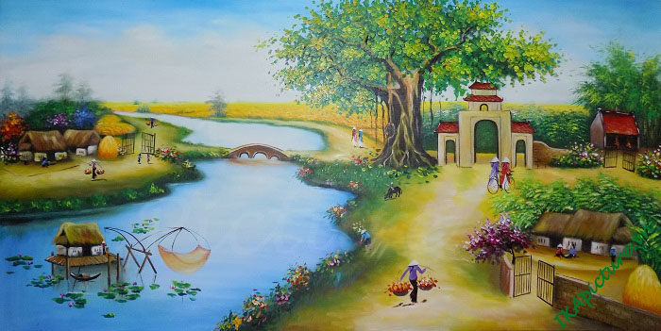
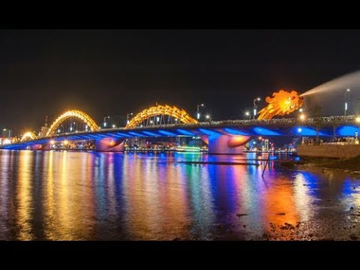

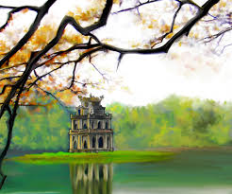
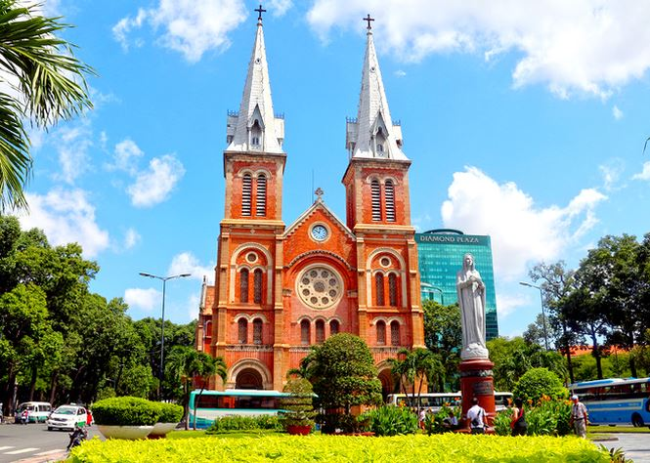
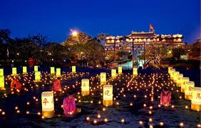
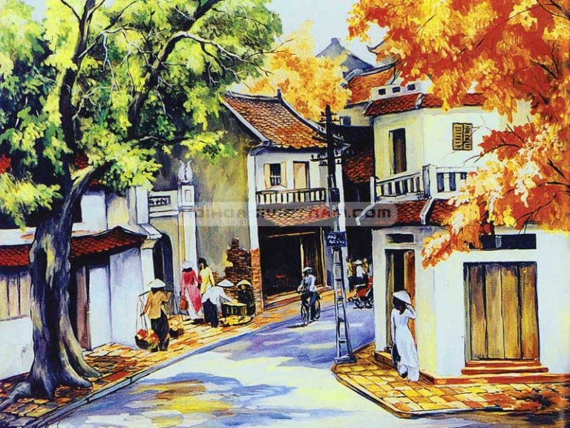

What is the name of this song ?
Hello Viet Nam
Who is the singer ?
Ms. Pham Huynh Anh

Slide 3

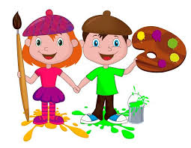

Slide 4


Unit 4: MUSIC AND ARTS
Lesson 1:GETTING STARTED/P.40-41
Making plans for the weekend

Slide 5

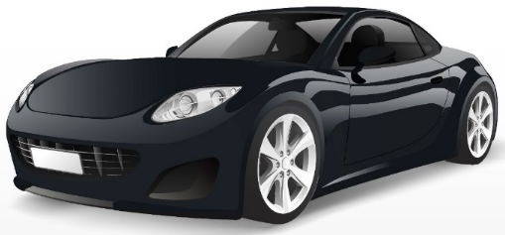
PRESENTATION
classical (adj)
modern
/ˈklæsɪkəl/
cổ điển

Slide 6




PRESENTATION
spare time (n)
/speər taɪm/
thời gian rảnh rỗi

Slide 7
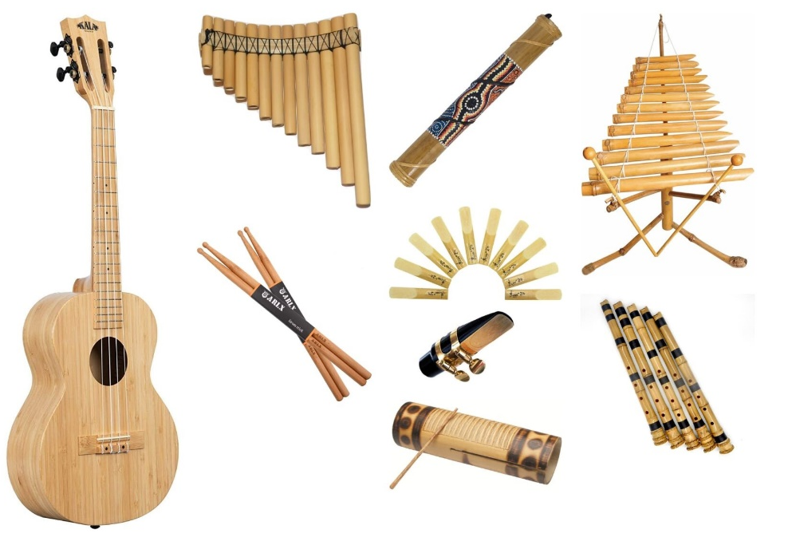
PRESENTATION
musical instruments (n)
/ˈmjuːzɪkəl ˈɪnstrəmənts/
nhạc cụ

Slide 8

PRESENTATION
landscape (n)
/ˈlændskeɪp/
cảnh quan

Slide 9
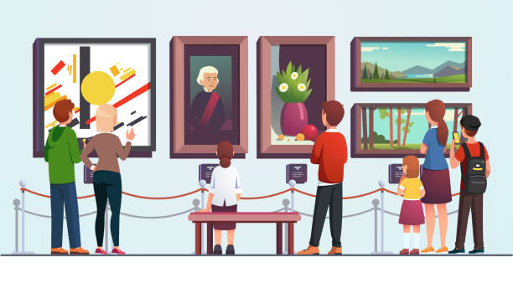
PRESENTATION
art gallery (n)
/ˈɑːt ˌɡæləri/
phòng trưng bày
nghệ thuật

Slide 10
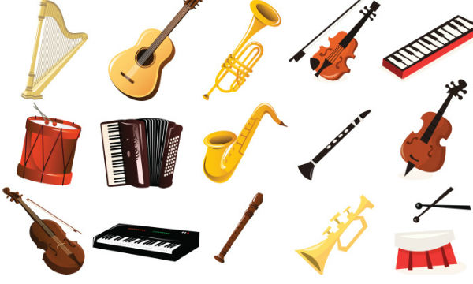
UNIT 4: MUSIC AND ARTS
LESSON 1: GETTING STARTED
I/ Vocabulary
- classical (a) :
cổ điển
- art gallery (n) :
triển lãm tranh
- Spare time (n):
thời gian rảnh
- landscape (n)
: cảnh quang
- musical instruments(n) :
nhạc cụ

Slide 11
Check vocabulary: Matching
A
B
1. photography (n)
A. ảnh chân dung
2. fantastic (a)
B. nhiếp ảnh
3. portrait(n)
C. tuyệt vời
4. art gallery (n)
D. triển lãm tranh
5.musical instruments(n)
E. nhạc cụ
F. viện bảo tàng

Slide 12
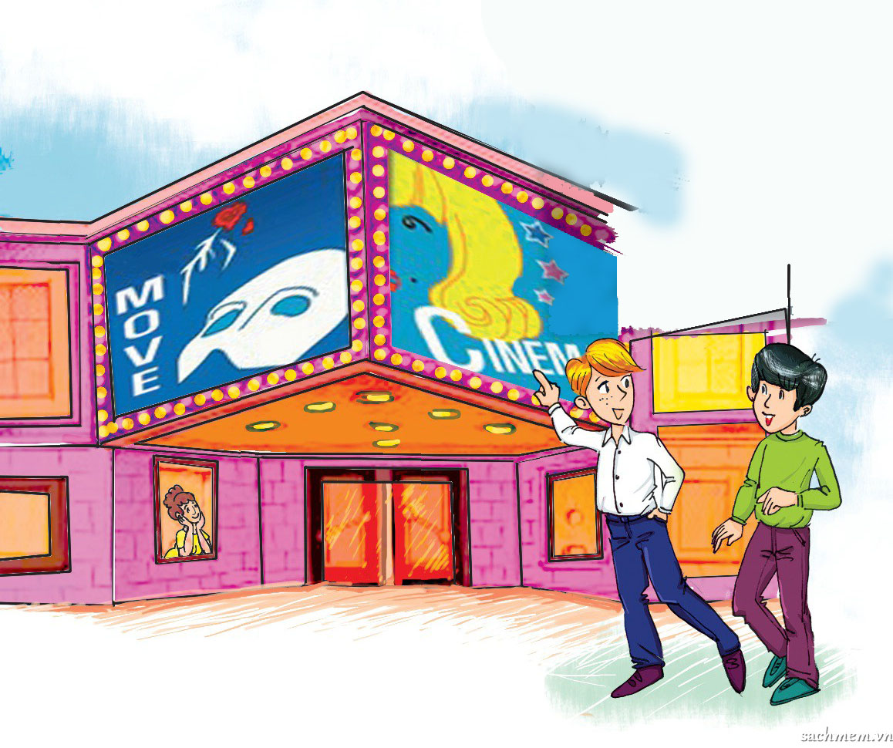
UNIT 4: MUSIC AND ARTS
LESSON 1: GETTING STARTED
Nick
Duong

Slide 13
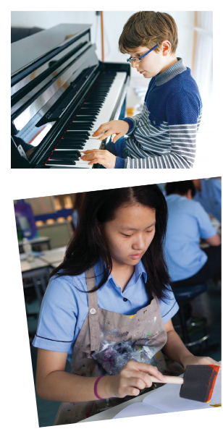
PRESENTATION: LISTEN AND READ.
Trang: Hi Nick. What are you listening to?
Nick: I’m listening to music. I like classical music, and I often play the piano in my spare time.
Trang: Wow. I can’t play any instruments.
Nick: And what about you? What’s your hobby?
Trang: I like painting and taking photos.
Nick: Taking photo? I’ve never tried it. Is it fun?
Trang: Yeah, it is, but not as fun as painting.
Nick: Right. They seem quite different from each other. What do you normally paint?
Trang: Landscapes and animals, just for pleasure, you know. I sometimes share them with my friends.
Nick: Really? Um, maybe we should go to an art gallery next weekend?
Trang: Sounds good, but I’d prefer to go to the music festival at my school.
Nick: Well … OK. That’s fine.

Slide 14
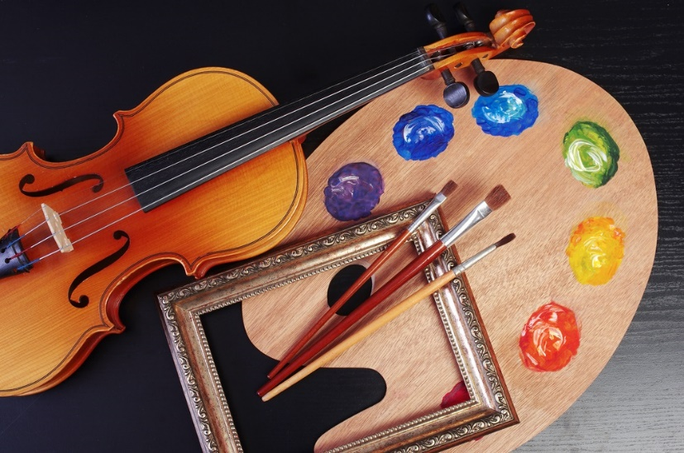
PRACTICE
1
Tick the correct answer.
1. What are Trang and Nick talking about?
A. Playing the piano.
B. Drawing and painting.
C. Music and arts.
Trang: Hi Nick. What are you listening to?
Nick: I’m listening to music. I like classical music, and I often play the piano in my spare time.

Slide 15
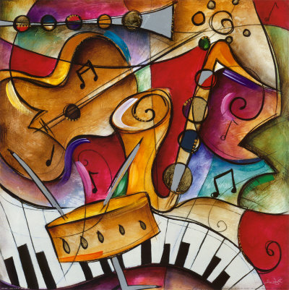
PRACTICE
2
Complete each of the sentences with a suitable word or phrase from the box.
photos like different from art gallery musical instruments
art gallery
Nick wants to go to a(n) _____________ next week.
You can use your smartphone to take ________.
This photo is very bright. It is _____________ that dark one.
Nick and Trang agree that taking photos is not _____________ painting.
My friend David is very talented. He plays three _______________________.
photos
different from
like
musical instruments

Slide 16


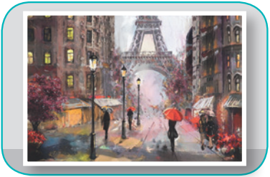
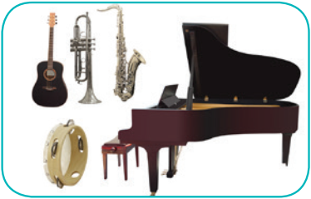
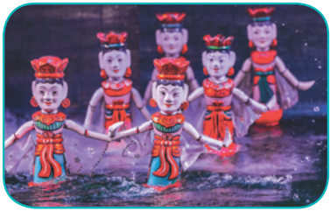
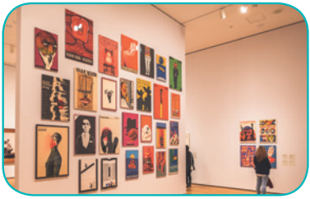
PRACTICE
3
Write the correct word or phrase under each picture. Then listen and repeat.
camera water puppet show art gallery
painting paintbrush musical instruments
paintbrush
1.
2.
camera
painting
3.
4.
art gallery
musical instruments
5
6.
water puppet show

Slide 17


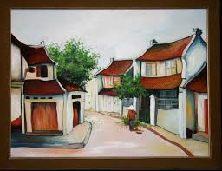
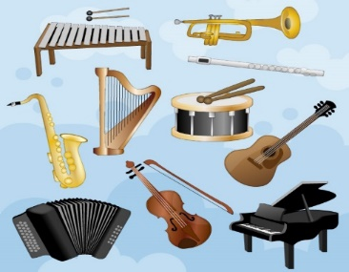
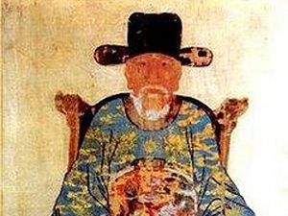
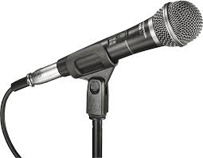

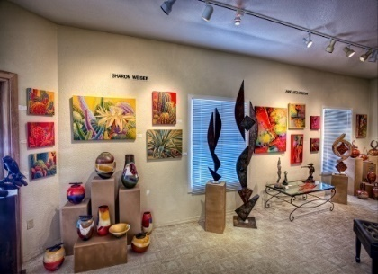
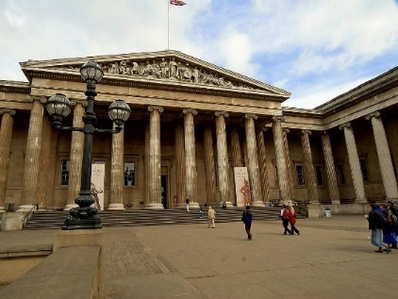
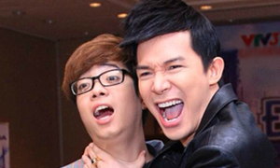
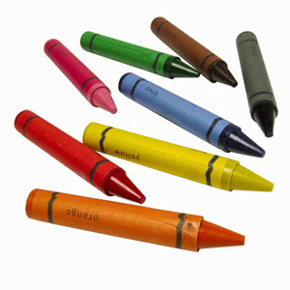
V/ Writing Write the correct word/phrase under each of the pictures
camera
portrait
microphone
paintbrush
museum
painting
crayons
art gallery
opera
musical instruments
2
3
1. ..................................
2. ..................................
3.
...............................
4.
........................
5
..................................
microphone
camera
painting
musical instruments
portrait
6. ..................................
7. ..................................
8. ..................................
9. ..................................
10. ..................................
art gallery
crayons
museum
opera
paintbrush

Slide 18
Complete these sentences with words from 2.
1. The painter’s exhibition, “Hidden Flower”, begins today at the city ______________.
2. Bui Xuan Phai is my favourite artist. I love his ___________ of the old Ha Noi streets.
3. In Barcelona, Spain, you can visit a ________ dedicated to the life of Picasso.
4. I think photography is an interesting art form. Of course, having a good _________ is important.
5. I rarely listen to ___________ at home. I can’t understand the words they sing, and I prefer modern music.
art gallery
paintings
museum
camera
opera

Slide 19
GAME: CROSSWORD
9
1
O | P | E | R | A
2
C | O | N | C | E | R | T
3
P | O | R | T | R | A | I | T
4
C | A | M | E | R | A
5
M | U | S | E | U | M
6
F | A | N | T | A | S | T | I | C
7
P | A | I | N | T | I | N | G | S
8
C | R | A | Y | O | N | S
5.In Barcelona, Spain, you can visit a ________ dedicated to the life of Picasso.
4. I think photography is an interesting art form. Of course, having a good _________is important
2.A musical performance given in public called_______
6. The concert will be _____________
3.A painting , drawing or photograph of a person, especially of the head and shoulders called_______
1. I rarely listen to _________ at home. I can’t understand the words they sing.
8.A pencil or stick of colored chalk or wax, used for drawing called__________
7. Bui Xuan Phai is my favourite artist. I love his __________ of the old Ha Noi streets.

Slide 20
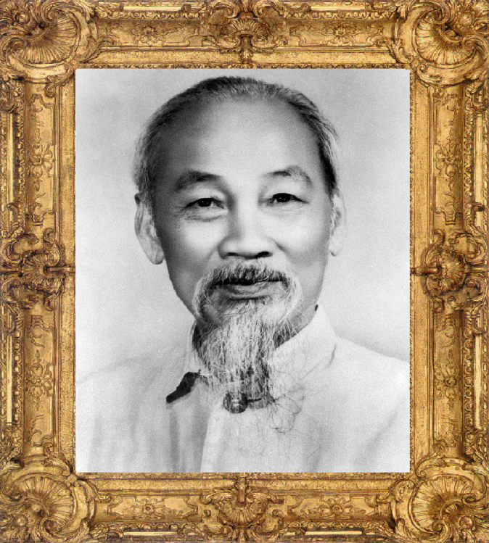
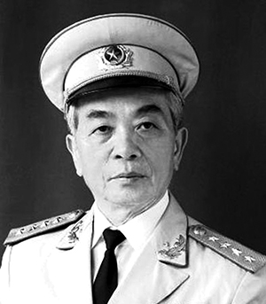
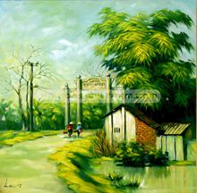
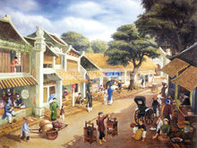
* What is the difference between a portrait and a painting?

Slide 21
A portrait : A painting , drawing or photograph of a person, especially of the head and shoulders.

Slide 22
A painting : A picture that has been made using paint.

Slide 23
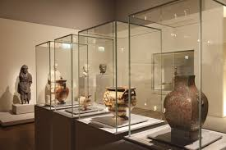
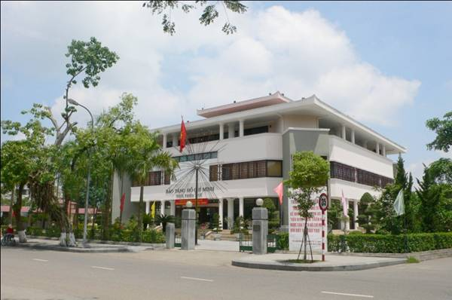
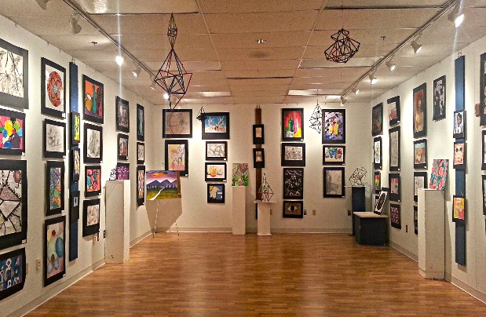
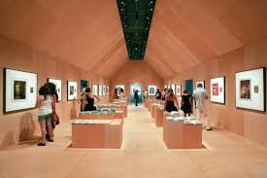
* What is the difference between a museum and an art gallery ?

Slide 24
A museum : A building in which objects of artistic , cultural, historical or scientific interest are kept and shown to the public.
At museum, there is nothing for sale.

Slide 25

An art gallery : A building where paintings and other works of art are shown to the public for sale.

Slide 26

Learn by heart new words .
Redo all the exercises.
Prepare A CLOSER LOOK 1.

Slide 27



