Slide 1

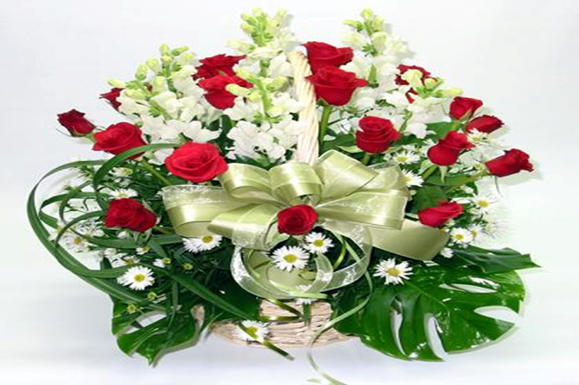

Welcome to our English class !

Slide 2
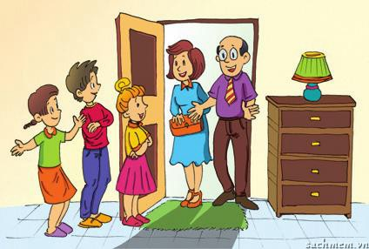
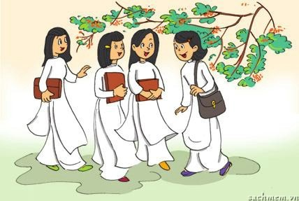
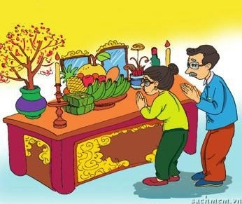
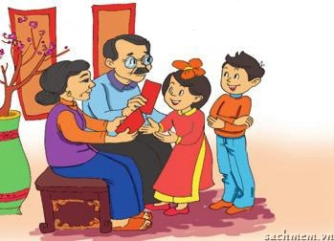
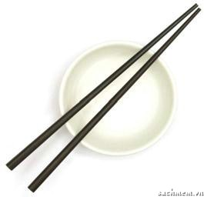
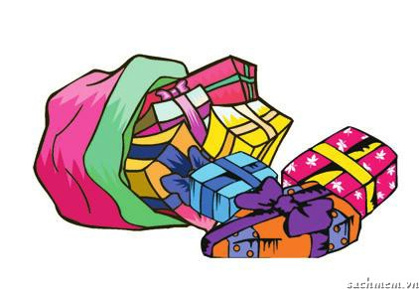
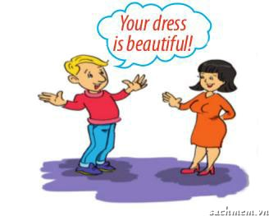
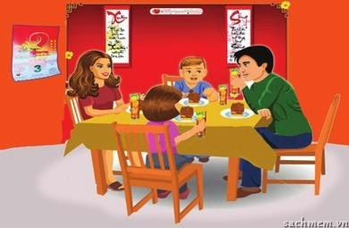
Warm-up: Match the pictures with the customs and traditions.
1. | smiling to accept a compliment
2. | worshipping ancestors
3. | wrapping gifts in colourful paper
4. | having lunch together on the second day of Tet
5. | placing the chopsticks on top of the rice bowl when finishing a meal
6. | children in the family standing in a row to greet guests
7. | wearing ao dai on special occasions
8. | giving children lucky money at Tet
a
b
c
d
e
f
g
h

Slide 3
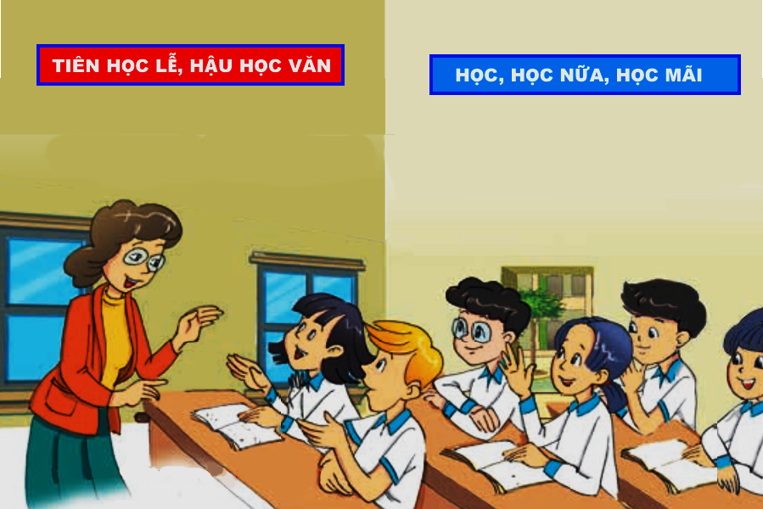
Period 27 - Unit 4 : Our customs and traditions
Lesson 1 : Getting started
A LESSON ON CUSTOMS AND TRADITIONS
Teacher
Phong
Nick
Mi
Mai

Slide 4
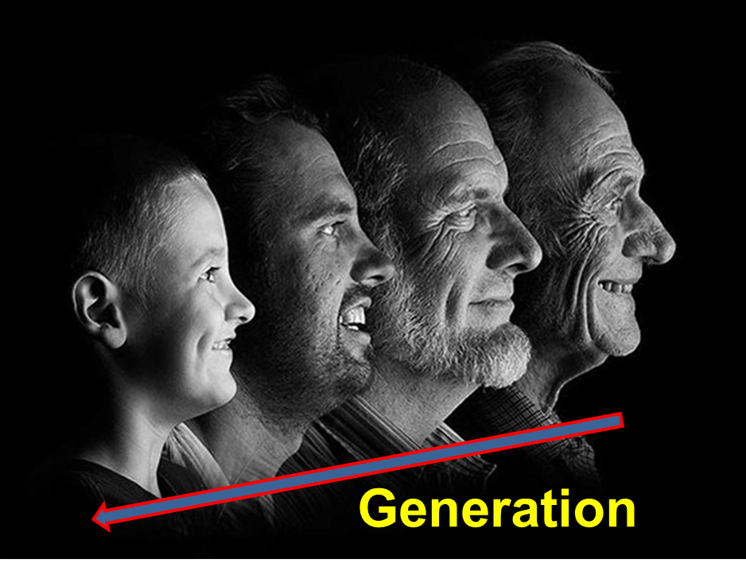

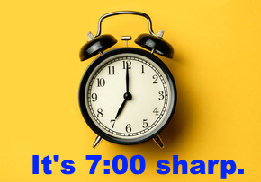
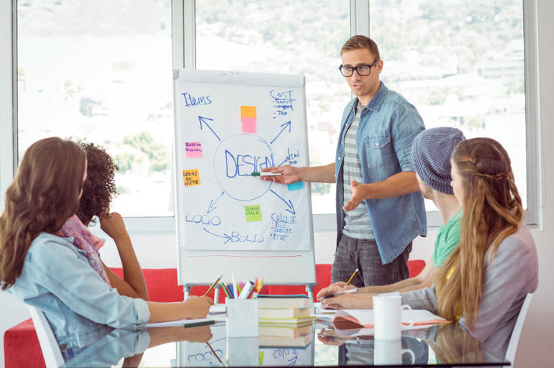
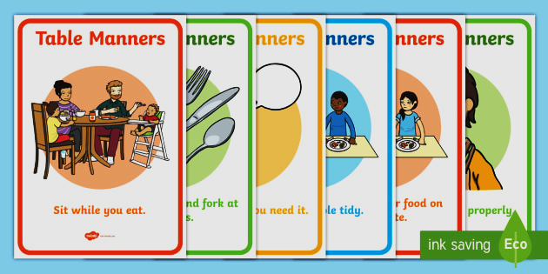
I.Vocabulary:
- accept / əkˈsept / (v)
- pass down /ˈpaːs daʊn / (v.phr)
- generation /ˌdʒenəˈreɪʃn / (n)
- spot on /spɒt ɔn / (adj)
- sharp / ʃɑːp / (adj)
- table manner /ˈteɪbl ˈmænə( r) / (n. phr)
- presentation /preznˈteɪʃn / (n)
: chấp nhận
: truyền lại
: thế hệ
: hoàn toàn đúng
: đúng, chính xác
: phép tắc ăn uống
: thuyết trình

Slide 5
*Checking vocabulary
accept / əkˈsept / (v)
pass down /ˈpaːs daʊn / (v.phr)
generation /ˌdʒenəˈreɪʃn / (n)
spot on /spɒt ɔn / (adj)
sharp / ʃɑːp / (adj)
- table manner /ˈteɪbl ˈmænə(r) / (n.phr)
presentation /preznˈteɪʃn / (n)
: công nhận
: truyền lại
: thế hệ
: hoàn toàn đúng
: đúng giờ, chính xác
: phép tắc ăn uống
: thuyết trình

Slide 6
II.LISTEN AND READ

Slide 7
II.LISTEN AND READ
1- b(page 39). Tick true (T) or false (F).
T F
1. Nick’s explanation of customs and
traditions is correct.
2. Only families have customs and
traditions.
3. In the UK there’s a tradition of having afternoon tea.
4. In the UK there is no accepted way of behaving at the dinner table.

Slide 8

A lesson on customs and traditions
Teacher: Today we’re going to learn about customs and traditions. Do you think they’re the same?
Mi: I think they’re different, but it’s hard to explain how.
Nick: In my opinion, a custom is something that has become an accepted way of doing things. And a tradition is something we do that is special and is passed down through the generations.
Teacher: Yes, spot on! Give me an example of a custom.
Mai: My family has this custom of eating dinner at 7 p.m. sharp.
Teacher: Really?
Mai: Yes, we have to be at the dinner table on time.
Teacher: That’s interesting! How about a tradition, Phong?
Phong: We have a family tradition of visiting the pagoda on the first day of every lunar month.
Nick: You’re kidding!
Phong: No, no. We’ve followed this tradition for generations.
Teacher: You’ve mentioned family, but what about social customs and traditions, Nick?
Nick: Well, in the UK there are lots of customs for table manners. For example, we have to use a knife and fork at dinner. Then, there’s a British tradition of having afternoon tea at 4 p.m.
Teacher: Sounds lovely! Now, for homework, you should find information about a custom or tradition. You’re doing mini presentations next week...

Slide 9
II.LISTEN AND READ
1- b(page 39). Tick true (T) or false (F).
T F
1. Nick’s explanation of customs and
traditions is correct.
✓
Nick: In my opinion, a custom is something that has become an accepted way of doing things. And a tradition is something we do that is special and is passed down through the generations.
Teacher: Yes, spot on! Give me an example of a custom.

Slide 10
II.LISTEN AND READ
1- b(page 39). Tick true (T) or false (F).
T F
2. Only families have customs and
traditions.
✓
There are also social ones
Phong: We have a family tradition of visiting the pagoda on the first day of every lunar month.
Nick: You’re kidding!
Phong: No, no. We’ve followed this tradition for generations.
Teacher: You’ve mentioned family, but what about social customs and traditions, Nick?
Nick: Well, in the UK there are lots of customs for table manners. For example, we have to use a knife and fork at dinner. Then, there’s a British tradition of having afternoon tea at 4 p.m.

Slide 11
II.LISTEN AND READ
1- b(page 39). Tick true (T) or false (F).
T F
3. In the UK there’s a tradition of having afternoon tea.
✓
Nick: Well, in the UK there are lots of customs for table manners. For example, we have to use a knife and fork at dinner. Then, there’s a British tradition of having afternoon tea at 4 p.m.

Slide 12
II.LISTEN AND READ
1- b(page 39). Tick true (T) or false (F).
T F
4. In the UK there is no accepted way of behaving at the dinner table.
✓
There are a lot of customs for table manners in the UK.
Nick: Well, in the UK there are lots of customs for table manners. For example, we have to use a knife and fork at dinner. Then, there’s a British tradition of having afternoon tea at 4 p.m.

Slide 13
II.LISTEN AND READ
1- b(page 39). Tick true (T) or false (F).
T F
1. Nick’s explanation of customs and
traditions is correct.
2. Only families have customs and
traditions.
3. In the UK there’s a tradition of having afternoon tea.
4. In the UK there is no accepted way of behaving at the dinner table.
✓
✓
There are also social ones
✓
There are a lot of customs for table manners in the UK.
✓

Slide 14
A lesson on customs and traditions
Teacher: Today we’re going to learn about customs and traditions. Do you think they’re the same?
Mi: I think they’re different, but it’s hard to explain how.
Nick: In my opinion, a custom is something that has become an accepted way of doing things. And a tradition is something we do that is special and is passed down through the generations.
Teacher: Yes, spot on! Give me an example of a custom.
Mai: My family has this custom of eating dinner at 7 p.m. sharp.
Teacher: Really?
Mai: Yes, we have to be at the dinner table on time.
Teacher: That’s interesting! How about a tradition, Phong?
Phong: We have a family tradition of visiting the pagoda on the first day of every lunar month.
Nick: You’re kidding!
Phong: No, no. We’ve followed this tradition for generations.
Teacher: You’ve mentioned family, but what about social customs and traditions, Nick?
Nick: Well, in the UK there are lots of customs for table manners. For example, we have to use a knife and fork at dinner. Then, there’s a British tradition of having afternoon tea at 4 p.m.
Teacher: Sounds lovely! Now, for homework, you should find information about a custom or tradition. You’re doing mini presentations next week...

Slide 15
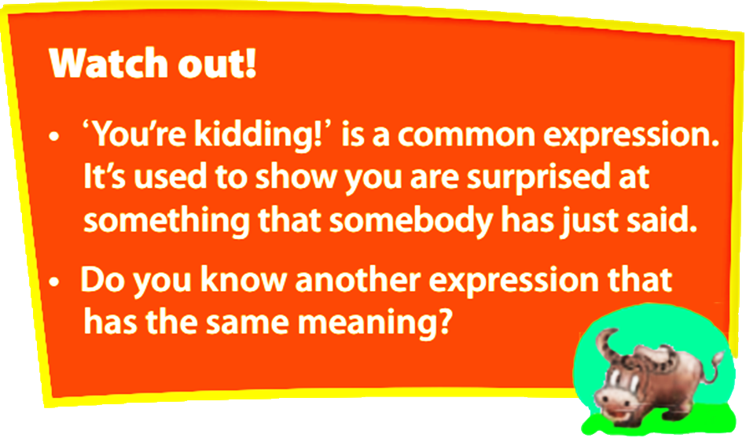
- You are joking!
- You must be joking!

Slide 16
A lesson on customs and traditions
Teacher: Today we’re going to learn about customs and traditions. Do you think they’re the same?
Mi: I think they’re different, but it’s hard to explain how.
Nick: In my opinion, a custom is something that has become an accepted way of doing things. And a tradition is something we do that is special and is passed down through the generations.
Teacher: Yes, spot on! Give me an example of a custom.
Mai: My family has this custom of eating dinner at 7 p.m. sharp.
Teacher: Really?
Mai: Yes, we have to be at the dinner table on time.
Teacher: That’s interesting! How about a tradition, Phong?
Phong: We have a family tradition of visiting the pagoda on the first day of every lunar month.
Nick: You’re kidding!
Phong: No, no. We’ve followed this tradition for generations.
Teacher: You’ve mentioned family, but what about social customs and traditions, Nick?
Nick: Well, in the UK there are lots of customs for table manners. For example, we have to use a knife and fork at dinner. Then, there’s a British tradition of having afternoon tea at 4 p.m.
Teacher: Sounds lovely! Now, for homework, you should find information about a custom or tradition. You’re doing mini presentations next week...
1. What is Mai’s family custom?
- It’s eating dinner at 7 p.m sharp.

Slide 17
A lesson on customs and traditions
Teacher: Today we’re going to learn about customs and traditions. Do you think they’re the same?
Mi: I think they’re different, but it’s hard to explain how.
Nick: In my opinion, a custom is something that has become an accepted way of doing things. And a tradition is something we do that is special and is passed down through the generations.
Teacher: Yes, spot on! Give me an example of a custom.
Mai: My family has this custom of eating dinner at 7 p.m. sharp.
Teacher: Really?
Mai: Yes, we have to be at the dinner table on time.
Teacher: That’s interesting! How about a tradition, Phong?
Phong: We have a family tradition of visiting the pagoda on the first day of every lunar month.
Nick: You’re kidding!
Phong: No, no. We’ve followed this tradition for generations.
Teacher: You’ve mentioned family, but what about social customs and traditions, Nick?
Nick: Well, in the UK there are lots of customs for table manners. For example, we have to use a knife and fork at dinner. Then, there’s a British tradition of having afternoon tea at 4 p.m.
Teacher: Sounds lovely! Now, for homework, you should find information about a custom or tradition. You’re doing mini presentations next week...
2. How does Nick feel when Phong talks about one of his family traditions?
- He’s surprised.

Slide 18
A lesson on customs and traditions
Teacher: Today we’re going to learn about customs and traditions. Do you think they’re the same?
Mi: I think they’re different, but it’s hard to explain how.
Nick: In my opinion, a custom is something that has become an accepted way of doing things. And a tradition is something we do that is special and is passed down through the generations.
Teacher: Yes, spot on! Give me an example of a custom.
Mai: My family has this custom of eating dinner at 7 p.m. sharp.
Teacher: Really?
Mai: Yes, we have to be at the dinner table on time.
Teacher: That’s interesting! How about a tradition, Phong?
Phong: We have a family tradition of visiting the pagoda on the first day of every lunar month.
Nick: You’re kidding!
Phong: No, no. We’ve followed this tradition for generations.
Teacher: You’ve mentioned family, but what about social customs and traditions, Nick?
Nick: Well, in the UK there are lots of customs for table manners. For example, we have to use a knife and fork at dinner. Then, there’s a British tradition of having afternoon tea at 4 p.m.
Teacher: Sounds lovely! Now, for homework, you should find information about a custom or tradition. You’re doing mini presentations next week...
3. What is the similarity between a custom and a tradition?
- They both refer to doing something that develops over time.

Slide 19
A lesson on customs and traditions
Teacher: Today we’re going to learn about customs and traditions. Do you think they’re the same?
Mi: I think they’re different, but it’s hard to explain how.
Nick: In my opinion, a custom is something that has become an accepted way of doing things. And a tradition is something we do that is special and is passed down through the generations.
Teacher: Yes, spot on! Give me an example of a custom.
Mai: My family has this custom of eating dinner at 7 p.m. sharp.
Teacher: Really?
Mai: Yes, we have to be at the dinner table on time.
Teacher: That’s interesting! How about a tradition, Phong?
Phong: We have a family tradition of visiting the pagoda on the first day of every lunar month.
Nick: You’re kidding!
Phong: No, no. We’ve followed this tradition for generations.
Teacher: You’ve mentioned family, but what about social customs and traditions, Nick?
Nick: Well, in the UK there are lots of customs for table manners. For example, we have to use a knife and fork at dinner. Then, there’s a British tradition of having afternoon tea at 4 p.m.
Teacher: Sounds lovely! Now, for homework, you should find information about a custom or tradition. You’re doing mini presentations next week...
4. What is the diﬀerence between them?
- A custom is something accepted. A tradition is something special and is passed down through the generations.

Slide 20
A lesson on customs and traditions
Teacher: Today we’re going to learn about customs and traditions. Do you think they’re the same?
Mi: I think they’re different, but it’s hard to explain how.
Nick: In my opinion, a custom is something that has become an accepted way of doing things. And a tradition is something we do that is special and is passed down through the generations.
Teacher: Yes, spot on! Give me an example of a custom.
Mai: My family has this custom of eating dinner at 7 p.m. sharp.
Teacher: Really?
Mai: Yes, we have to be at the dinner table on time.
Teacher: That’s interesting! How about a tradition, Phong?
Phong: We have a family tradition of visiting the pagoda on the first day of every lunar month.
Nick: You’re kidding!
Phong: No, no. We’ve followed this tradition for generations.
Teacher: You’ve mentioned family, but what about social customs and traditions, Nick?
Nick: Well, in the UK there are lots of customs for table manners. For example, we have to use a knife and fork at dinner. Then, there’s a British tradition of having afternoon tea at 4 p.m.
Teacher: Sounds lovely! Now, for homework, you should find information about a custom or tradition. You’re doing mini presentations next week...
5. What should the students do for homework?
- They should find information about a custom or tradition.

Slide 21
1-c.(page 39) Answer the following questions.
1. What is Mai’s family custom?
- It’s eating dinner at 7 p.m. sharp.
2. How does Nick feel when Phong talks about one of his family traditions?
- He’s surprised.
3. What is the similarity between a custom and a tradition?
-They both refer to doing something that develops over time.
4. What is the diﬀerence between them?
- A custom is something accepted. A tradition is something special and is passed down through the generations.
5. What should the students do for homework?
- They should find information about a custom or tradition.

Slide 22
2 a (page 39 ). Match the pictures with the customs and traditions.
1. | smiling to accept a compliment
2. | worshipping ancestors
3. | wrapping gifts in colourful paper
4. | having lunch together on the second day of Tet
5. | placing the chopsticks on top of the rice bowl when finishing a meal
6. | children in the family standing in a row to greet guests
7. | wearing ao dai on special occasions
8. | giving children lucky money at Tet
a
b
c
d
e
f
g
h

Slide 23
2-b (page 39). Write C (Custom) or T (Tradition) next to each activity. In pairs, compare your answers.
1. | smiling to accept a compliment
2. | worshipping ancestors
3. | wrapping gifts in colourful paper
4. | having lunch together on the second day of Tet
5. | placing the chopsticks on top of the rice bowl when finishing a meal
6. | children in the family standing in a row to greet guests
7. | wearing ao dai on special occasions
8. | giving children lucky money at Tet
C
C or T
C
T
C
C
T
C or T

Slide 24
III.Productions
1 a+d (page 39). Play game: RINGING THE GLODEN BELL

Slide 25



RINGING THE GOLDEN BELL
RINGING THE GOLDEN BELL
Question 1: Choose the best option A, B or C to answer
the below question.
agree means...............
A
accepted
13s
00
14s
12s
11s
10s
09s
08s
07s
06s
05s
04s
03s
02s
01s
15s
B
well
C
disagree
Start!
Finish!

Slide 26
RINGING THE GOLDEN BELL
RINGING THE GOLDEN BELL
Question 2: Choose the best option A, B or C to answer
the below question.
grandparents, parents, and children means......
A
family
13s
00
14s
12s
11s
10s
09s
08s
07s
06s
05s
04s
03s
02s
01s
15s
B
generations
C
ancester
Start!
Finish!

Slide 27
RINGING THE GOLDEN BELL
RINGING THE GOLDEN BELL
Question 3: Choose the best option A, B or C to answer
the below question.
totally correct means...............
A
no
13s
00
14s
12s
11s
10s
09s
08s
07s
06s
05s
04s
03s
02s
01s
15s
B
spot on
C
disagree
Start!
Finish!

Slide 28
RINGING THE GOLDEN BELL
RINGING THE GOLDEN BELL
Question 4: Choose the best option A, B or C to answer
the below question.
exactly on time means...............
A
half
13s
00
14s
12s
11s
10s
09s
08s
07s
06s
05s
04s
03s
02s
01s
15s
B
not true
C
sharp
Start!
Finish!

Slide 29
RINGING THE GOLDEN BELL
RINGING THE GOLDEN BELL
Question 5: Choose the best option A, B or C to answer
the below question.
relating to human society means...............
A
social
13s
00
14s
12s
11s
10s
09s
08s
07s
06s
05s
04s
03s
02s
01s
15s
B
building
C
house
Start!
Finish!

Slide 30
RINGING THE GOLDEN BELL
RINGING THE GOLDEN BELL
Question 6: Choose the best option A, B or C to answer
the below question.
a polite way of eating at the dinner table is ....
A
dinner
13s
00
14s
12s
11s
10s
09s
08s
07s
06s
05s
04s
03s
02s
01s
15s
B
cooking
C
table manners
Start!
Finish!

Slide 31
RINGING THE GOLDEN BELL
RINGING THE GOLDEN BELL
Question 7: Choose the best option A, B or C to complete
this sentence
We _____be at the dinner table on time.
A
have to
13s
00
14s
12s
11s
10s
09s
08s
07s
06s
05s
04s
03s
02s
01s
15s
B
has to
C
are
Have to => It’s an obligation – you have no choice
Start!
Finish!

Slide 32
RINGING THE GOLDEN BELL
RINGING THE GOLDEN BELL
Question 8: Choose the best option A, B or C to complete
this sentence
You _____find information about custom or tradition
A
has to
13s
00
14s
12s
11s
10s
09s
08s
07s
06s
05s
04s
03s
02s
01s
15s
B
should
C
does
Should => It’s a suggestion or advice – it would be best to follow it.
Start!
Finish!

Slide 33
GV: Can you remember What you have learnt today? Ss :

Slide 34
Period 27- Unit 4 : Our customs and traditions
Lesson 1 : Getting started
Consolidations
Types of customs and traditions Expressions with ‘customs and tradition’
Vocabulary
OUR CUSTOMS AND TRADITIONS
Have to => It’s an obligation – you have no choice Should => It’s a suggestion or advice – it would be best to follow it.
Grammar

Slide 35

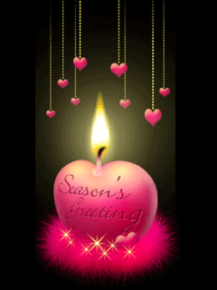
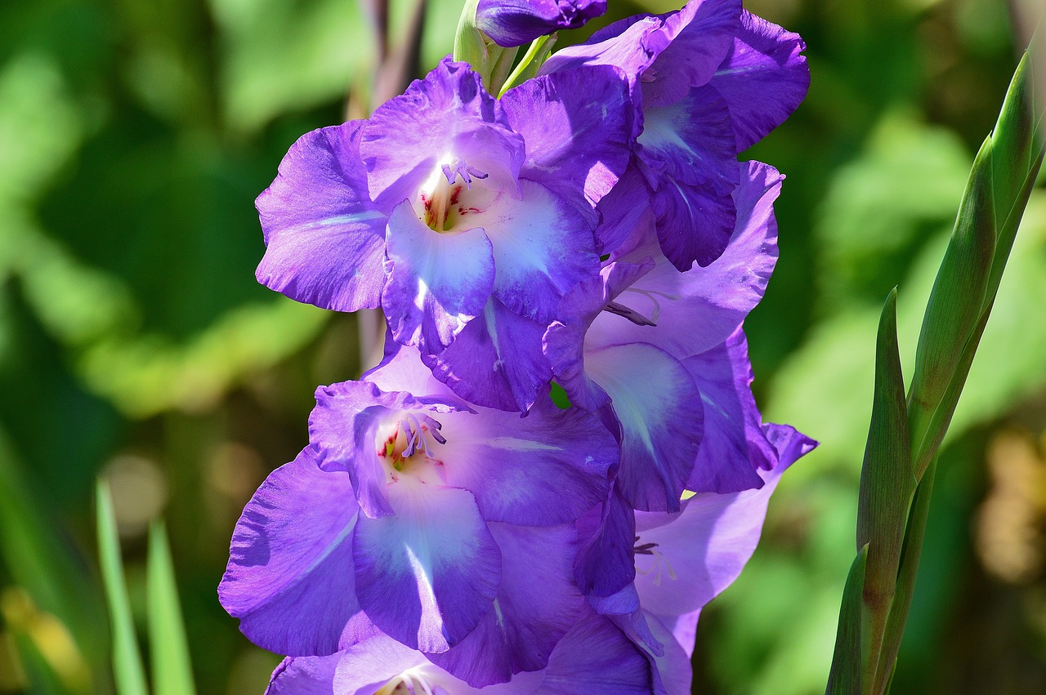
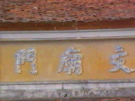
IV.HOMEWORK
- Learn the new words by heart.
- Practice the dialogue again.
- Do exercises:3.Game (p39)write down as many local customs and traditions as you can think of, and B1,2 in workbook (page 29).
Prepare Unit 4: A closer look 1.
pronunciation : Clusters:/spr/ and /str/
+

Slide 36
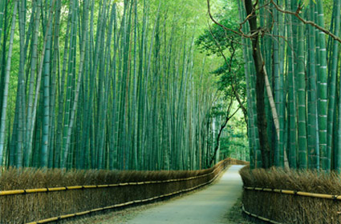
THANKS FOR YOUR ATTENTION!
Goodbye!
See you again!

Slide 37
2-a(page 39). Match the pictures with the customs and traditions.
1. | smiling to accept a compliment
2. | worshipping ancestors
3. | wrapping gifts in colourful paper
4. | having lunch together on the second day of Tet
5. | placing the chopsticks on top of the rice bowl when finishing a meal
6. | children in the family standing in a row to greet guests
7. | wearing ao dai on special occasions
8. | giving children lucky money at Tet
g
c
a
e
f
h
b
f
e
a
c
g
b
d
d
h

Slide 38

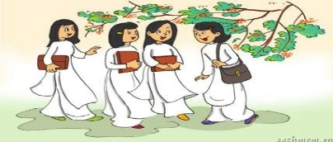

2 a (page 39 ). Match the pictures with the customs and traditions.
1. | smiling to accept a compliment
2. | worshipping ancestors
3. | wrapping gifts in colourful paper
4. | having lunch together on the second day of Tet
5. | placing the chopsticks on top of the rice bowl when finishing a meal
6. | children in the family standing in a row to greet guests
7. | wearing ao dai on special occasions
8. | giving children lucky money at Tet
a
b
c
d
e
f
g
h

Slide 39

Consolidations
Types of customs and traditions Expressions with ‘customs and tradition’
Vocabulary
OUR CUSTOMS AND TRADITIONS
Grammar
Have to => It’s an obligation – you have no choice Should => It’s a suggestion or advice – it would be best to follow it.

