Slide 1

Unit 6: Education
Lesson 2.3: Pronunciation & Speaking
Page 49

Slide 2



Lesson 2.3
LESSON OUTLINE
Consolidation

Slide 3
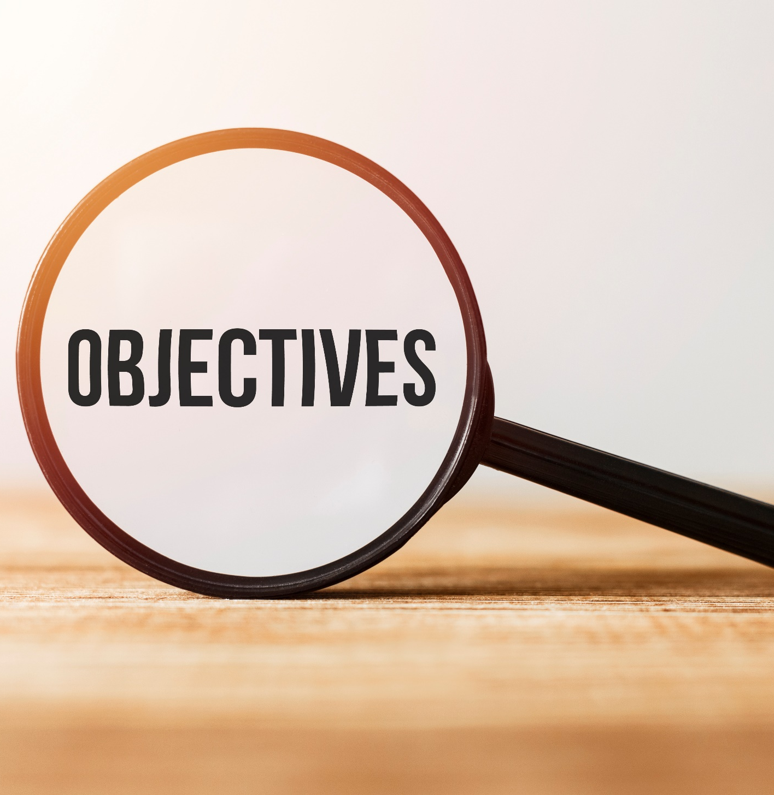
By the end of this lesson, students will be able to…
• To practice sentence stress.
• To talk about how you feel about school.

Slide 4
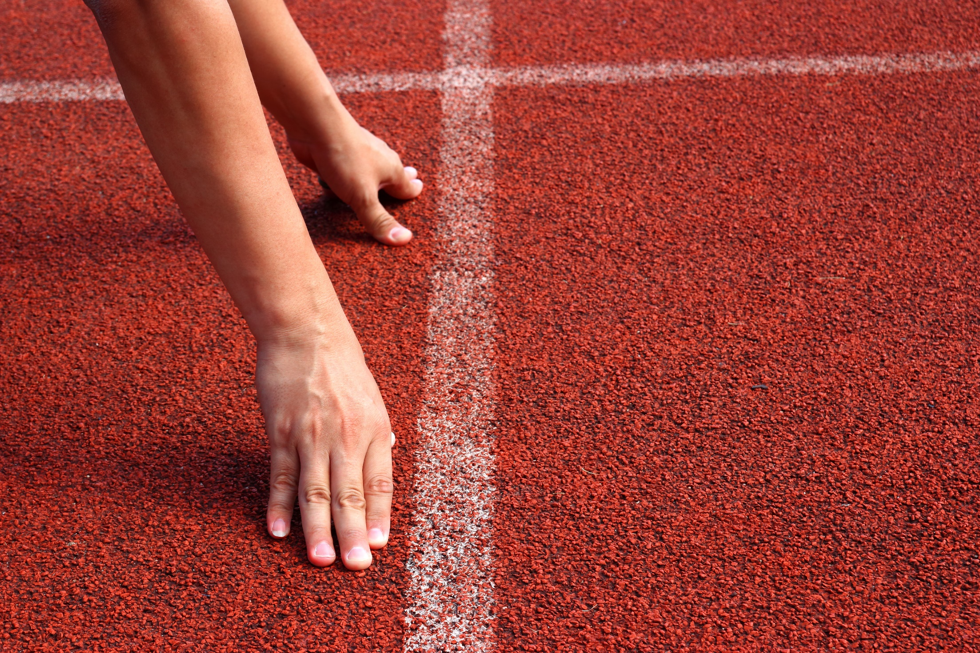
WARM UP

Slide 5

Work in pairs.
Choose the word whose underlined part is
pronounced differently from that of the other words.
A. have B. take C. stay D. play
2. A. fever B. market C. event D. setting
3. A. safety B. skating C. alley D. table
/hæv/
/teɪk/
/steɪ/
/pleɪ/
/ˈfi:vər/
/ˈmɑ:rkɪt/
/ɪˈvent/
/ˈsetɪŋ/
/ˈseɪfti/
/ˈskeɪtɪŋ/
/ˈæli/
/ˈteɪbəl/

Slide 6
Work in pairs.
Choose the word whose main stress is placed
differently from the others.
A. experience B. competition C. transportationD.presentation
2. A. bowling B. market C. project D. report
3. A. barbecue B. skateboarding C. lemonade D. tablespoon
/ɪkˈspɪriəns/
/ˌkɑmpəˈtɪʃn/
/ˌtrænspərˈteɪʃn/
/ˌprezənˈteɪʃn/
/ˈboʊlɪŋ/
/ˈmɑːr.kɪt/
/ˈprɑ:dʒekt/
/rɪˈpɔ:rt/
/ˈbɑ:rbɪkju:/
/ˈskeɪtbɔrdɪŋ/
/ˌleməˈneɪd/
/ˈteɪblspuːn/

Slide 7
Memory game: Ten seconds to remember the words with the same color before they disappear.
Work in pairs.
disappointed
lost English book
delighted
annoyed
passed biology test
surprised
bought me a bike
failed English test

Slide 8
Work in pairs.
Make sentences, using “because”
disappointed
lost English book
delighted
annoyed
passed biology test
surprised
bought me a bike
failed English test

Slide 9
Work in pairs.
Make sentences, using “because”
I was disappointed because I failed English test.
I was annoyed because I lost English book.
I was delighted because I passed biology test.
I was surprised because my mother bought me a bike.

Slide 10



Slide 11
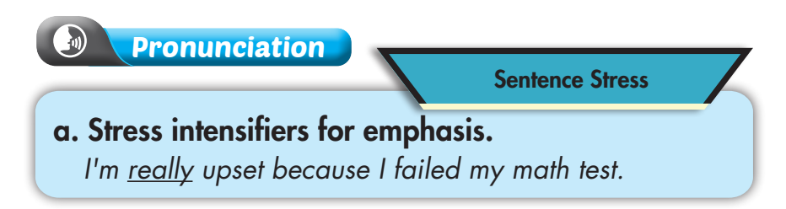
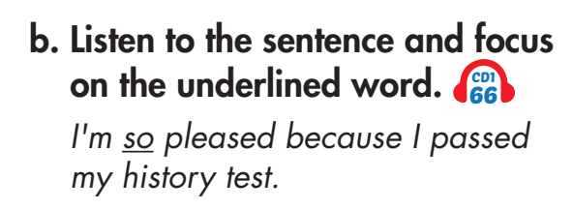

Listen again and repeat.

Slide 12
Complete the rule:
Listen and complete the rule.
so
really
Put stress on “……….” or “…..………” for emphasis
Click on the sentence to listen.
I'm so pleased because I passed my history test.
2. She's really happy because she got 90% on her English test.

Slide 13
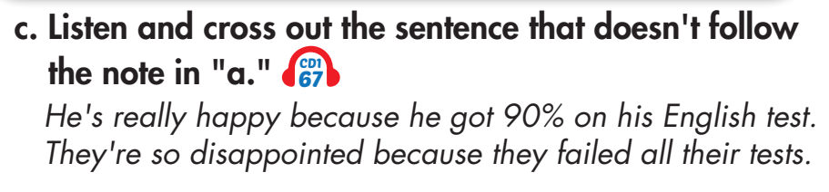
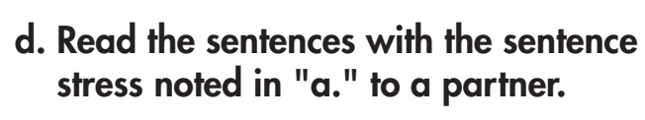
Listen again and repeat

Slide 14
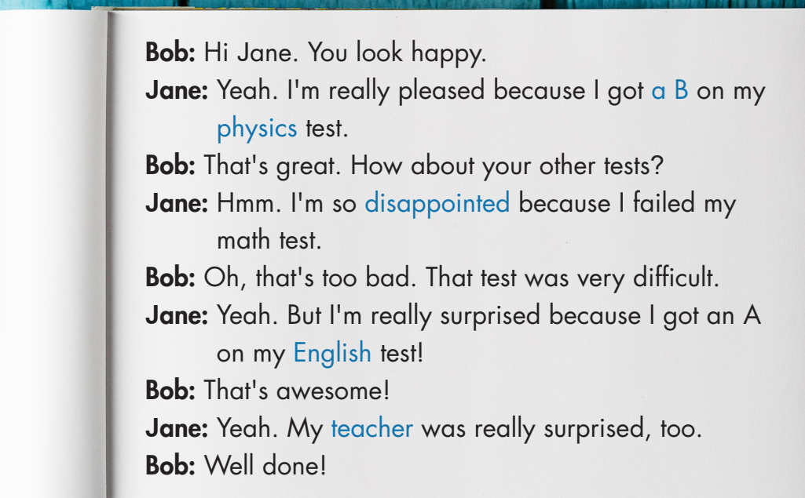
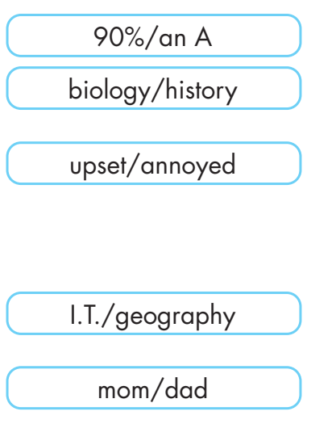

Slide 15
Bob: Hi Jane. You look happy.
Jane: Yeah. I'm really pleased because I got _____ on my ________ test.
Bob: That's great. How about your other tests?
Jane: Hmm. I'm so _______ because I failed my math test.
Bob: Oh, that's too bad. That test was very difficult.
Jane: Yeah. But I'm really surprised because I got an A on my _______ test!
Bob: That's awesome!
Jane: Yeah. My _______ was really surprised, too.
Bob: Well done!
90%
biology
upset
I.T.
mom

Slide 16
Bob: Hi Jane. You look happy.
Jane: Yeah. I'm really pleased because I got ______ on my _________ test.
Bob: That's great. How about your other tests?
Jane: Hmm. I'm so __________ because I failed my math test.
Bob: Oh, that's too bad. That test was very difficult.
Jane: Yeah. But I'm really surprised because I got an A on my ___________ test!
Bob: That's awesome!
Jane: Yeah. My _______ was really surprised, too.
Bob: Well done!
dad
history
annoyed
geography
dad

Slide 17
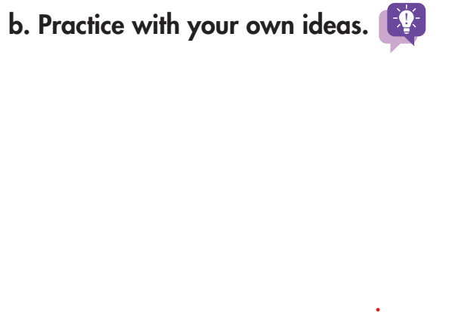
Bob: Hi Jane. You look happy.
Jane: Yeah. I'm really pleased because I got ______ on my _________ test.
Bob: That's great. How about your other tests?
Jane: Hmm. I'm so __________because I failed my math test.
Bob: Oh, that's too bad. That test was very difficult.
Jane: Yeah. But I'm really surprised because I got an A on my _________ test!
Bob: That's awesome!
Jane: Yeah. My ___________ was really surprised, too.
Bob: Well done!

Slide 18

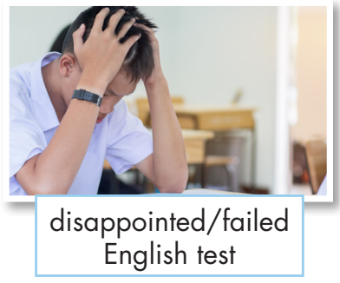
a. You're at school and want to know why your friend feels good or bad. In pairs: Take turns acting out the situations in the pictures while your partner guesses how you feel and why.

Slide 19
You: Hi ______. You look upset.
Your friend: Yeah. I'm really disappointed because I failed English test.

Slide 20
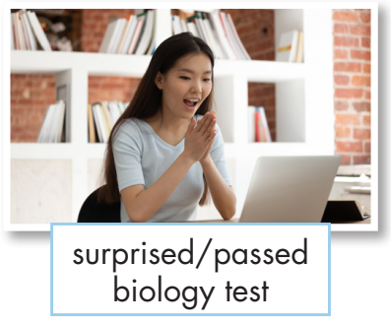
a. You're at school and want to know why your friend feels good or bad. In pairs: Take turns acting out the situations in the pictures while your partner guesses how you feel and why.

Slide 21
You: Hi ______. You look happy.
Your friend: Yeah. I'm really surprised because I passed biology test.

Slide 22
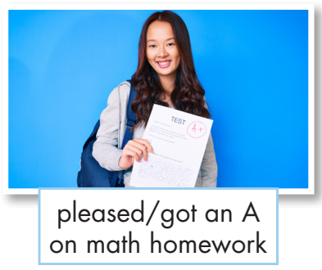
a. You're at school and want to know why your friend feels good or bad. In pairs: Take turns acting out the situations in the pictures while your partner guesses how you feel and why.

Slide 23
You: Hi ______. You look happy.
Your friend: Yeah. I'm really pleased because I got an A on math homework.

Slide 24
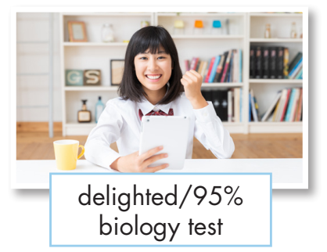
a. You're at school and want to know why your friend feels good or bad. In pairs: Take turns acting out the situations in the pictures while your partner guesses how you feel and why.

Slide 25
You: Hi ______. You look happy.
Your friend: Yeah. I'm really delighted because I got 90% biology test.

Slide 26
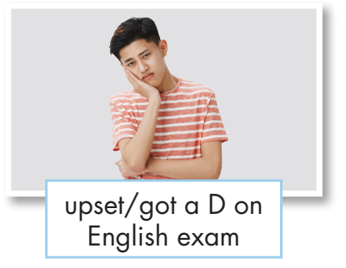
a. You're at school and want to know why your friend feels good or bad. In pairs: Take turns acting out the situations in the pictures while your partner guesses how you feel and why.

Slide 27
You: Hi ______. You look unhappy.
Your friend: Yeah. I'm really upset because I got a D on English exam.

Slide 28
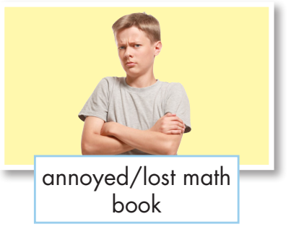
a. You're at school and want to know why your friend feels good or bad. In pairs: Take turns acting out the situations in the pictures while your partner guesses how you feel and why.

Slide 29
You: Hi ______. You look upset.
Your friend: Yeah. I'm really annoyed because I lost math book.

Slide 30
b. Now, join another pair and play again using your own ideas

Slide 31

CONSOLIDATION

Slide 32
Write about how your friends feel about school, using the words and information you asked in speaking task a. (about 50-70 words)

Slide 33
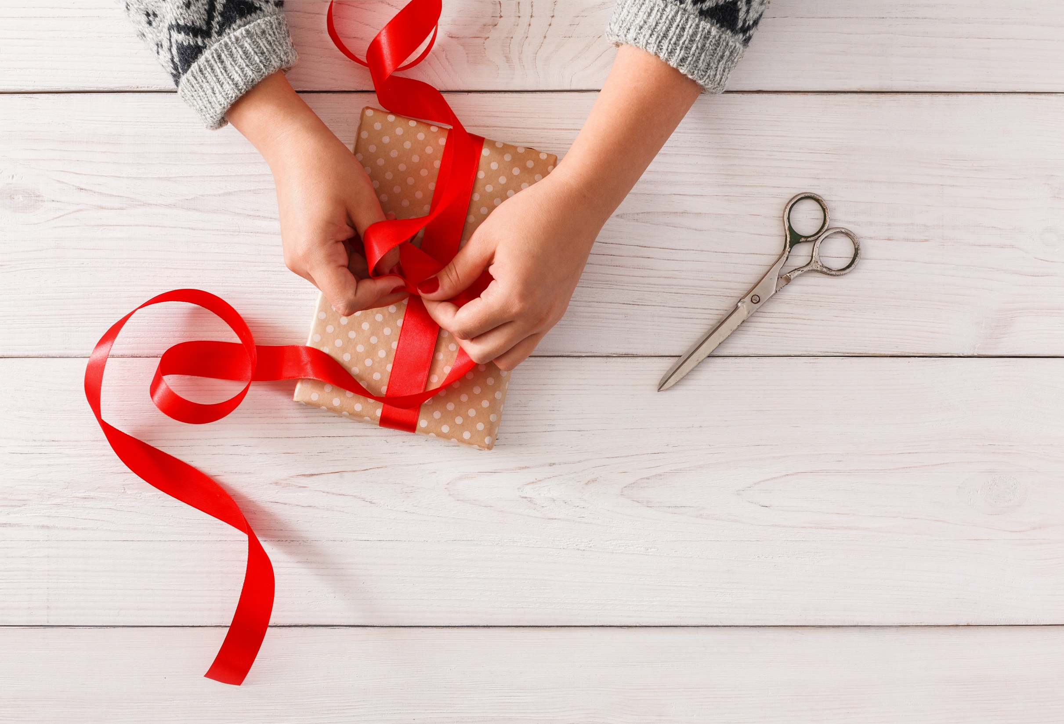
WRAP-UP

Slide 34
Today’s lesson
Pronunciation:
- Practice sentence stress
Speaking & Writing:
- talk and write about how you and your friend feel about school

Slide 35
Homework
Practice sentence stress.
Practice talking about how you feel about school.
Prepare the next lesson (page 50 SB).
Play the consolidation games in Tiếng Anh 10 i-Learn Smart World DHA App on www.eduhome.com.vn

Slide 36

Lesson 3
Stay positive and have a nice day!

