Slide 1

ENGLISH:8
THÁI HÒA SECONDARY SCHOOL

Slide 2
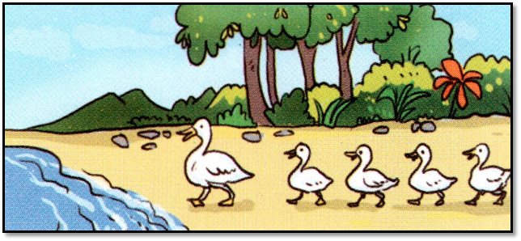
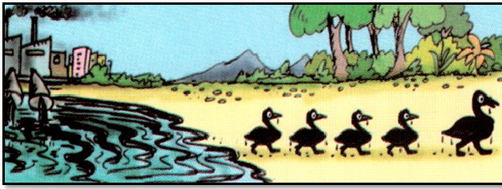
PICTURE A | PICTURE B
The ducks are white. | The ducks are black.
They’re going to the lake. | They’re going far from the lake.
There aren’t any factories near the lake. | There are some factories near the lake.
The lake water is clean. | The lake water is dirty.

Slide 3
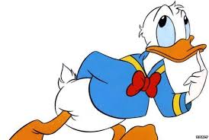
What does the picture tell you?
Water pollution

Slide 4

Unit 7: POLLUTION
Period 59: Skills 1

Slide 5
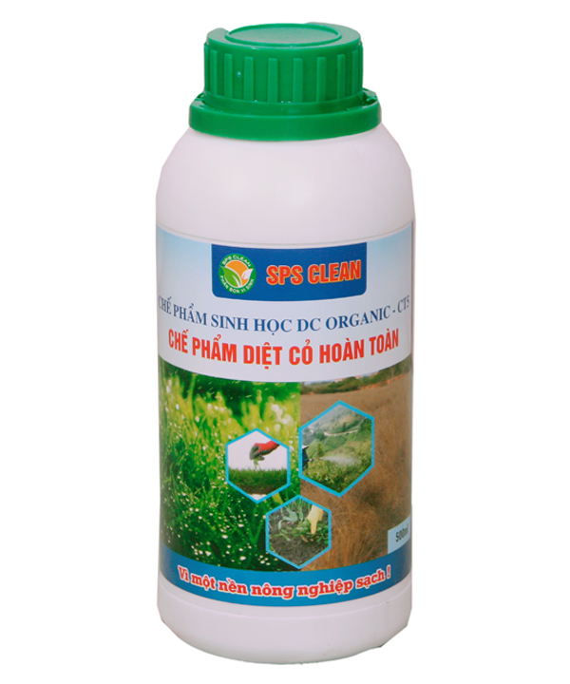
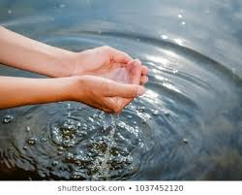

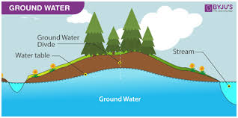
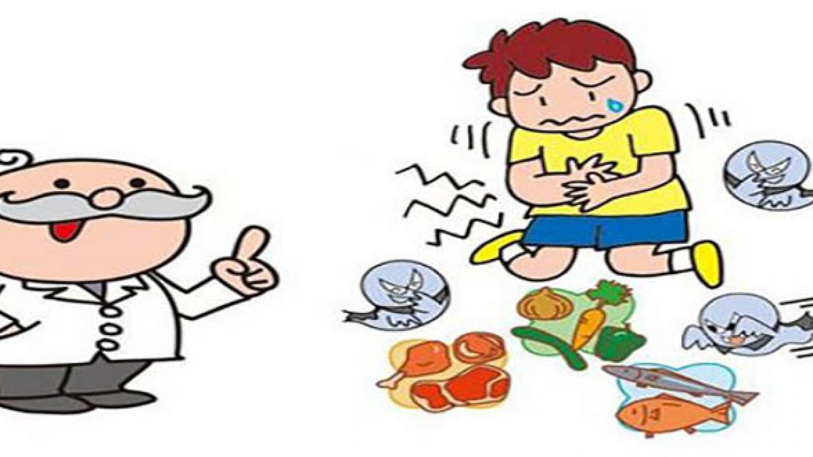

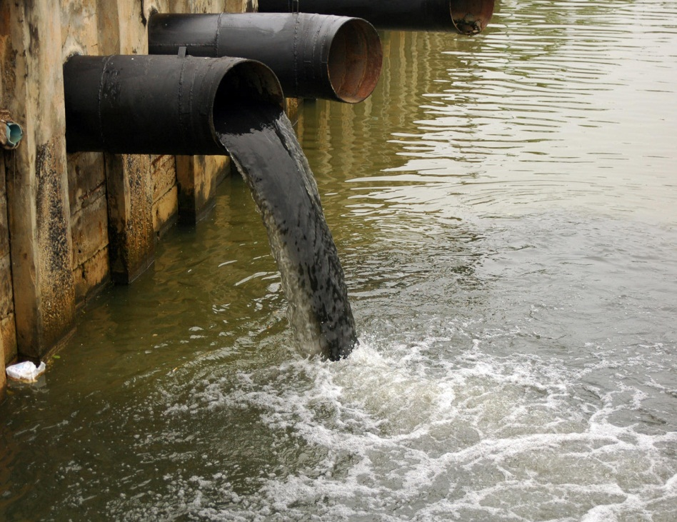
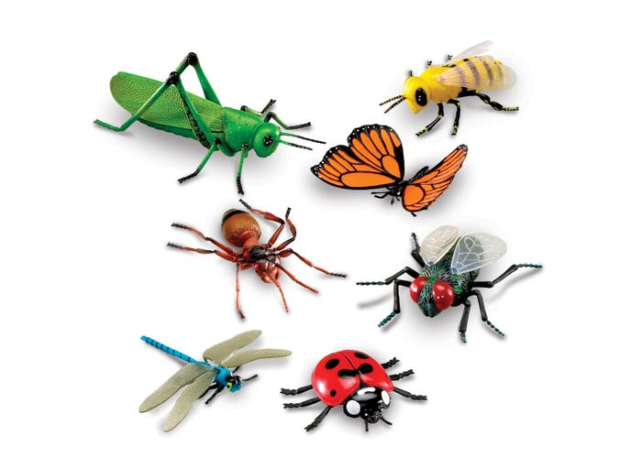
Vocabulary:
- contamination (n) /kənˌtæmɪˈneɪʃn/:
sự làm bẩn
- groundwater (n)/ˈɡraʊndwɔːtə(r)/:
nước ngầm
- pesticide (n)/ˈpestɪsaɪd/:
thuốc trừ sâu
- herbicide (n)/ˈhɜːbɪsaɪd/:
thuốc diệt cỏ
- insect (n)/ˈɪnsekt/:
côn trùng
- cholera (n)/ˈkɒlərə/:
dịch tả
- untreated water (n)/ˌʌnˈtriːtɪd/ /ˈwɔːtər/:
nước chưa qua xử lí
- sewage (n)/ˈsuːɪdʒ/:
nước thải

Slide 6
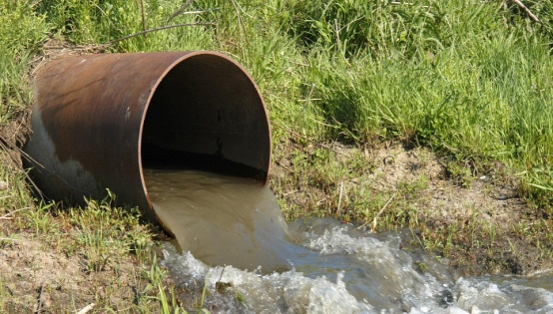
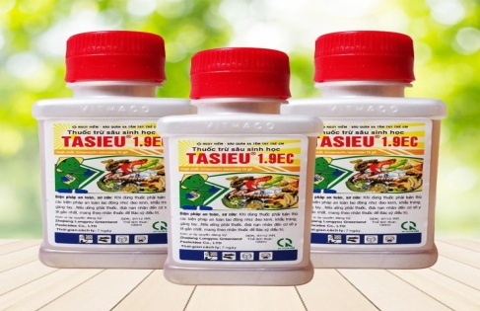
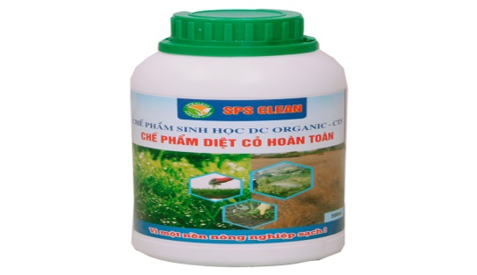

CHECK VOCABULARY: MATCHING
sewage
cholera
pesticides
insects
herbicides
groundwater
untreated water
1.
2.
3.
4.
5.
6.
7.

Slide 7
1. Guess True or False for each sentence below.
1. Groundwater is the water above the Earth's surface.
2. Industrial waste, sewage, pesticides and herbicides are factors cause 'point source pollution.
3. The outbreaks of cholera, the death of aquatic animals and plants are the effects of water pollution.
4. Polluted water only makes aquatic animals die.

Slide 8
Read the text and check your prediction
Water pollution is the contamination of bodies of water such as lakes, rivers, oceans and groundwater (the water beneath the Earth’s surface). It is one of the most serious types of pollution.
Water pollution can have many different causes. Factories dump industrial waste into lakes and rivers. Sewage from households is another cause. Farms using pesticides to kill insects and herbicides to kill weeds can also lead to water pollution. These factors cause ‘point source’ pollution while pollutants from storm water and the atmosphere result in ‘non-point source’ pollution.
Water pollution can have dramatic effects. In many poor nations, there are frequent outbreaks of cholera and other diseases because of people drinking untreated water. Humans can even die if they drink contaminated water. Polluted water also causes the death of aquatic animals such as fish, crabs, or birds. Other animals eat these dead animals and may also get sick. In addition, herbicides in water can kill aquatic plants and cause further damage to the environment.
So what should we do to reduce water pollution?

Slide 9
Activity 2: Read the text and answer True or False, then correct the false sentences.
1. Groundwater is the water above the Earth's surface.
F
beneath
2. Industrial waste, sewage, pesticides and herbicides are factors cause 'point source pollution.
T
3. The outbreaks of cholera, the death of aquatic animals and plants are the effects of water pollution.
T
F
4. Polluted water only make aquatic animals die.
not only

Slide 10
3. Reading the text again and then answer the questions.
1. What is the first paragraph about?
2. What is the second paragraph about?
3. What is the third paragraph about?
4. What is ground water?
5. What are the point source pollutants?
6. What are the non-point source pollutants?
7. Why do people use herbicides?

Slide 11
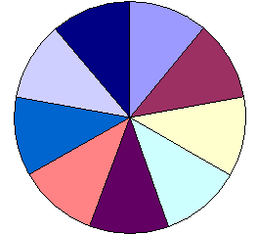
3. What is the first paragraph about?
5. Why do people use herbicides?
2. What are the non-point source pollutants?
1. What is ground water?
4. What are the point source pollutants?
Water pollution is the contamination of bodies of water such as lakes, rivers, oceans and groundwater (the water beneath the Earth’s surface). It is one of the most serious types of pollution.
→ The water beneath the Earth’s surface.
→The definition of water pollution.
→ Pollutants from storm water and the atmosphere.
→ Waste, sewage, pesticides, and herbicides.
→ to kill weeds..
50
10
30
70
Magic
Wheel
gift
20
Team Scores
40
share
60
JERRY
TOM
Points

Slide 12
4. Correct the answers.
1. What is the first paragraph about?
Water pollution is the contamination of bodies of water such as lakes, rivers, oceans and groundwater (the water beneath the Earth’s surface). It is one of the most serious types of pollution.
The definition of water pollution

Slide 13
2. What is the second paragraph about?
Water pollution can have many different causes. Factories dump industrial waste into lakes and rivers. Sewage from households is another cause. Farms using pesticides to kill insects and herbicides to kill weeds can also lead to water pollution. These factors cause ‘point source’ pollution while pollutants from storm water and the atmosphere result in ‘non-point source’ pollution.
Causes of water pollution

Slide 14
Water pollution can have dramatic effects. In many poor nations, there are frequent outbreaks of cholera and other diseases because of people drinking untreated water. Humans can even die if they drink contaminated water. Polluted water also causes the death of aquatic animals such as fishes, crabs, or birds. Other animals eat these dead animals and may also get sick. In addition, herbicides in water can kill aquatic plants and cause further damage to the environment.
So what should we do to reduce water pollution?
Water pollution can have dramatic effects. In many poor nations, there are frequent outbreaks of cholera and other diseases because of people drinking untreated water. Humans can even die if they drink contaminated water. Polluted water also causes the death of aquatic animals such as fishes, crabs, or birds. Other animals eat these dead animals and may also get sick. In addition, herbicides in water can kill aquatic plants and cause further damage to the environment.
So what should we do to reduce water pollution?
3. What is the third paragraph about?
Effects of water pollution

Slide 15
4. What is ground water?
Water pollution is the contamination of bodies of water such as lakes, rivers, oceans and groundwater (the water beneath the Earth’s surface). It is one of the most serious types of pollution.
The water beneath the Earth’s surface

Slide 16
Water pollution can have many different causes. Factories dump industrial waste into lakes and rivers. Sewage from households is another cause. Farms using pesticides to kill insects and herbicides to kill weeds can also lead to water pollution. These factors cause ‘point source’ pollution while pollutants from storm water and the atmosphere result in ‘non-point source’ pollution.
Water pollution can have many different causes. Factories dump industrial waste into lakes and rivers. Sewage from households is another cause. Farms using pesticides to kill insects and herbicides to kill weeds can also lead to water pollution. These factors cause ‘point source’ pollution while pollutants from storm water and the atmosphere result in ‘non-point source’ pollution.
5. What are the point source pollutants?
waste, sewage, pesticides, and herbicides.

Slide 17
6. What are the non-point source pollutants?
Water pollution can have many different causes. Factories dump industrial waste into lakes and rivers. Sewage from households is another cause. Farms using pesticides to kill insects and herbicides to kill weeds can also lead to water pollution. These factors cause ‘point source’ pollution while pollutants from storm water and the atmosphere result in ‘non-point source’ pollution.
Water pollution can have many different causes. Factories dump industrial waste into lakes and rivers. Sewage from households is another cause. Farms using pesticides to kill insects and herbicides to kill weeds can also lead to water pollution. These factors cause ‘point source’ pollution while pollutants from storm water and the atmosphere result in ‘non-point source’ pollution.
pollutants from storm water and the atmosphere

Slide 18
7. Why do people use herbicides?
Water pollution can have many different causes. Factories dump industrial waste into lakes and rivers. Sewage from households is another cause. Farms using pesticides to kill insects and herbicides to kill weeds can also lead to water pollution. These factors cause ‘point source’ pollution while pollutants from storm water and the atmosphere result in ‘non-point source’ pollution.
to kill weeds.

Slide 19
5. Read the text again and fill each blank with no more than three words.
Water pollution can have dramatic effects. In many poor nations, there are frequent outbreaks of cholera and other diseases because of people drinking untreated water. Humans can even die if they drink contaminated water. Polluted water also causes the death of aquatic animals such as fishes, crabs, or birds. Other animals eat these dead animals and may also get sick. In addition, herbicides in water can kill aquatic plants and cause further damage to the environment.
So what should we do to reduce water pollution?
1. If the drinking water is untreated, an outbreak of_____________may happen
cholera
2. People drinking contaminated water
may ______________.
die
3. Fish, crabs or birds may also die because of ______________
polluted water
4. Other animals may become ill if they eat the ____________animals
dead
5. Herbicides kill both weeds and_____________.
aquatic plants

Slide 20
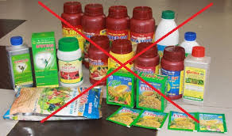
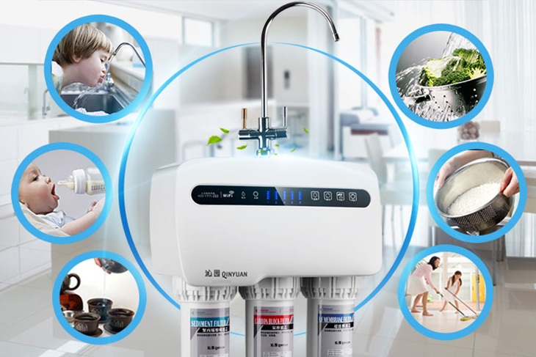
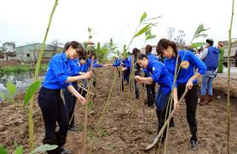
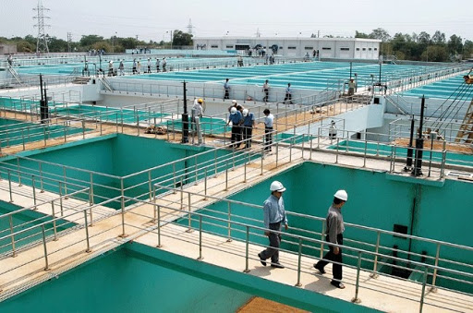
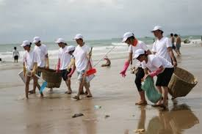
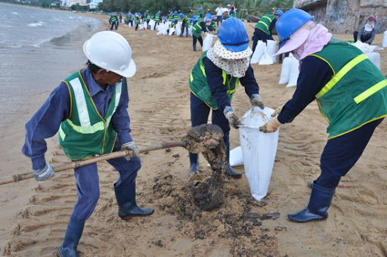
6. Work in groups and discuss the solution to water pollution.
Reduce to use herbicides and pesticides in agriculture
Use purifier
Plant more trees
Treat water before pumping out of the nature
Collect trash along the beach
Collect oil spills

Slide 21





HOMEWORK
- Write and learn by heart vocabulary.
- Write a paragraph (70-80 words) about the causes and effects of water pollution.

Slide 22


