Slide 1
NHIỆT LIỆT CHÀO MỪNG
CÁC THẦY CÔ TỚI DỰ
TIẾT HỌC CHUYÊN ĐỀ

Slide 2
WORD PUZZLE
10
4
3
2
1
0
BOYS
1
T
E
N
N
I
S
T
10
4
3
2
1
0
M
U
C
H
2
H
GIRLS
P
L
A
Y
3
A
W
I
T
H
4
I
S
K
I
L
L
F
U
L
5
L
P
A
R
T
A
6
R
E
A
D
I
N
G
N
7
S
P
E
N
D
D
8
Children shouldn’t …………too much time on video games
Ba is a ……….tennis player. He plays skillfully.
You shouldn’t ……….video game for a long time.
Children should take …………in outdoor activities.
Hoa doesn’t like the city very …………
Nam likes playing ………tennis in his free time.
Hoa lives in Hanoi ………her aunt and uncle.
He prefers watching TV to …………..books.

Slide 3
Friday, April 20th 2012
Unit 16: People and Places
Lesson 1: A1 + A2

Slide 4

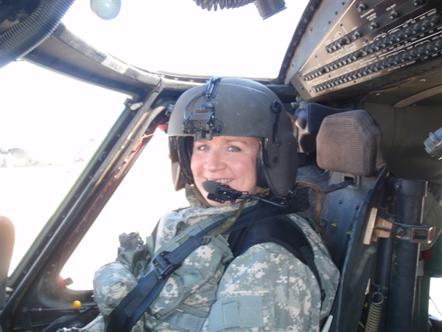
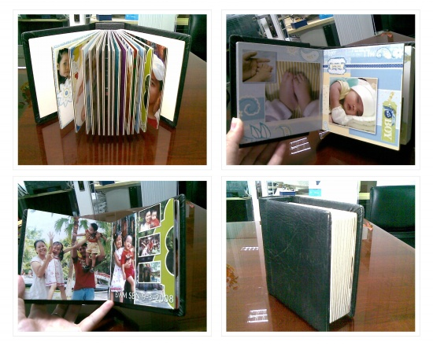

Friday, April 20th 2012
Unit 16: People and Places
Lesson 1: A1 + A2
1. New words
- pilot (n)
phi công
- fly (v)
bay
- region (n)
vùng, miền
- album (n)
an bom ảnh
- occasionally (adv)
thỉnh thoảng
- postcard (n)
bưu thiếp

Slide 5
Friday, April 20th 2012
Unit 16: People and Places
Lesson 1: A1 + A2
1. New words
MATCHING
1
bay
2
an bom ảnh
3
bưu thiếp
4
phi công
5
vùng, miền
6
thỉnh thoảng

Slide 6
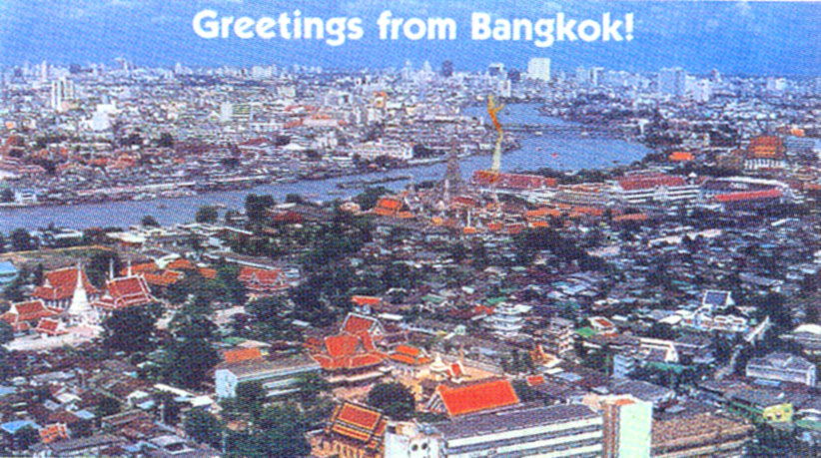
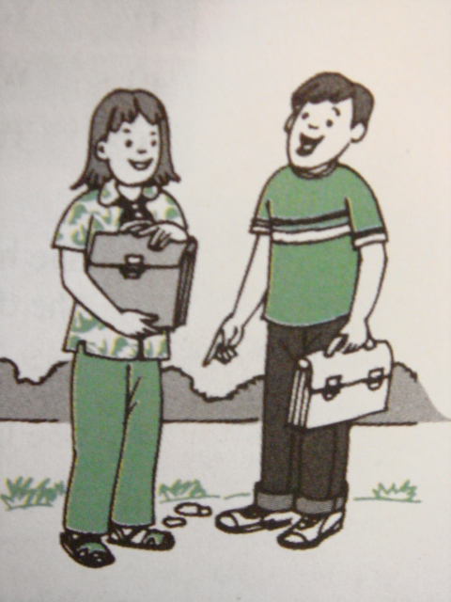

Friday, April 20th 2012
Unit 16: People and Places
Lesson 1: A1 + A2
1. New words
2. Listen and practice: A1
Hoa
Ba

Slide 7
Friday, April 20th 2012
Unit 16: People and Places
Lesson 1: A1 + A2
1. New words
2. Listen and practice: A1
TRUE / FALSE PREDICTION
N_{o} | True or False? | I guess | I read
1 | Ba’s uncle is a pilot
2 | He sent Ba a postcard from Thailand
3 | Ba’s uncle only flies to Bangkok
4 | Ba keeps the stamps in a box.
5 | Hoa doesn’t want to see the stamps.

Slide 8
Friday, April 20th 2012
Unit 16: People and Places
Lesson 1: A1 + A2
1. New words
2. Listen and practice: A1
MATCH THE HALF-SENTENCES
a) Ba’s uncle is
A see the stamps.
b) Uncle Nghia sends postcards
B as well as the stamps.
c) Ba keeps the postcards
C in a special book.
d) Ba puts the stamps
D a pilot
e) Hoa wants to
E many different places
f) Ba and Hoa would like to visit
F to Ba from the cities he visits
a -
b -
c -
d -
e -
f -

Slide 9
Friday, April 20th 2012
Unit 16: People and Places
Lesson 1: A1 + A2
1. New words
BOYS
2. Listen and practice: A1
3. Complete the table: A2
GIRLS
PELMANISM
CAPITAL
COUNTRY
Beijing
1
Vientiane
5
Laos
Cambodia
A
E
Yanggon
2
6
Jakarta
F
Myanmar
Thailand
B
Bangkok
3
Phnom Penh
7
Indonesia
C
G
China
Kuala Lumpur
4
Malaysia
D

Slide 10
Friday, April 20th 2012
Unit 16: People and Places
Lesson 1: A1 + A2
1. New words
2. Listen and practice: A1
3. Complete the table: A2
Bangkok
Thailand
Vientiane
Laos
Beijing
China
Yanggon
Myanmar
Kuala Lumpur
Malaysia
Jakarta
Indonesia
Phnom Penh
Cambodia

Slide 11
PRACTICE
Bangkok
Thailand
Vientiane
Laos
Beijing
China
Yanggon
Myanmar
Kuala Lumpur
Malaysia
Jakarta
Indonesia
Phnom Penh
Cambodia
Example:
S1: Where does Ba’s uncle fly to?
S2: He usually flies to Bangkok.
S1: Where is that?
S2: It’s in Thailand.

Slide 12
Friday, April 20th 2012
Unit 16: People and Places
Lesson 1: A1 + A2
1. New words
2. Listen and practice: A1
3. Complete the table: A2
4. Homework
- Learn by heart the new words.
- Practice reading the dialogue.
- Exercise A1, 2 in the workbook.
- Prepare the next lesson: A3, 4
Goodbye

