Slide 1



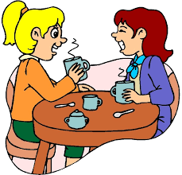
Unit
4
MUSIC AND ARTS
LESSON 4: COMMUNICATION
Unit
HOBBIES

Slide 2
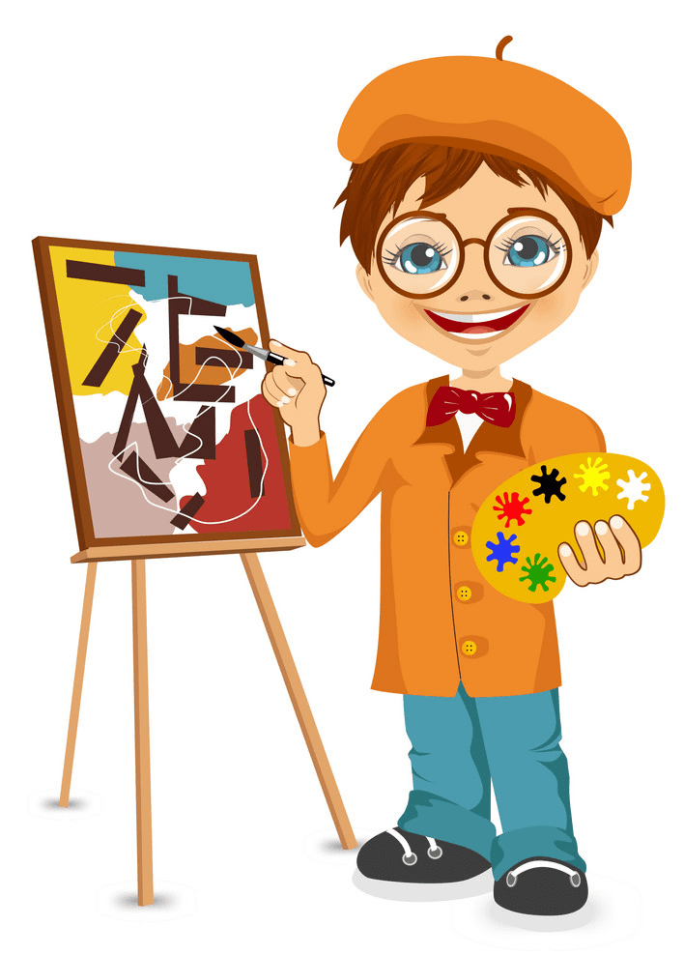

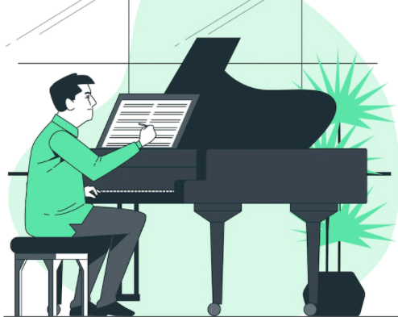
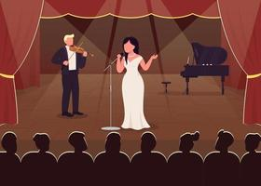
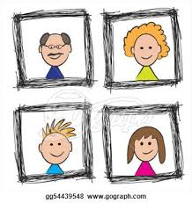
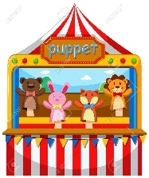


WARM-UP
concert hall
art gallery
actress
portrait
puppet theatre
composer
landscape
painter

Slide 3


EVERYDAY ENGLISH
1
Listen and read the conversations. Pay attention to the highlighted sentences.
Nick: Which do you prefer, pop or folk music?
Nam: I prefer folk music. It has a better beat.
Nick: And which do you like better, modern art or folk art?
Nam: I like modern art better.

Slide 4
EVERYDAY ENGLISH
- Prefer sth
- Like sth better
I prefer folk music.
I like modern art better.

Slide 5
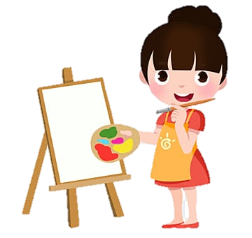



EVERYDAY ENGLISH
2
Work in pairs. Make similar conversations.
painting and taking photos
singing and dancing
A: Which do you prefer, singing or dancing?
B: I prefer singing.
A: And which do you like better, jazz or pop?
B: I like pop. It has a better beat.

Slide 6
MUSIC AND ARTS IN SCHOOL
3
Choose the correct answer to each question.
Who is the composer of Viet Nam’s national anther “Tien Quan Ca”?
Pham Tuyen B. Van Cao C. An Thuyen
2. Where in Viet Nam did water puppetry originate?
In the North B. In the central region C. In the South
3. What is Bac Ninh famous for?
Quan Ho singing B. Vi Dam singing C. Cai Luong opera
4. Mozart is one of the world’s greatest ______ .
A. singers B. composers C. poets

Slide 7
MUSIC AND ARTS IN SCHOOL
4
Read and underline the words related to the topic of arts and music.
Hi. My name is Susie. I’m from Australia. I’m in grade 7. My school teaches arts and music to all the students. Some forms of art such as painting, or drama are optional: you can choose to learn them if you like. Music and dancing are compulsory: all of us must study them every week. The school even has a choir, and they perform every month. There are also different art clubs, and you can join any of them.

Slide 8
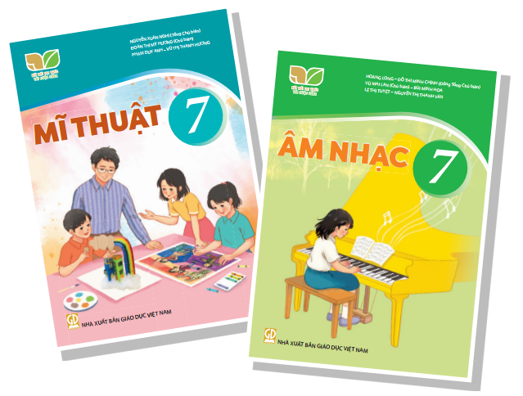
FUTHER PRACTICE
5
Work in groups. Talk about how you learn music and arts. Compare Susie’s school with your school.
Hi. My name is Linh. I'm from Vietnam. I'm in grade 7. In daily life, music plays an important role in improving the human spirit. Arts and music are compulsory like Susie’s school. We must have to study every Wednesday. On Monday. each class has to perform one or more songs in the school meeting. My school is different from Susie’s school. My school doesn’t have a choir. But we also have many arts and music clubs.

Slide 9

CONSOLIDATION
1
WRAP-UP
In this lesson, we have:
learnt how to expressing preferences
practiced using some grammar points and vocabulary related to the topic

Slide 10

CONSOLIDATION
2
HOMEWORK
Do exercises in the workbook.

