Slide 1

WELCOME TO OUR CLASS

Slide 2

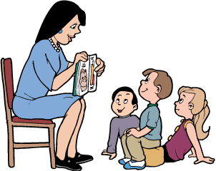
Period 28th- UNIT 4:
Lesson 2: A CLOSER LOOK 1
ENGLISH 9
UNIT 4

Slide 3
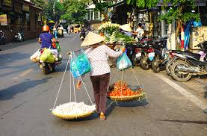
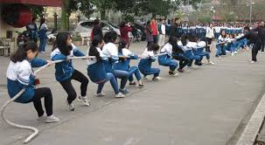
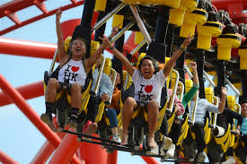
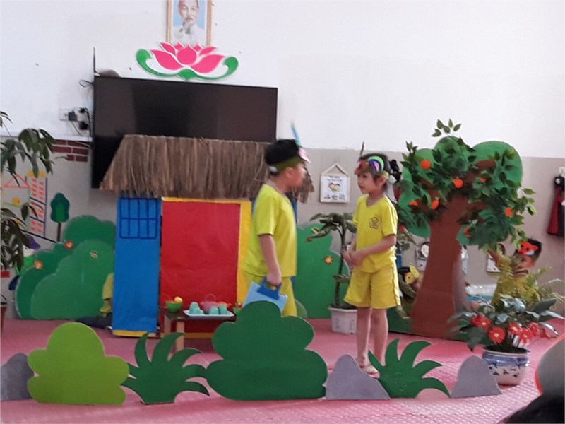
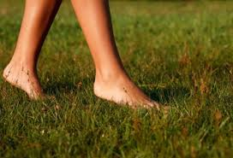
I. Vocabulary

Slide 4
I. Vocabulary
entertain / ,entə'tein / (v): - giải trí
act out ( v) : - diễn
bare-footed / beə ˈfʊtɪd / (adj) : - đi chân đất
street vendor / 'vendɔ / (n) : - người / quán bán rong
tug of war / tʌg əv wɔ: / : - trò kéo co
Illiterate /ɪˈlɪtərət/ :- mù chữ
seniority /ˌsiːniˈɒrəti/ :- người lớn tuổi, thế hệ trước
keep a diary / 'daiəri / : - viết nhật ký
Pay respect to + N : - tôn trọng
bold / bould / : - trơ tráo, liều lĩnh

Slide 5
1. Match a verb in A with a word/phrase in B.
A | B
1. go | a. to drum music
2. collect | b. themselves
3. entertain | c. stories
4. dance | d. a diary
5. act out | e. your imagination
6. use | f. bare-footed
7. preserve | g. the post
8. keep | h. our traditions
Key:
1 | 2 | 3 | 4 | 5 | 6 | 7 | 8
f
g
b
a
c
e
h
d

Slide 6
2. Use the newly-formed phrases in with the verbs in their correct forms to complete the sentences.
1. In my time, most girls ____________ where they could
write down their daily thoughts and feelings.
2. 'Grandpa, how did the children in your village use to ________________ ?' - 'They played games like tug of war, hide and seek, or flew their kites.'
3. We should work together to ____________________ . They are of great value to us.
4. __________________ and draw a picture of your dream house.
5. Children are very creative. They are good at _____________ .
6. A postman comes once a day to ______________ from the
post box.
7. I love ___________ on the beach and feeling the sand
under my feet.
8. The Lion Dance is usually performed at Mid-Autumn Festival, where the dancers skilfully _____________.
kept a diary
entertain themselves
preserve our traditions
Use your imagination
acting out stories
collect the post
going bare-footed
dance to drum music

Slide 7
3. Choose a word/phrase from the box to complete the sentences.
illiterate
face to face
physical
strict rules
street vendors
seniority
1. Paying respect to people of ____________is a tradition in Viet Nam.
2. Quite a large number of ethnic people in the mountains are still ____________. They can't read or write.
3. Eating from ______________is a popular habit of people in
big cities in Viet Nam.
4. There should be _____________ on the roads to reduce
the number of accidents.
5. _____________ punishment was common at schools in
the past.
6. I prefer talking ____________ to talking on the phone.
seniority
illiterate
street vendors
strict rules
Physical
face to face

Slide 8
4. Complete the sentences with the right form of the words below.
tradition
habit
behaviour
practice
1. It's never easy to break a bad ____________.
2. His bold ____________shocked everybody present.
3. It runs as a ____________ in Viet Nam that elderly
grandparents and parents are taken care of by their children until they die.
4. It was his ____________ to take a nap after lunch.
5. Using blackboards and chalk as the only teaching
aid is still a common ____________in most developing
countries.
6. He could be fired for his rude ____________ towards the VIP guest.

Slide 9
Remember!
tradition: an inherited way of thinking or acting
habit: what you frequently do
behaviour: the way in which one acts, especially towards others
practice: the actual application or use of an idea, belief,or method

Slide 10
4. Complete the sentences with the right form of the words below.
tradition
habit
behaviour
practice
habit
1. It's never easy to break a bad ____________.
2. His bold ____________shocked everybody present.
3. It runs as a ____________ in Viet Nam that elderly
grandparents and parents are taken care of by their children until they die.
4. It was his ____________ to take a nap after lunch.
5. Using blackboards and chalk as the only teaching
aid is still a common ____________in most developing
countries.
6. He could be fired for his rude ____________ towards the VIP guest.
behaviour
tradition
habit
practice
behaviour

Slide 11


PRONUNCIATION
Stress on auxiliary verbs in sentences
Remember!
An auxiliary verb combines with another verb to help form the tense, mood, voice of the main verb. They are: be, have, do, can, shall, will, may, must, need, used (to).
5 Listen and underline the auxiliary verbs which are stressed. Then practise saying the sentences.
1. Life will be improved in those remote areas.
2. They can see the rain coming in from the west.
3. You did make me laugh!
4. He hasn't handed in his assignment.
5. I don't like the idea of going there at night.
6. Sam doesn't like fast food but I do.

Slide 12
Remember!
An auxiliary verb is not usually stressed.
Example: We’ll start from here.
Does he like it?
However, an auxiliary will often be stressed when:
it is emphasised.
Example: I have done my homework.
we add it to emphasise the main verb.
Example: I did see him at the party.
it comes at the end of the sentence.
Example: I can’t attend the meeting, but John can.
it is negative.
Example: He isn’t coming.
Remember!
An auxiliary verb is not usually stressed.
Example: We’ll start from here.
Does he like it?
However, an auxiliary will often be stressed when:
it is emphasised.
Example: I have done my homework.
we add it to emphasise the main verb.
Example: I did see him at the party.
it comes at the end of the sentence.
Example: I can’t attend the meeting, but John can.
it is negative.
Example: He isn’t coming.

Slide 13
6. Underline an auxiliary if it is stressed. Then listen, check, and repeat the sentences.
1. - The men in my village used to catch fish with a spear.
- Could you do that?
- No, I couldn't.
2. I have told you many times not to leave the door open.
3. We' re going to visit Howick, a historical village.
4. - You aren't going to the party? Is it because you can't
dance?
- I can dance. Look!
5. - I hope she doesn't do any damage to the car.
- Don't worry. She does know how to drive.

Slide 14
6. Underline an auxiliary if it is stressed. Then listen, check, and repeat the sentences.
1. - The men in my village used to catch fish with a spear.
- Could you do that?
- No, I couldn't.
2. I have told you many times not to leave the door open.
3. We' re going to visit Howick, a historical village.
4. - You aren't going to the party? Is it because you can't
dance?
- I can dance. Look!
5. - I hope she doesn't do any damage to the car.
- Don't worry. She does know how to drive.

Slide 15
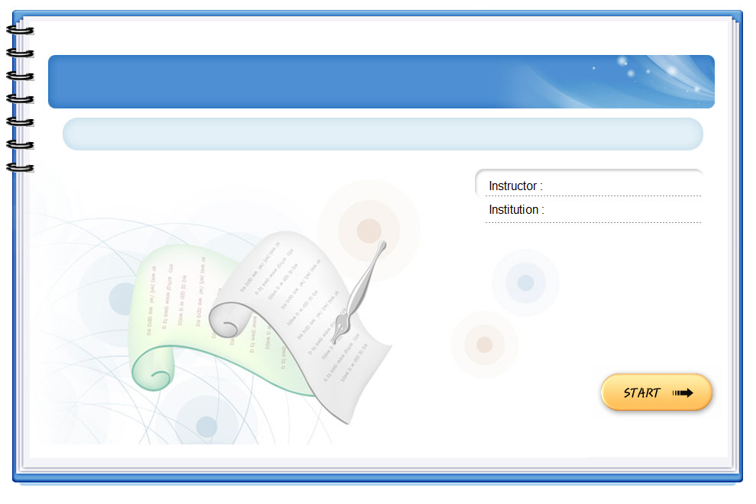
Homework
Learn new words by heart.
- Prepare “Lesson 3: A closer look 2”

