Slide 1



WELCOME TO OUR CLASS

Slide 2

WELCOME TO OUR CLASS
ENGLISH 6

Slide 3
WARM UP
market
bank
hospital
places
zoo
hotel
school
cinema
museum
park
stadium

Slide 4


UNIT 4: MY NEIGHBOURHOOD
Lesson 2:
Vocabulary

Slide 5
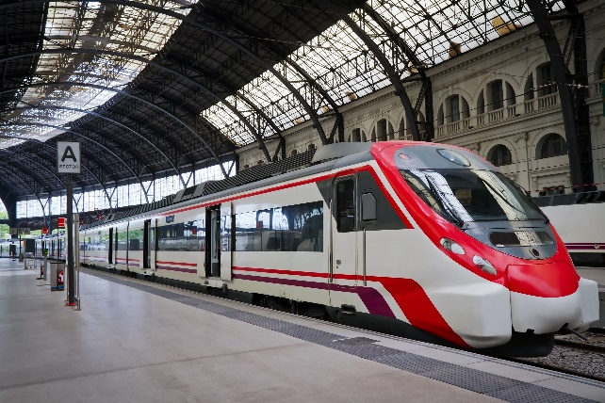
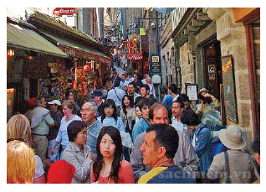
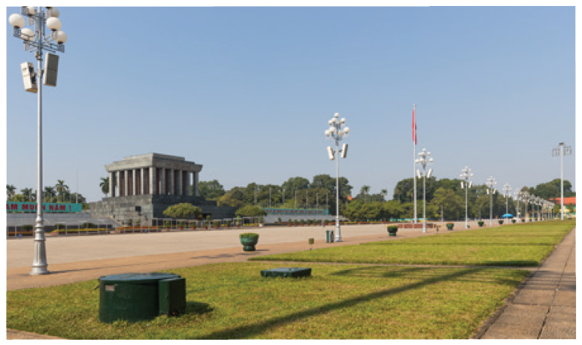
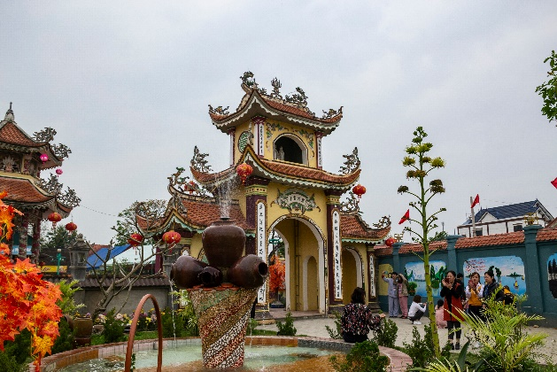
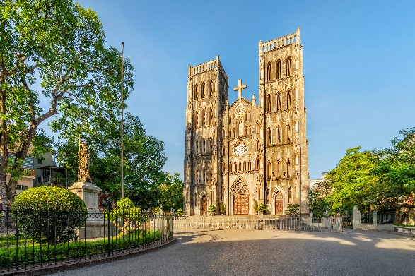
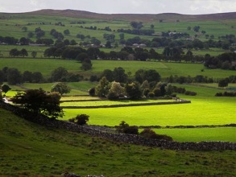
* Vocabulary
d
a
- square (n):
quảng trường
- cathedral (n):
thánh đường
- railway station (n):
nhà ga xe lửa
- temple (n):
ngôi đền
- crowded (adj):
đông đúc
- peaceful (adj
= quiet: yên tĩnh
- modern (adj) #
historic: hiện đại# cổ kính
- interesting(adj) #
boring: thú vị, hay # buồn tẻ

Slide 6
* Checking vocabulary
- square (n):
nhà ga xe lửa
- cathedral (n):
đông đúc
- railway station (n):
quảng trường
- temple (n):
historic
- crowded (adj):
thánh đường
- peaceful (adj
= quiet
- modern (adj) #
ngôi đền
- interesting(adj) #
boring

Slide 7


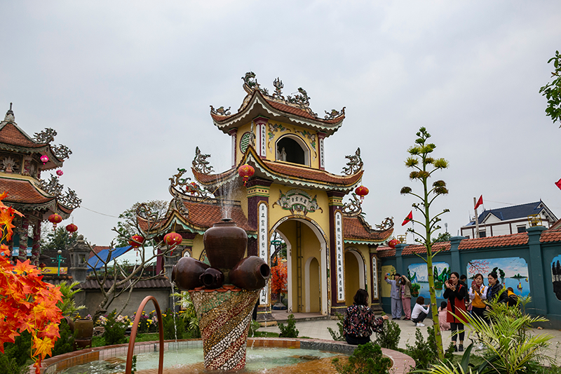
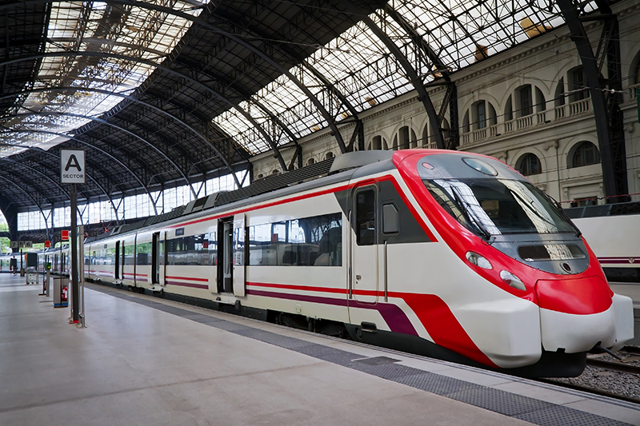
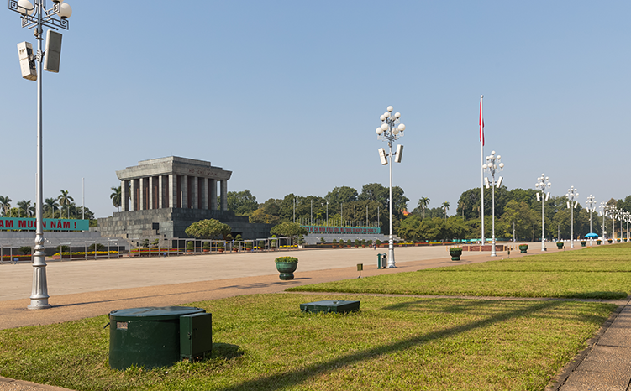
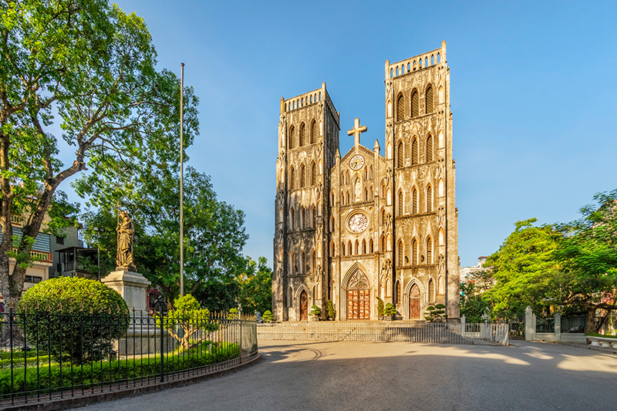
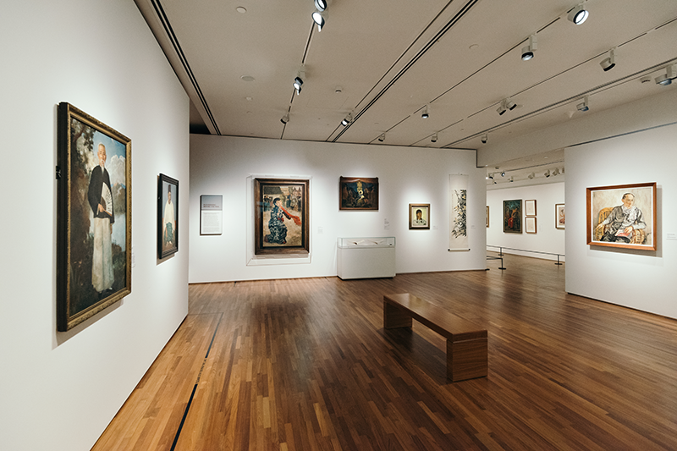
Ex 1. Match places below with the pictures. Then listen, check and repeat the words.
a
b
1. square
Name some other places in your neighbouthood
2. art gallery
3. cathedral
4. temple
4. temple
/ˈtempəl/
5. railway station
/reɪl /ˈsteɪʃən/
5. railway station
c
d
e
1. square
/skweə/
3. cathedral
/kəˈθiːdrəl/
2. art gallery
/ɑːt ˈɡæləri/
Notes:
Here they are, now look and match the words/ phrases with the pictures
Send your answers to me privately
Great, listen, repeat and check:
Number 1: Thanh Xuân
Number 2: Vĩnh phúc

Slide 8


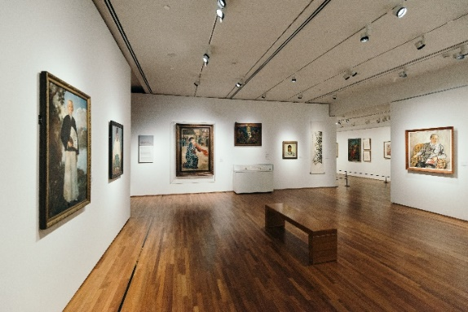
Match the places below with the pictures. Then listen, check and repeat the words.
b
b
a
1. square
2. art gallery
a
3. catherdral
4. temple
4. temple
4. temple
5. railway station
5. railway station
5. railway station
c
e
d
1. square
3. catherdral
2. art gallery

Slide 9
Name some other places in your neighbourhood.
bank
market
hospital
school
hotel
park

Slide 10

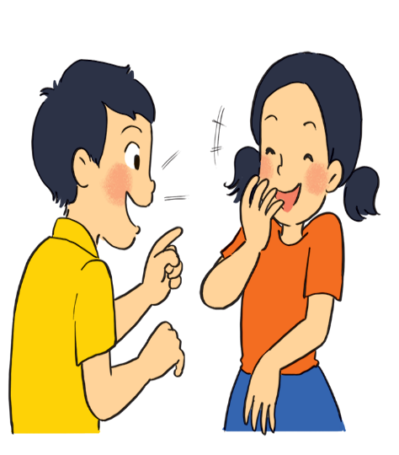
Work in pairs. Ask and answer questions about where you live.
Example:
A: Is there a square in your neighbourhood?
B: Yes, there is. / No, there isn’t.

Slide 11

Work in groups. Ask and answer about your neighbourhood. You can use the adjectives below.
noisy:ồn ào
busy: bận rộn
modern:hiện đại
peaceful
quiet
crowded
boring: buồn tẻ
beautiful
Example:
A: Is your neighbourhood quiet?
B: Yes, it is. / No, it’s noisy.

Slide 12
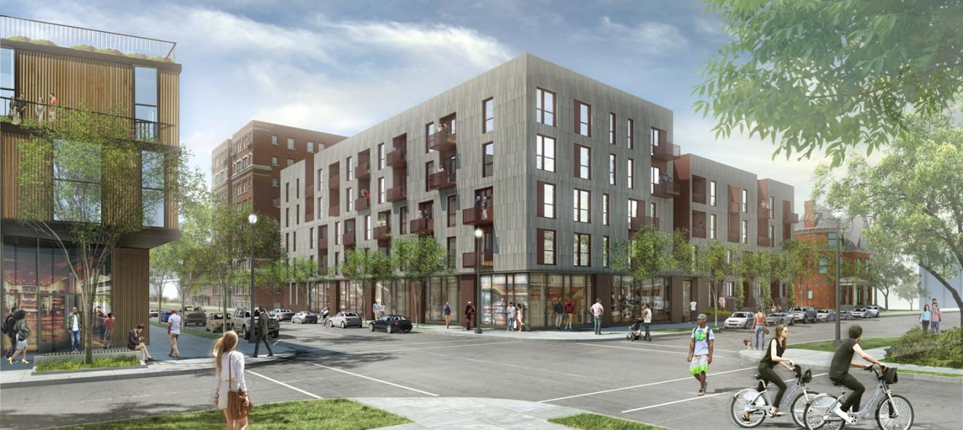
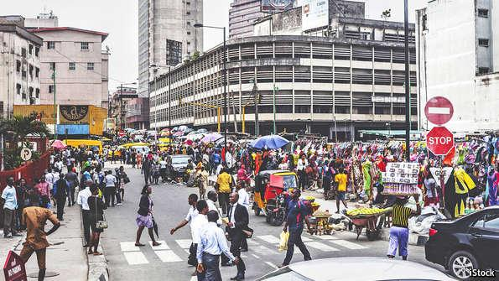
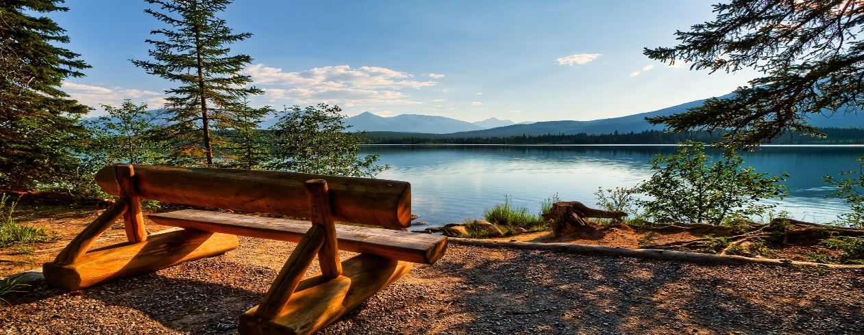
Ex 3. Describe the places. Use the adjectives below.
noisy
crowded
peaceful
quiet
modern
beautiful
busy
boring
noisy
crowded
busy
modern
peaceful
quiet
beautiful
boring
Notes:
Can you help me to describe the following places using these adjective

Slide 13

* Pronunciation:
/ɪ/ and /i:/
Listen and repeat the words. Pay attention to the sounds /ɪ/ and /i:/.
noisy
cheap
peaceful
expensive
noisy
cheap
peaceful
expensive
clean
exciting
friendly
convenient
clean
exciting
friendly
convenient
Now, in pairs put the words in the correct column.
/ɪ/ | /i:/
noisy
convenient
expensive
cheap
exciting
peaceful
friendly
clean

Slide 14
*Give some words they know containing these sounds.
Suggested answers:
/i/: chip, tin, ship, …
/i:/: cheap, teen, sheep, …

Slide 15

Listen and practise the chant. Notice the sounds /ɪ/ and /i:/.
MY NEIGHBOURHOOD
My city is very noisy.
There are lots of trees growing. The people here are busy.
It’s a lively place to live in.
My village is very pretty.
There are lots of places to see.
The people here are friendly.
It’s a fantastic place to be.

Slide 16
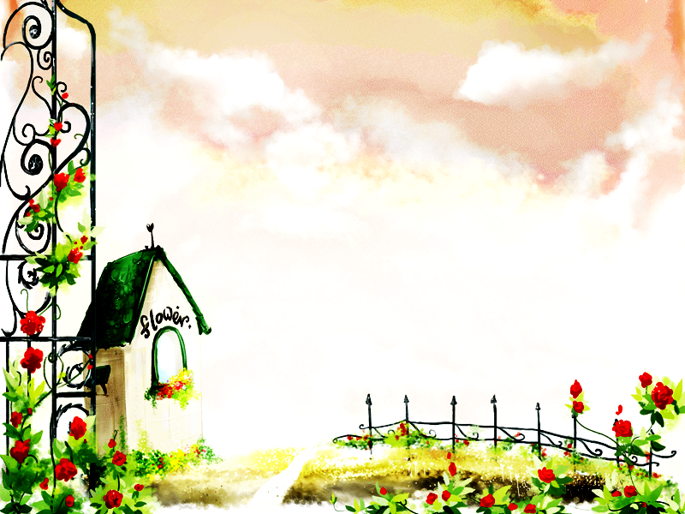
HOMEWORK
- Leran by heart Vocab.
Find 5 more words with the sound /i/
and 5 more words with the sound /i:/.
Prepare lesson 3 .

Slide 17
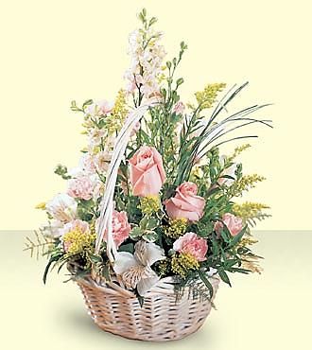
Thank you very much.

