Slide 1



ENGLISH 6

Slide 2
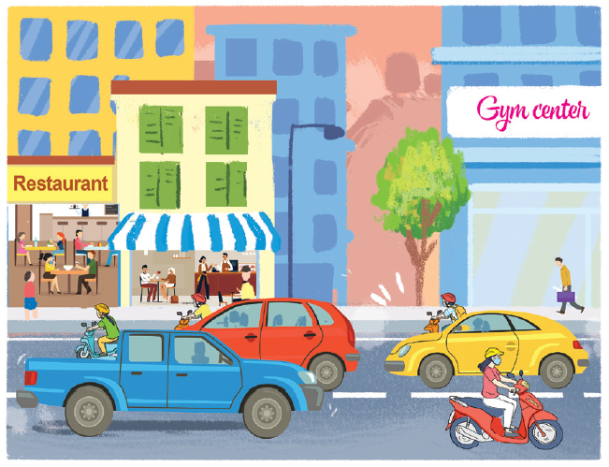
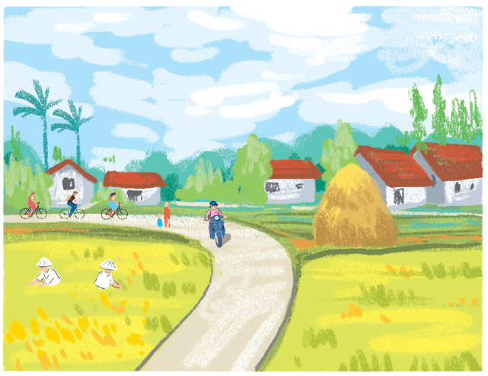
Warm up:
https://padlet.com/tranthithu30121976/Tienganh
List adjectives to describre the two places.
START TIMER
1 : 00
0 : 59
0 : 58
0 : 57
0 : 56
0 : 55
0 : 54
0 : 53
0 : 52
0 : 51
0 : 50
0 : 49
0 : 48
0 : 47
0 : 46
0 : 45
0 : 44
0 : 43
0 : 42
0 : 41
0 : 40
0 : 39
0 : 38
0 : 37
0 : 36
0 : 35
0 : 34
0 : 43
0 : 32
0 : 31
0 : 30
0 : 29
0 : 28
0 : 27
0 : 26
0 : 25
0 : 24
0 : 23
0 : 22
0 : 21
0 : 20
0 : 19
0 : 18
0 : 17
0 : 16
0 : 15
0 : 14
0 : 13
0 : 12
0 : 11
0 : 10
0 : 09
0 : 08
0 : 07
0 : 06
0 : 05
0 : 04
0 : 03
0 : 02
0 : 01
TIME’S UP!
0 : 00
noisy, crowded, modern, busy, exciting, expensive….
quiet, peaceful, boring, cheap, clean, small……

Slide 3

UNIT 4: MY NEIGHBOURHOOD
Period 29:
Objective:
Understand and use comparative structures to compare two people or things.

Slide 4
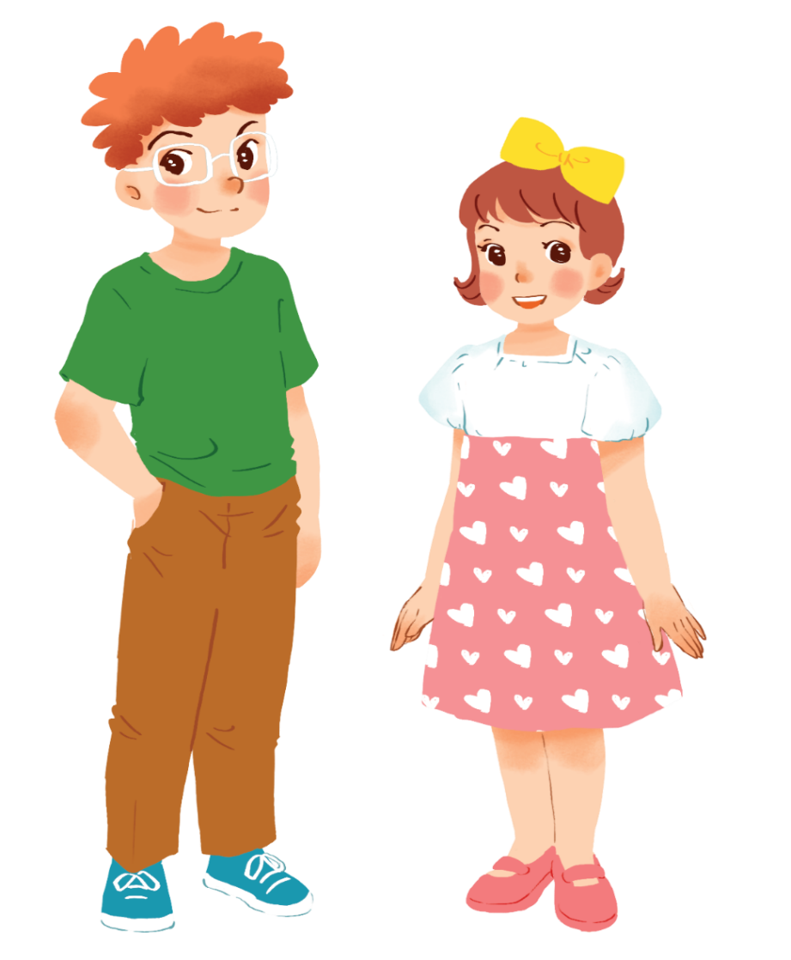
Example:
Tom
Mary
Tom is taller than Mary.
Mary is shorter than Tom.

Slide 5
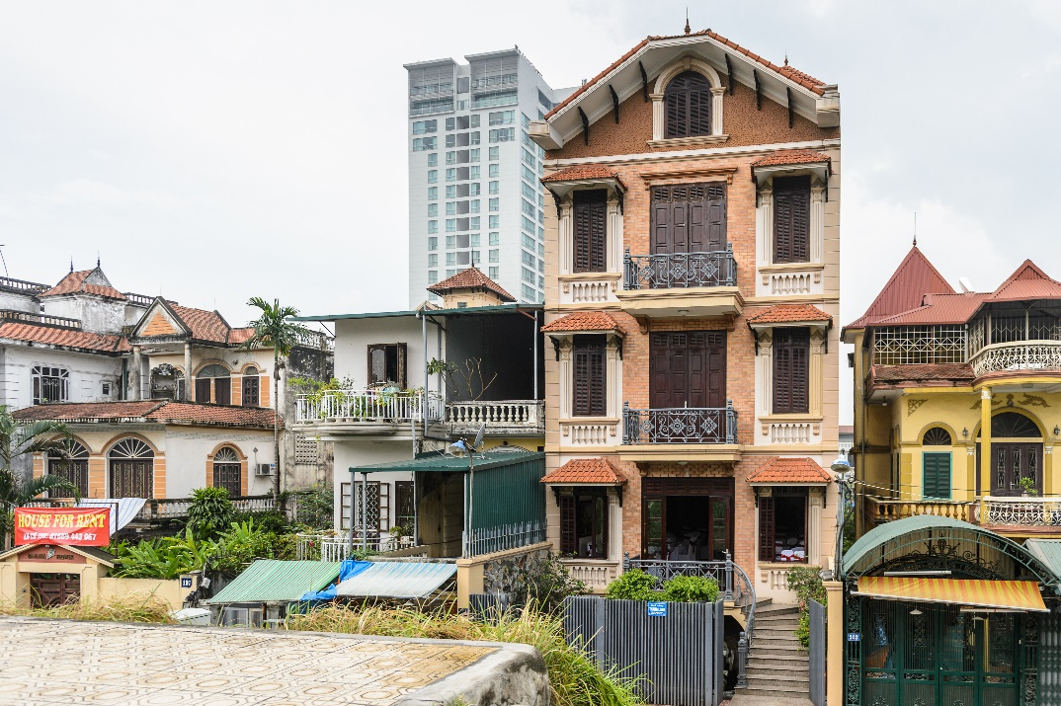
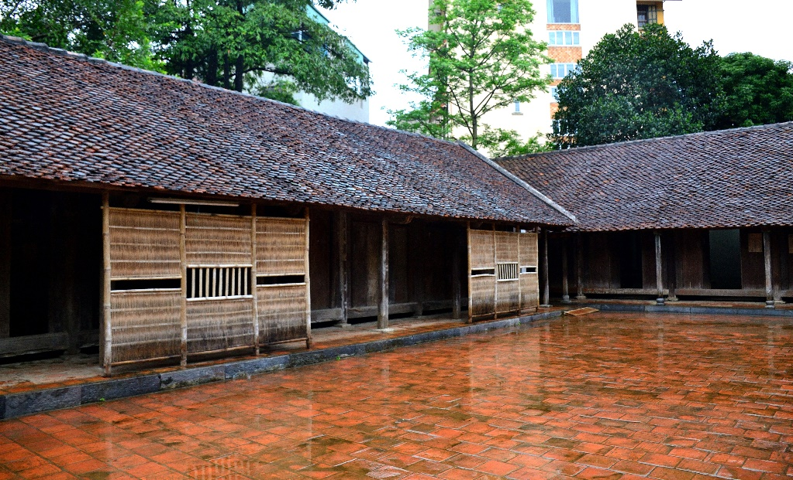
Example:
A house in a city is more expensive than a house in the countryside.

Slide 6
*Grammar
Comparative adjectives
Ex1: Tom is taller than Mary.
+ Short Adj:
S1 + be + adj-er + than + S2.
Ex 2: A house in a city is more expensive than a house in the countryside.
+ Long Adj:
S1 + be + more + adj + than + S2.

Slide 7
* Note:
syllable | Positive | Comparative | Rule
one
syllable
fast
faster
+ er
large
larger
+ r
big
bigger
+ ...er
two
syllables (y)
noisy
noisier
y → ier
two or more syllables
modern
more modern
more + adj

Slide 8


Comparative adjectives
We can use comparative adjectives to compare two people or things.

Slide 9


Slide 10

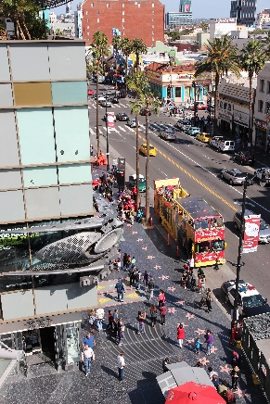
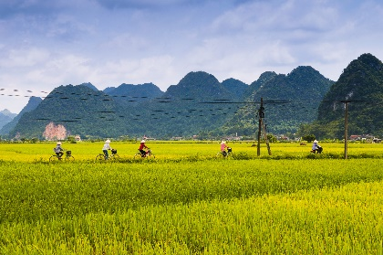
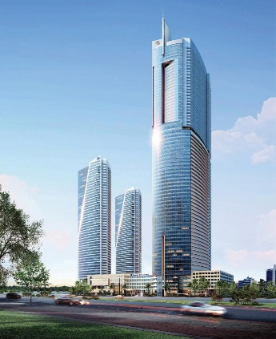
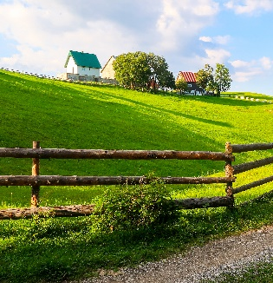
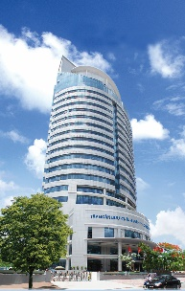
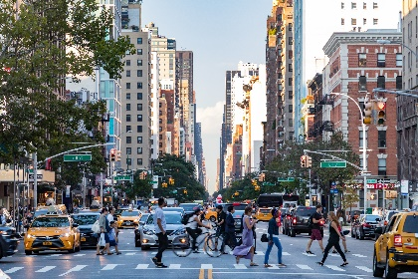
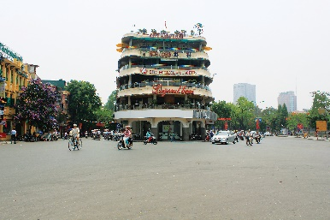
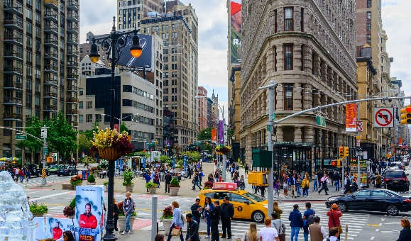
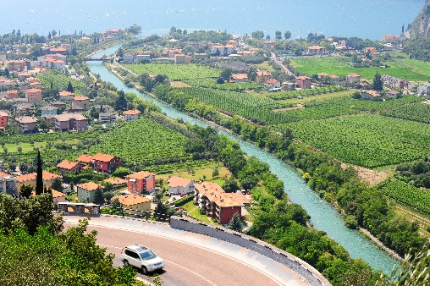
Complete the following sentences with the comparative form of the adjectives in brackets. Number 1 is an example.
https://wordwall.net/play/24190/705/532

Slide 11


Use the correct form of the words in brackets to complete the letter.
Dear Nick,
How are you?
Ha Noi is beautiful but it’s too busy for me. I’m having a great time at Cua Lo Beach now. The weather is (1. hot) _____ than that in Ha Noi. The houses and buildings are (2. small) _______ and (3. old) _______ than those in Ha Noi.
The streets are (4. wide) _______ with less traffic. the seafood here is (5. delicious) ______________and (6. cheap) ______ than the seafood in Ha Noi.
See you soon,
Vy
hotter
smaller
older
wider
more delicious
cheaper

Slide 12
Use the correct form of the words in brackets to complete the letter.
Dear Nick,
How are you?
Ha Noi is beautiful but it’s too busy for me. I’m having a great time at Cua Lo Beach now. The weather is (1. hot) hotter than that in Ha Noi. The houses and buildings are (2. small) smaller and (3. old) older than those in Ha Noi.
The streets are (4. wide) wider with less traffic. the seafood here is (5. delicious) more delicious and (6. cheap) cheaper than the seafood in Ha Noi.
See you soon,
Vy

Slide 13

Look at the pictures of the two neighbourhoods: Binh Minh and Long Son. Compare two neighbourhoods. You can use the adjectives below.
noisy
quiet
modern
boring
crowded
peaceful
busy
Example:
Binh Minh is noisier than Long Son.
Binh Minh
Long Son

Slide 14

Work in pairs. Ask and answer questions about Binh Minh and Long Son neighbourhoods using the pictures in 3.
noisy noisier
crowed more crowed
quiet quieter
peaceful more peaceful
modern more modern
busy busier
Example:
A: Is Binh Minh noisier than Long Son?
B: Yes, it is.
A: Is Long Son more modern than Binh Minh?
B: No, it isn’t.

Slide 15
Wrap up:
What have you learnt in this lesson?
-Use comparative adjectives to compare two people or things.

Slide 16


-Revise comparative structures to compare 2 people or things.
-Write the 5 sentences to compare two people or things, using the adjectives you have learnt.
(submit homework to Azota.)
- Prepare the next lesson: Communication

Slide 17

Thank you very much.

