Slide 1
UNIT 8
SPORTS AND GAMES
Lesson 4: Communication

Slide 2
OBJECTIVES
After this lesson, students will be able to:
Express and respond to congratulations!
Talk about the sport/game they like

Slide 3
01
Everyday English

Slide 4

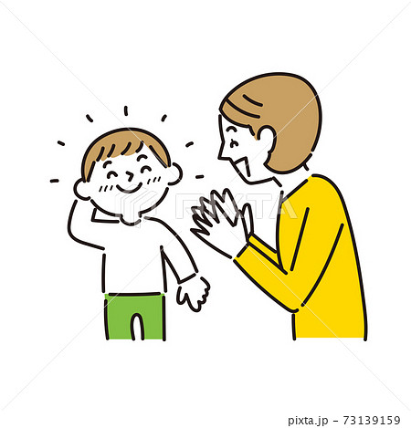
1 (p.21) Listen and read the short conversation below, paying attention to the highlighted parts.
Duong: Last week I played table tennis with Duy, and I won for the first time.
Mai: Congratulations!
Duong: Thank you, Mai.
Mai: So you're our class champion now.
Thank you, Mai.
Congratulations!
Expressing and responding to congratulations!
Duong
Mai

Slide 5
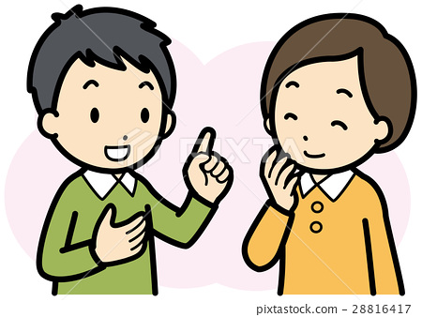

2 (p.21) Work in pairs. Make a similar dialogue.
Student A has won a prize in the school's singing contest / sports competition.
Student B congratulates him / her.
A: Last week I …
B: Congratulations!
A: Thank you.
Student A
Student B

Slide 6
02
The sport/game you like

Slide 7
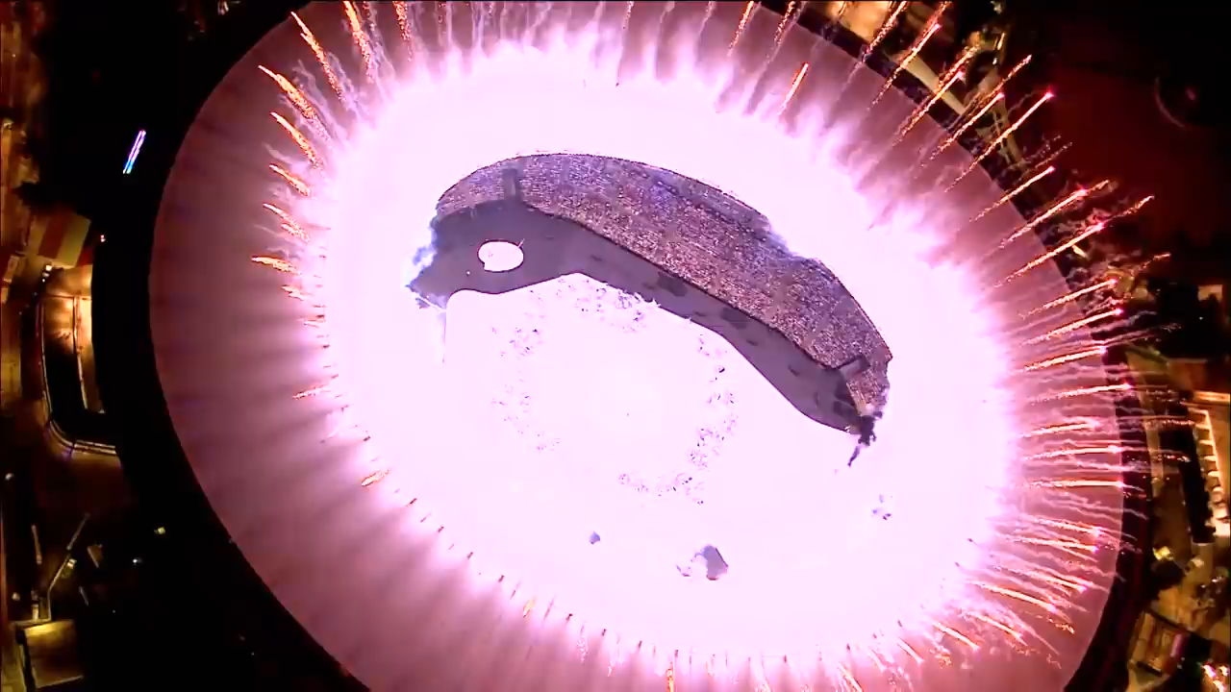
Watch and tell What sport event it is.
Olympic Rio 2016

Slide 8


3 (p.21) Work in pairs. Do the quiz.
1. How many players are there in a football match?
2. How long does a football match last?
3. How often do the Olympic Games take place?
4. How long is a marathon?
5. Where did the first Olympic Games take place?
There are usually 22 players.
It normally lasts 90 minutes. (2 halves)
They are held every four year.
A marathon is 42.195 kilometres long.
They were held in Olympia (in Ancient Greece in 776 BC)
Notes:
1. 2. 3. 4. 5. 6. 7. Boxing does.

Slide 9
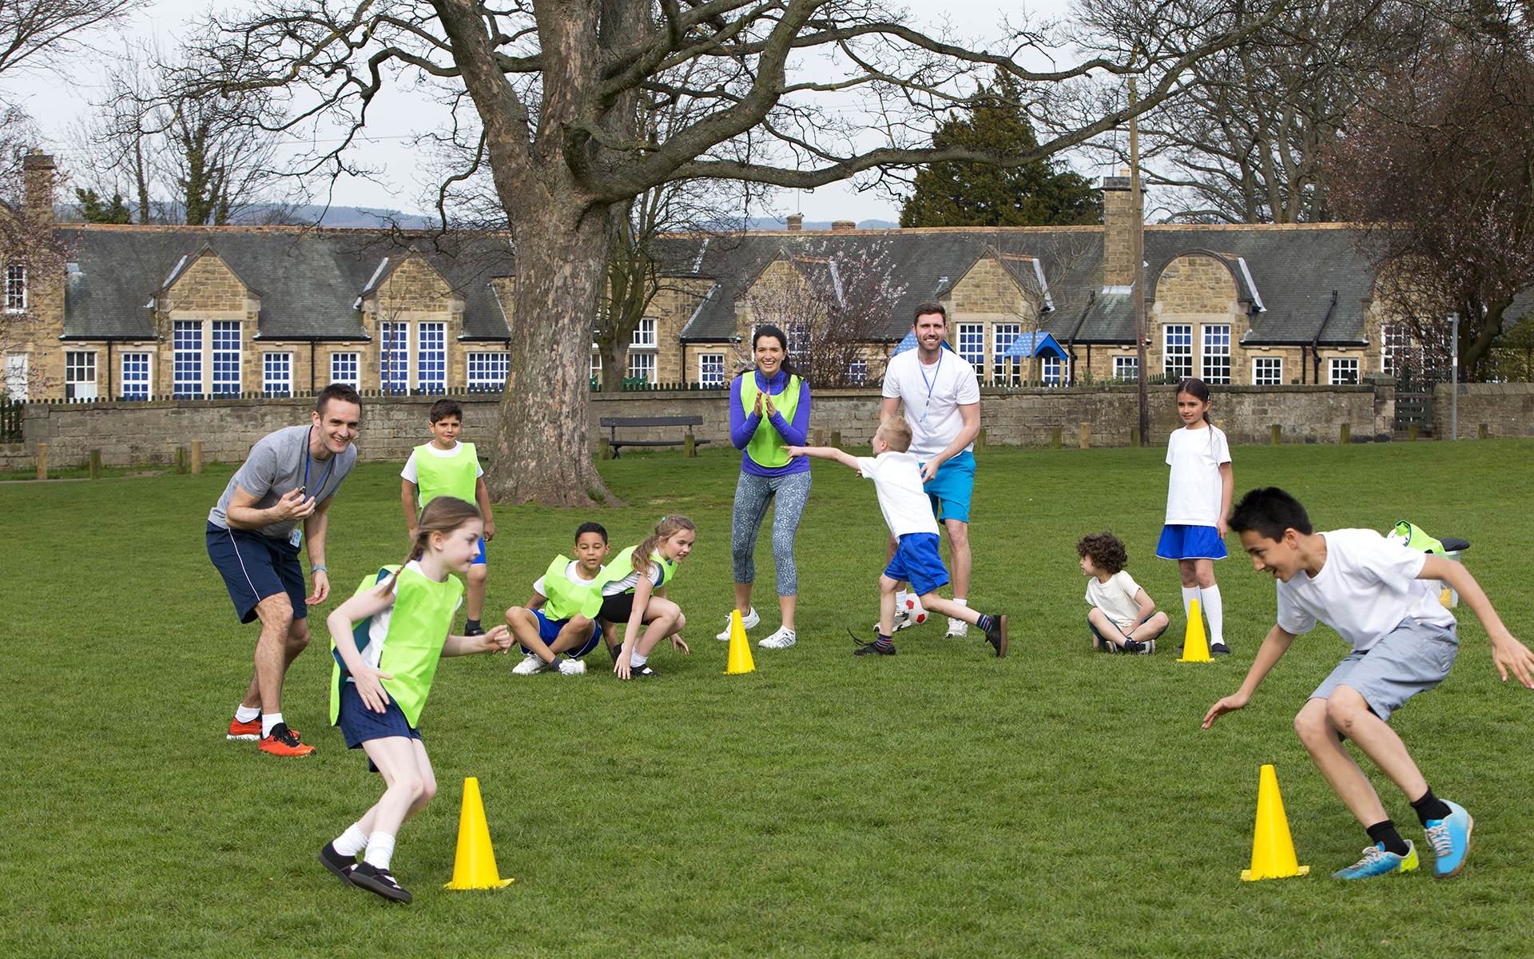
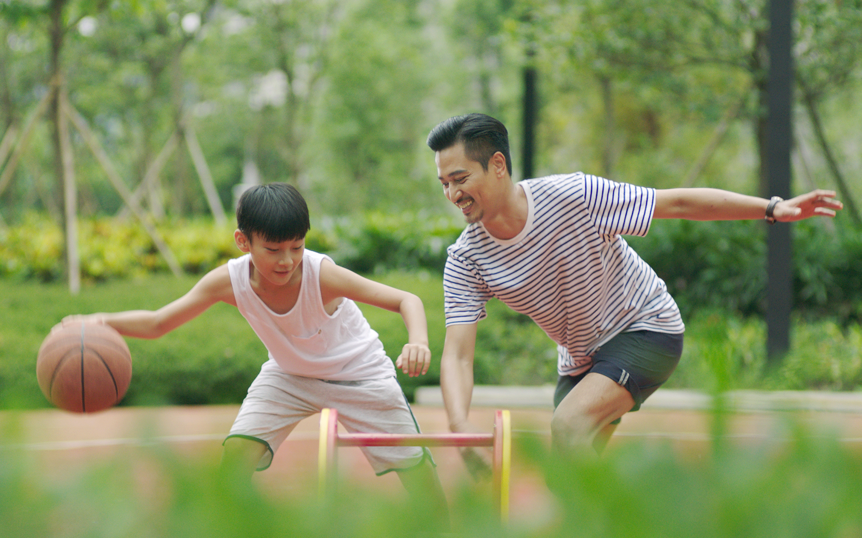
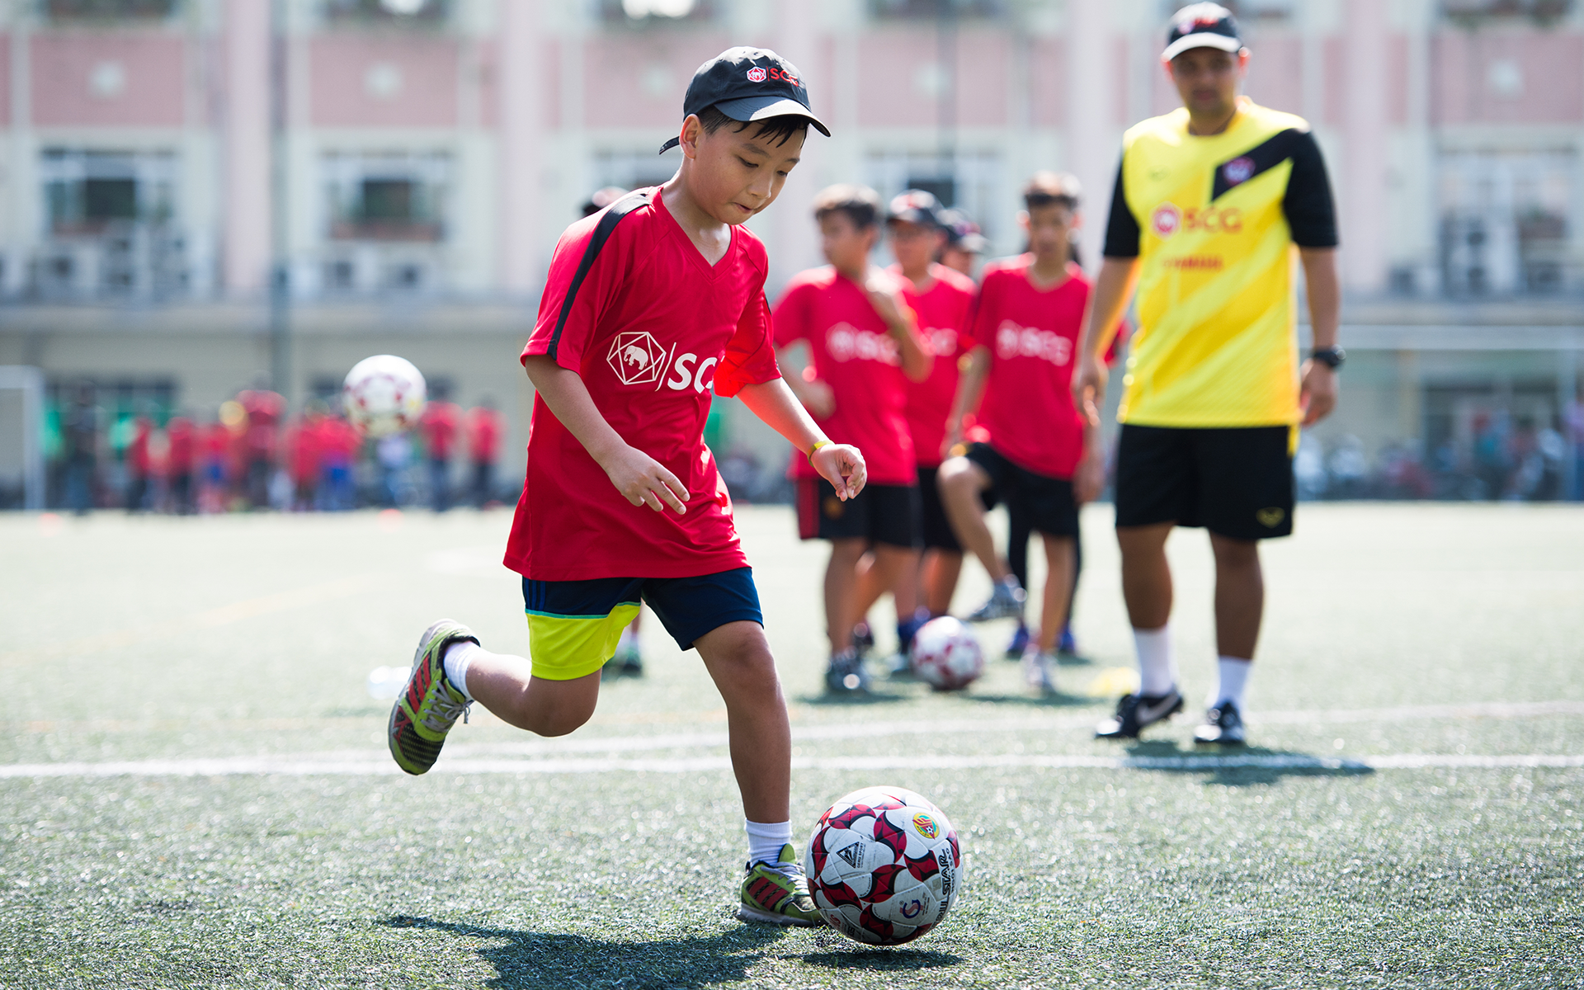
4 (p.21) Work in groups. Interview your partners using the following questions. You may ask for more information.
1. What sports / games do you play in your free time? Do you play them well? When and how often do you play them?
2. Which sport / game do you like watching on TV?
3. Did you join any clubs?
4. If you don't play sport, what do you often do in your spare time?
Notes:
Report your interviews to the class.

Slide 10
Let’s share with the whole class.
Example:
My friend, … plays football in his/ her free time. He/ She can play it very well. He/ She usually play foot ball after school.
… like watching playing basketball on TV.
… joins many clubs like volleyball, tennis, chess and cycling.
If … doesn’t play sport, he/ she often listens to music.

Slide 11
Let’s share with the whole class.
Example:
My friend, … plays football in his/ her free time. He/ She can play it very well. He/ She usually play foot ball after school.
… like watching playing basketball on TV.
… joins many clubs like volleyball, tennis, chess and cycling.
If … doesn’t play sport, he/ she often listens to music.

Slide 12
Wrap up
In this lesson, students have been able to:
 Express and respond to congratulations!
 Talk about the sport/game they like

Slide 13
Thanks for your attention!
Please keep this slide for attribution

Slide 14
Alternative resources

Slide 15
Fonts & colors used
This presentation has been made using the following fonts:
Lexend
(https://fonts.google.com/specimen/Lexend)
Commissioner
(https://fonts.google.com/specimen/Commissioner)
#272727
#ffffff
#686868
#ede2ca
#5ea7c5
#8cd3a3
#ffcb77
#e78d48
#bd5323

