Slide 1
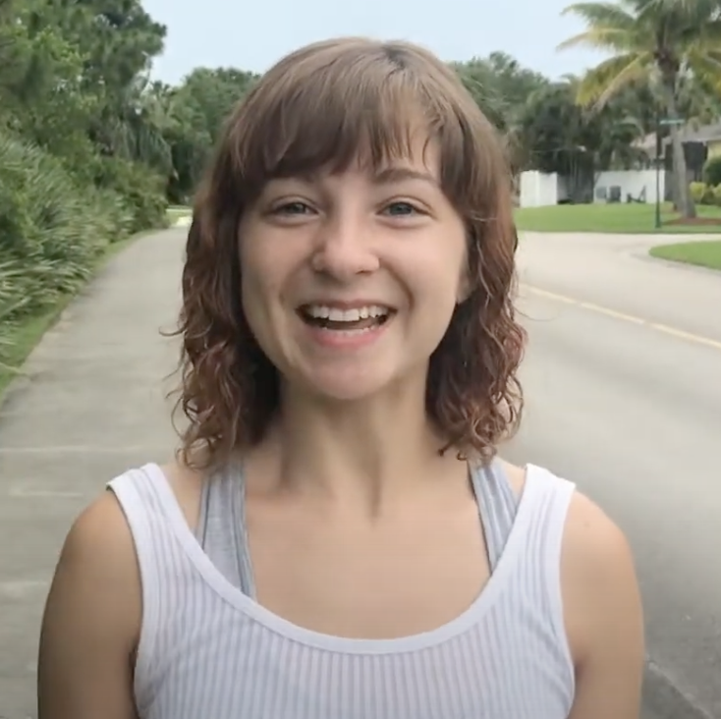


let’s go to
Katya - Florida
Katya’s house

Slide 2
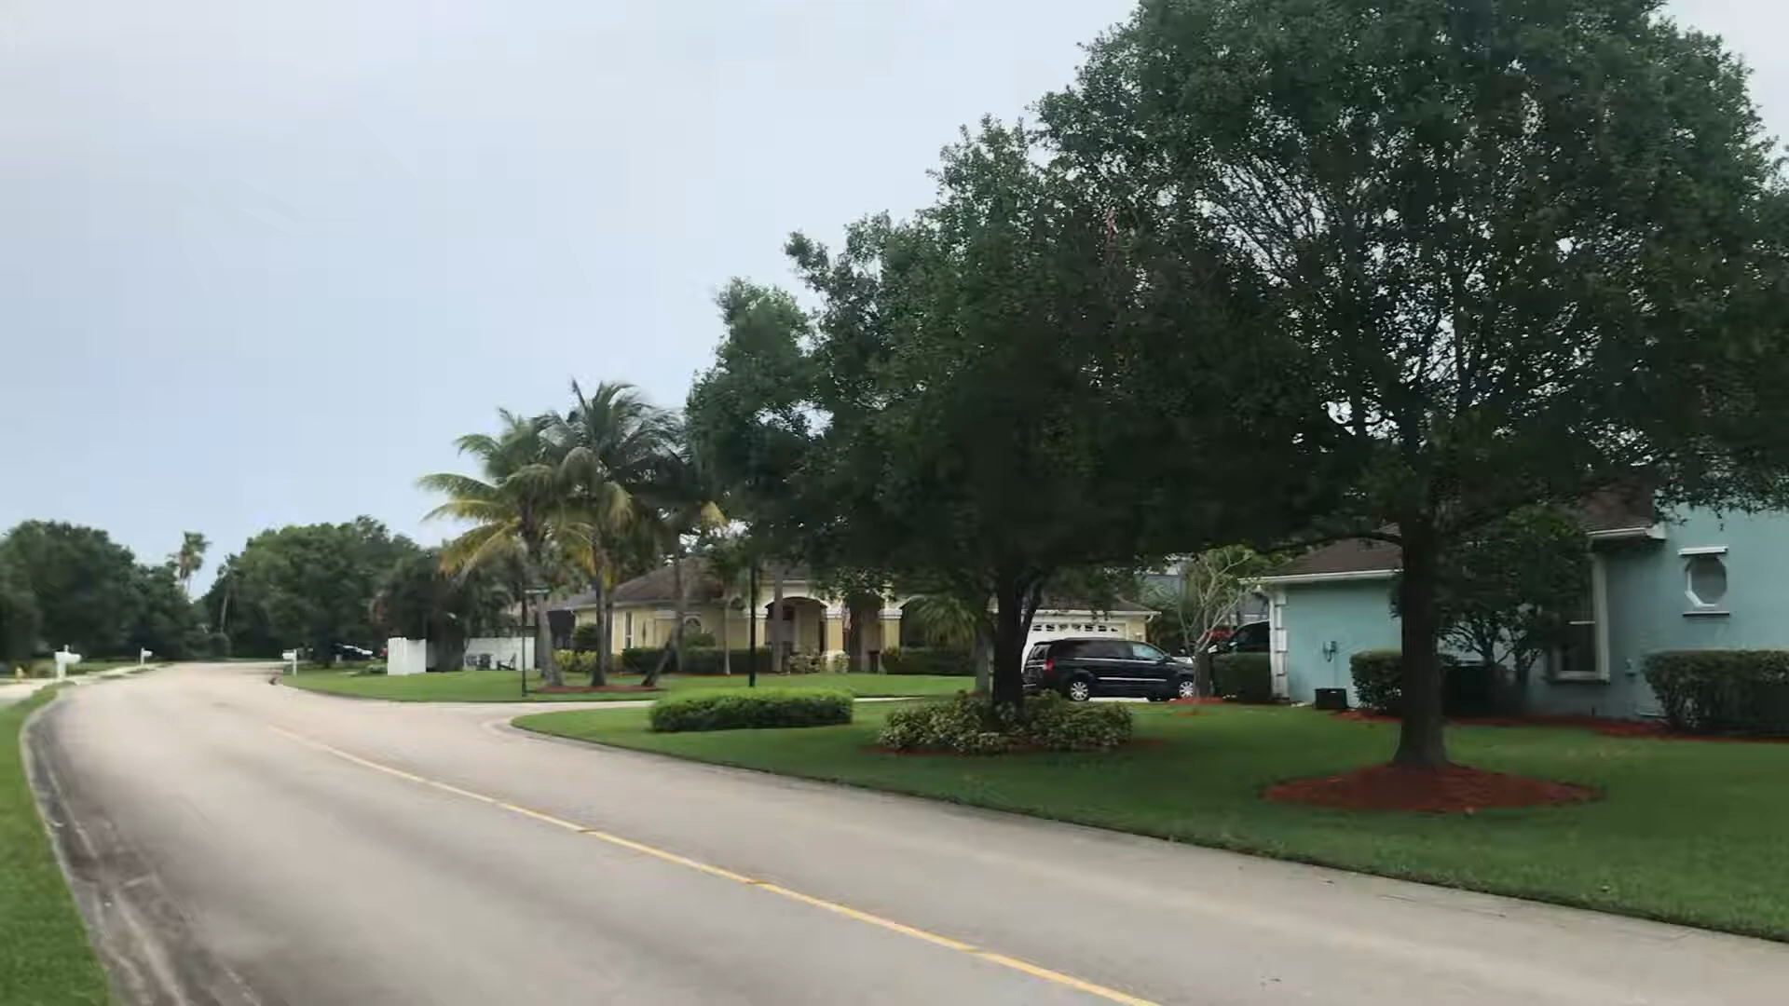
How many rooms are there in Katya’s house?

Slide 3
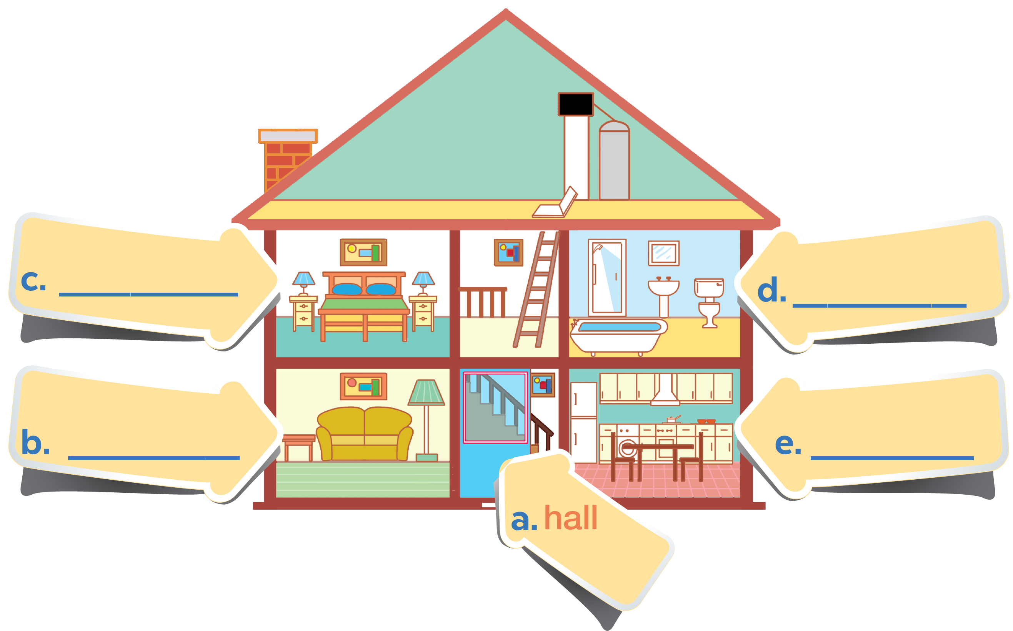

Check your answer
bedroom
bathroom
living room
kitchen

Slide 4
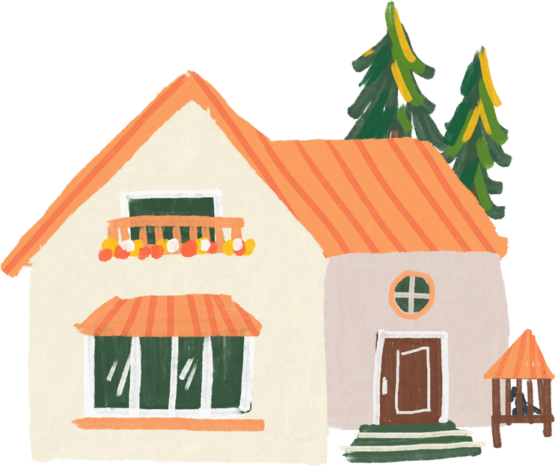
UNIT 2
MY HOUSE
Lesson 2
A closer look 2
School year 2022 - 2023

Slide 5

Objectives
By the end of this lesson, students will be able to:
use the words for rooms and furniture
pronounce the final sounds /s/ and /z/ correctly

Slide 6
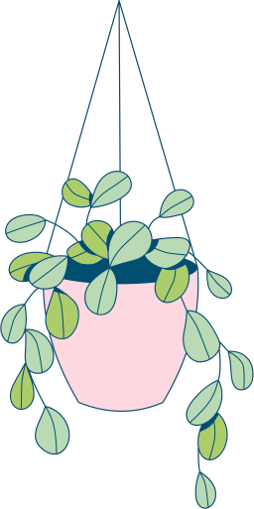
01
VOCABULARY
use the words for rooms and furniture

Slide 7

In 3 minutes. Put these things in each room.
(You may use a word more than one)
lamp
picture
chest of drawers
sofa
fridge
cupboard
dishwasher
sink
bath
toilet

Slide 8


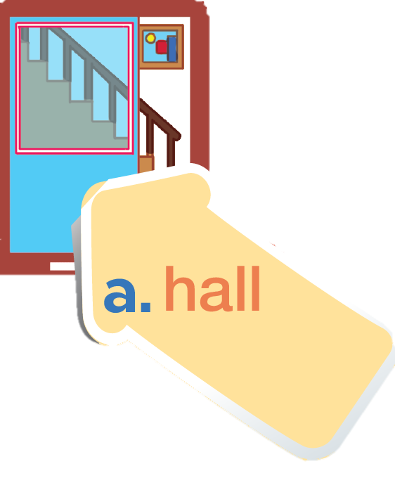

Check your answer
picture

Slide 9

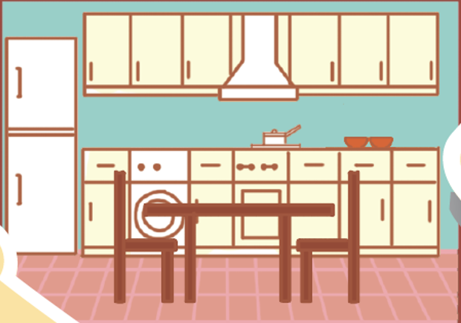
dishwasher
fridge
cupboard
kitchen

Slide 10
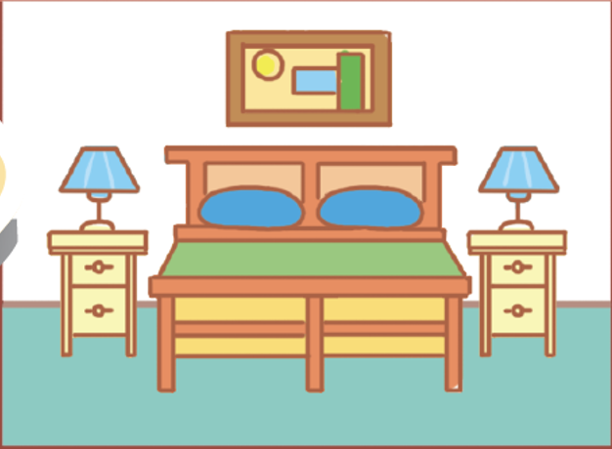
picture
lamp
chest
of drawers
bedroom

Slide 11
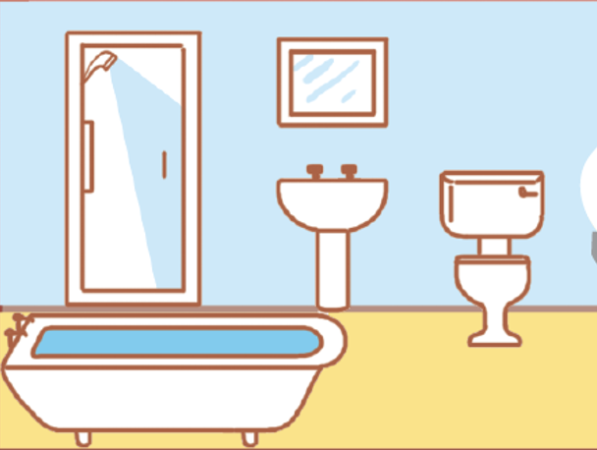
sink
bath
toilet
bathroom

Slide 12
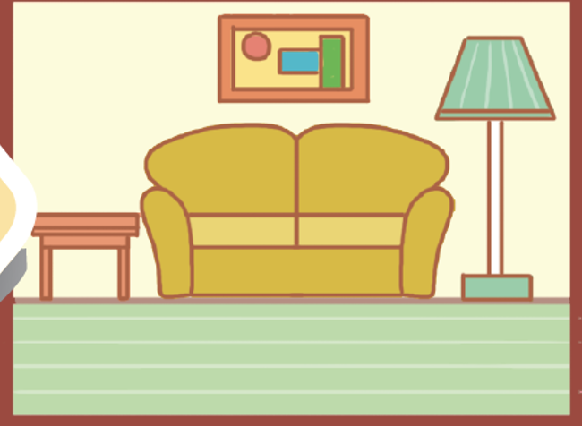
picture
sofa
lamp
living room

Slide 13
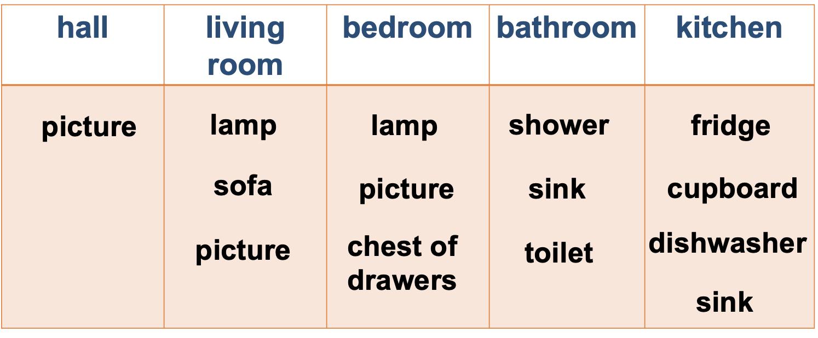
Check your answer
hall | kitchen | bedroom | bathroom | living room
picture
fridge
picture
sink
sofa
dishwasher
chest of drawers
bath
picture
cupboard
lamp
toilet
lamp

Slide 14
In groups, add more things for each room
hall | kitchen | bedroom | bathroom | living room
picture
fridge
picture
sink
sofa
dishwasher
chest of drawers
bath
picture
cupboard
lamp
toilet
lamp

Slide 15
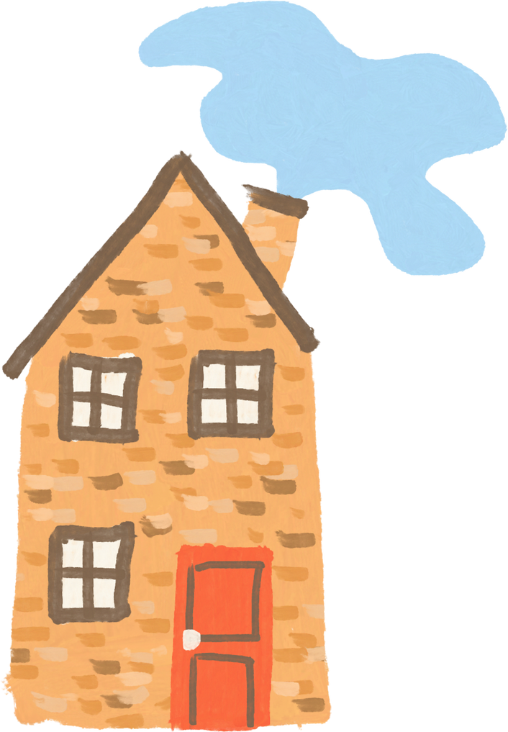
02
PRONUNCIATION
pronounce the final sounds /s/ and /z/ correctly

Slide 16

Ex 4. Listen and repeat the words.
Pay attention to the final -s sounds.
lamps
cupboards
sinks
sofas
flats
kitchens
toilets
rooms

Slide 17

Final sounds: /s/
lamps
months
/p/
/θ/
sinks
laughs
/k/
/f/
flats
/t/
Final -s is pronounced /s/ after
voiceless sounds (/t/, /p/, /k/, /f/, /θ/).
Notes:
5. Listen to the conversation.
Underline the final - s in the words and put them into the correct column.

Slide 18
Final sounds: /z/
cupboards
kitchens
/d/
/n/
rooms
sofas
/m/
/ə/
Final -s is pronounced /z/ after voiced sounds
(/b/, /d/, /g/, /n/, /m/, /l/, etc.) and any vowel sounds.

Slide 19
Ex 5 (pg 18) Underline the final -s in the words and put them into the correct column.
Mi: Mum, are you home?
Mum: Yes, honey. I’m in the kitchen. I’ve bought these new bowls and chopsticks.
Mi: They’re beautiful, Mum. Where did you buy them?
Mum: In the department store near our house. They have a lot of things for homes.
Mi: Don’t forget we need two lamps for my bedroom, Mum.
Mum: Let’s go there this weekend.
/s/ | /z/
bowls
chopsticks
things
lamps
homes

Slide 20
SUMMARY
/s/ | /z/
Final -s is pronounced /s/ after voiceless sounds (/t/, /p/, /k/, /f/, /θ/) | Final -s is pronounced /z/ after voiced sounds (/b/, /d/, /g/, /n/, /m/, /l/, etc.) and any vowel sounds.
E.g: cats, lamps, books, months | E.g: beds, dogs, cans, rooms, videos, cookers, bees

Slide 21


* Learn all of the words by heart and make sentences using them
* Practice saying the words and sentences in front of a mirror, record and then listen again
* Do Part A – Exercise 1,2 in Workbook

