Slide 1
Game:
Guess the word

Slide 2
GUESS THE WORD
3 teams
Choose a number
Guess one letter
1 correct answer/ 2 pts
1 wrong answer/ -1 pt
Hint: The area of a town or a city
N
1
E
2
I
3
G
4
H
5
B
6
O
7
U
8
R
9
H
10
O
11
O
12
D
13

Slide 3
Unit 4
My neighbourhood
Unit 1 – Lesson 1: Getting started

Slide 4


Hoi An
Do you know anything special in Hoi an ?
Where is it?
Notes:
Where is it?
What do you know about Hoi An? Any famous places….
Wow, fantastic,
So, Today we are going to travel around Hoi An. Let’s meet our friends

Slide 5

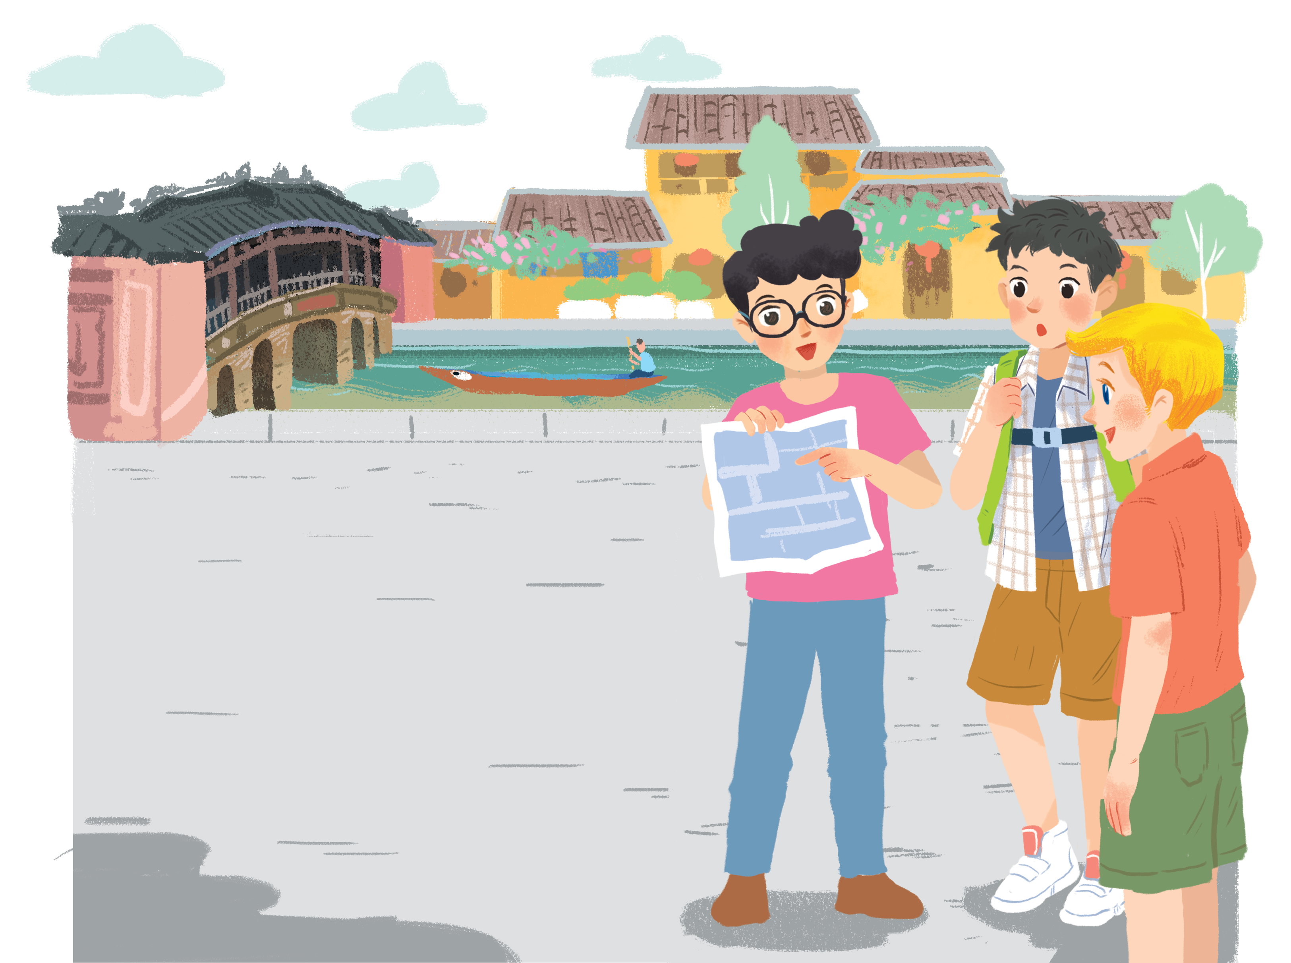
Look and answer
1. Who are they?
Phong, Nick and Khang
2. Where are they?
In Hoi An
3. Do they live near here?
No, they don’t.
They are looking at a map.
4. Are they getting lost?
Yes, they are
Listen and check

Slide 6
Ex 3. Read and check
Work in pairs. Guess the order.
a. The girl shows them the way to Tan Ky House.
b. Nick, Khang and Phong arrive in Hoi An.
c. Nick, Khang and Phong decide to go to Tan Ky House.
d. Nick, Khang and Phong get lost.
e. Phong askes a girl how to get to Tan Ky House.
Notes:
What might happen to the three boys? Let’s guess the order. Now. Work in pairs.

Slide 7
Lost in the old town!
b. Nick, Khang and Phong arrive in Hoi An
Phong: Wow! We’re in Hoi An. I’m so excited.
Nick: Me too. It’s so beautiful. Where shall we go first?
Khang: Let’s go to Chua Cau.
Phong: Well, but Tan Ky house is nearer. Shall we go there first?
Nick & Khang: OK, sure.
Phong: First, cross the road, and then turn left.
Nick: Fine, let’s go.
Phong: Wait.
Khang: What’s up, Phong?
Phong: I think we’re lost.
Nick: Look, there’s a girl. Let’s ask her.
Phong: Excuse me? Can you tell us the way to Tan Ky House?
Girl: Sure. Go straight. Take the second turning on the left, and then turn right.
Phong, Nick & Khang: Thank you.
c. Nick, Khang and Phong decide to go to Tan Ky House
d. Nick, Khang and Phong get lost.
e. Phong asks a girl how to get to Tan Ky House.
a. The girl shows them the way to Tan Ky House.

Slide 8
Answer
a. The girl shows them the way to Tan Ky House.
b. Nick, Khang and Phong arrive in Hoi An.
c. Nick, Khang and Phong decide to go to Tan Ky House.
d. Nick, Khang and Phong get lost.
e. Phong askes a girl how to get to Tan Ky House.
5
1
2
3
4

Slide 9
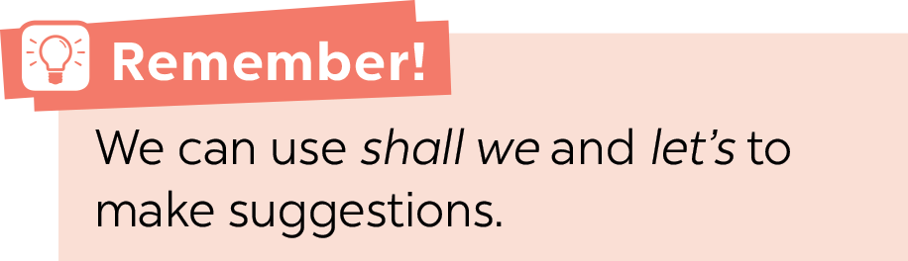
Ex 2. Find sentences used to make suggestions
Phong: Wow! We’re in Hoi An. I’m so excited.
Nick: Me too. It’s so beautiful. Where shall we go first?
Khang: Let’s go to Chua Cau.
Phong: Well, but Tan Ky house is nearer. Shall we go there first?
Nick & Khang: OK, sure.
Phong: First, cross the road, and then turn left.
Nick: Fine, let’s go.
Phong: Wait.
Khang: What’s up, Phong?
Phong: I think we’re lost.
Nick: Look, there’s a girl. Let’s ask her.
Phong: Excuse me? Can you tell us the way to Tan Ky House?
Girl: Sure. Go straight. Take the second turning on the left, and then turn right.
Phong, Nick & Khang: Thank you.
Let’s go to Chua Cau
Shall we go there first?
let’s go.
Let’s ask her.

Slide 10
Ex 4. Find and underline
A. turn right B. cross the road
C. turn left C. go straight
E. take the second turning on the left
Phong: Wait.
Khang: What’s up, Phong?
Phong: I think we’re lost.
Nick: Look, there’s a girl. Let’s ask her.
Phong: Excuse me? Can you tell us the way to Tan Ky House?
Girl: Sure. Go straight. Take the second turning on the left, and then turn right.
Phong, Nick & Khang: Thank you.
Phong: Wow! We’re in Hoi An. I’m so excited.
Nick: Me too. It’s so beautiful. Where shall we go first?
Khang: Let’s go to Chua Cau.
Phong: Well, but Tan Ky house is nearer. Shall we go there first?
Nick & Khang: OK, sure.
Phong: First, cross the road, and then turn left.
Nick: Fine, let’s go.

Slide 11

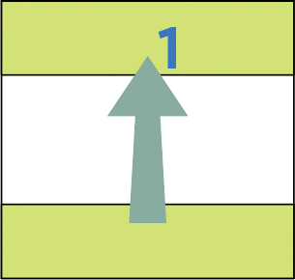
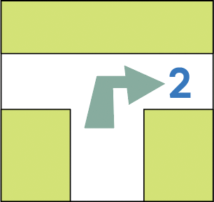
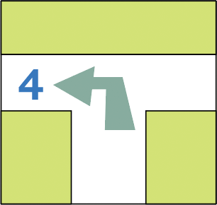
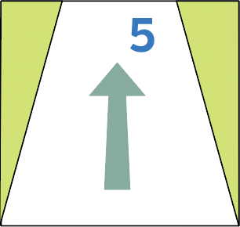
Ex 4. Match the directions with the diagrams.
B. cross the road
A. turn right
E. take the second turning on the left
C. turn left
D. go straight

Slide 12
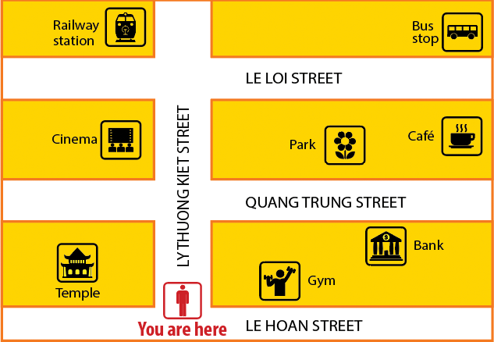
Ex 5. Find places
3 teams
Look at the map.
Take turns to give directions.
Others guess the place in 5 seconds
Example
A: Go straight. Take the second turning on the left. It’s on your right.
B: Is that the railway station ?
A: Yes, It is .

Slide 13
ACTIVITY: WAY BACK HOME
Way back home
Group work.
(One volunteer, the others give instruction.)
Close your eyes
Listen to instructions
Find the way back to your place.
Notes:
Activity: Way back home
- Group work. One volunteer, the others give instruction.
Close your eyes
Listen to instructions
Find the way back home

Slide 14
Thanks
CREDITS: This presentation template was created by Slidesgo, including icons by Flaticon, infographics & images by Freepik
Please, keep this slide for the attribution

