Slide 1
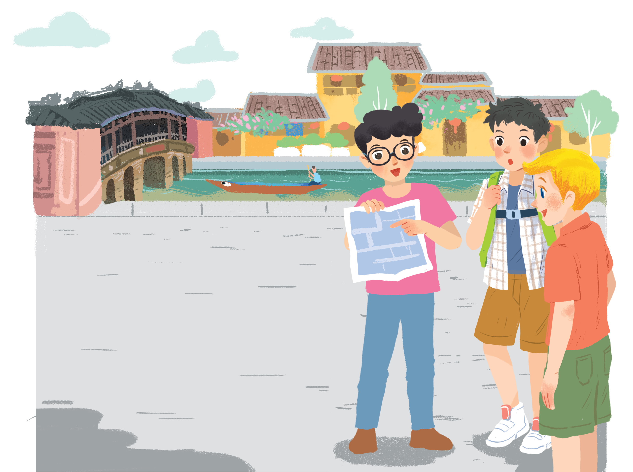
Khang
1. Who is Khang?
2. Where is he?
In Hoi An
He’s back home now.
WHERE?
Notes:
Now, look at the picture. Do you remember them?
Guess Who is Khang? Where is he? Yeah, he is in Hoi An.
BUT NOW, He’s back home.

Slide 2

Where does Khang live?
Da Nang City
Notes:
Where? Yes, it’s Danang city.
Let’s see how his neighborhood is in Lesson 5- skills 1.

Slide 3
Unit 4:
My neighbourhood
LESSON 5: SKILLS 1

Slide 4
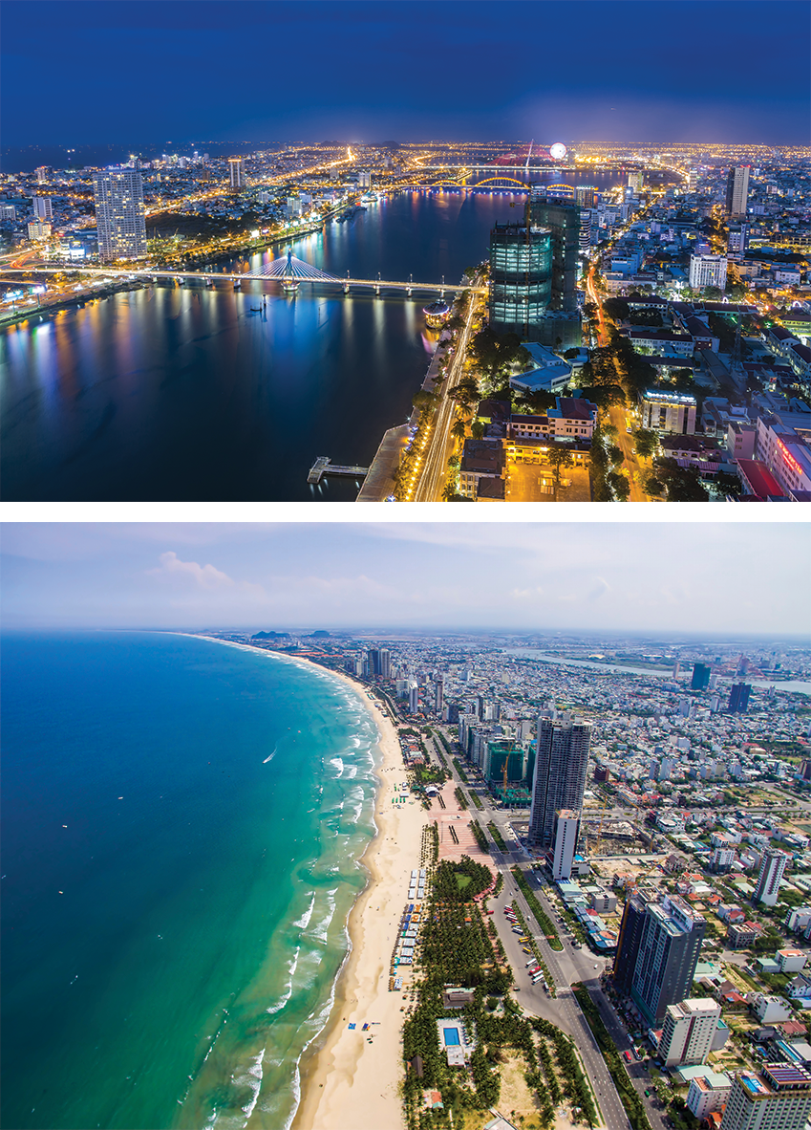
READING

Slide 5
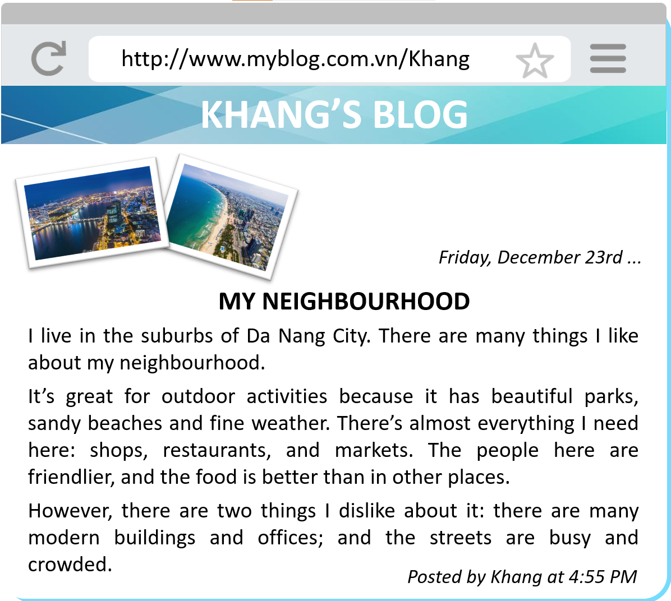
What type of the text is it?
A blog
What is the topic?
Khang’s neighbourhood

Slide 6
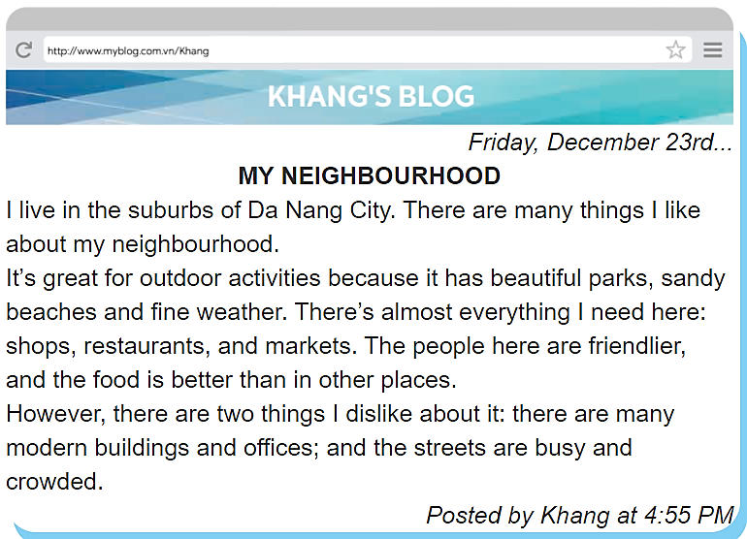
Find the words in the blog – 15 seconds
suburbs
dislike
outdoor
START
STOP
TIME
:
0
0
0
00
59
58
57
56
55
54
53
52
51
50
49
48
47
46
45
44
43
42
41
40
39
38
37
36
35
34
33
32
31
30
29
28
27
26
25
24
23
22
21
20
19
18
17
16
15
14
13
12
11
10
09
08
07
06
05
04
03
02
01
00
Notes:
15 seconds

Slide 7
Find the words in the blog
suburbs
dislike
outdoor
Notes:
15 seconds

Slide 8
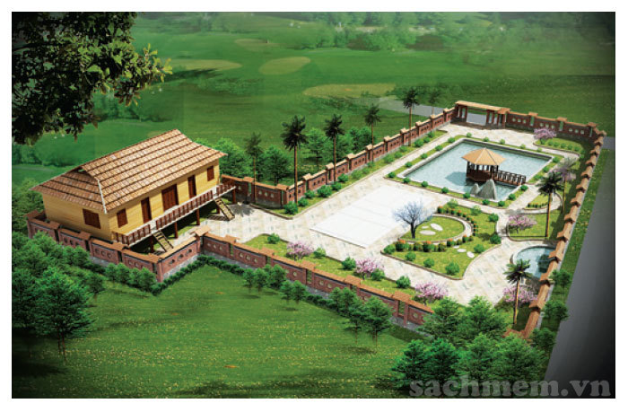
A. an area OUTSIDE the centre of a city.
Suburb?
B. an area INSIDE the centre of a city.

Slide 9
Read and answer
1. Where is Khang’s neighbourhood?
Place
2. Why is his neighbourhood great for outdoor activities?
Reason (because)
3. What are the people in his neighbourhood like?
Adj
4. How are the street in his neighbourhood?
Adj

Slide 10

Read and answer
1. Where is Khang’s neighbourhood?
in the suburbs of Da Nang City
2. Why is his neighbourhood great for outdoor activities?
Because it has beautiful parks, sandy beaches and fine weather.
3. What are the people in his neighbourhood like?
1
very friendly
2
4. How are the streets in his neighbourhood?
3
busy and crowed.
4

Slide 11
Read again and fill
LIKES | DISLIKES
beautiful parks

Slide 12
Let’s check.
LIKES
beautiful parks
sandy beaches
fine weather
There’s almost everything: shops, restaurants and markets.
friendly people
good food

Slide 13
Let’s check.
DISLIKES
many modern buildings and offices
busy and crowded streets

Slide 14
Answers
LIKES | DISLIKES
beautiful parks
many modern buildings and offices
sandy beaches
fine weather
busy and crowded streets
There’s almost everything: shops, restaurants and markets.
friendly people
good food

Slide 15
SPEAKING

Slide 16

Make notes about your own neighbourhood.
Where is it?
What do you like about it?
What do you dislike about it?
LIKES | DISLIKES

Slide 17

ROLE-PLAY
Pair students (A and B)
5 minutes
Ask and answer
No Vietnamese
Example
A: Where do you live?
B: I live in the suburbs of Da Nang City.
A: What do you like about it?
B: The weather is fine. The people are friendly
and the food is good.
A: What do you dislike about it?
B: The streets are busy and crowded.

Slide 18



ROLE-PLAY
Student
A
Student A  an interviewer  Ask
Where is it?
What do you like about it?
What do you dislike about it?
B
Student B  a local  Answer
A
1 min to prepare
B

Slide 19
THANKS
Do you have any questions?

