Slide 1
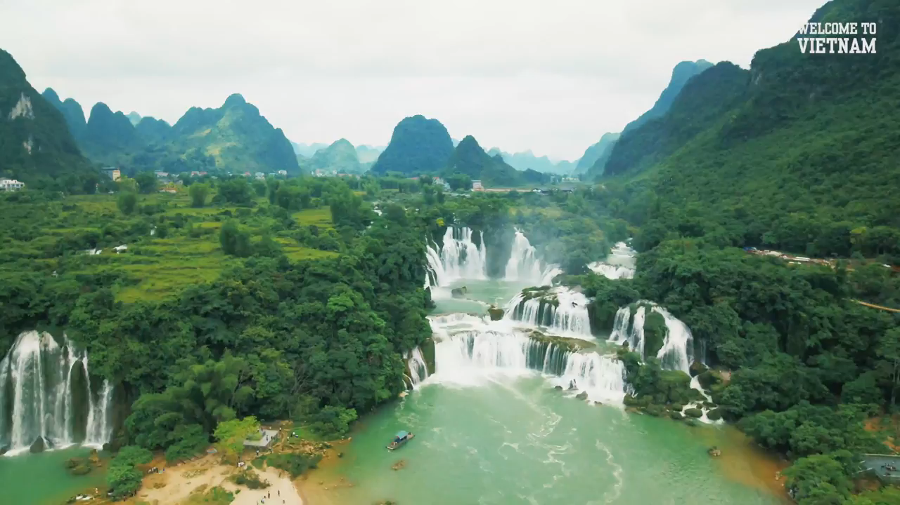
Watch and guess the topic.

Slide 2
Unit 5
Natural wonders of Vietnam
Lesson 1: Getting started

Slide 3
OBJECTIVES
By the end of the lesson, students will be able to:
□ have an overview of the topic: Natural wonders of Vietnam
□ Know more nouns for things in nature through pictures and listening exercise.

Slide 4

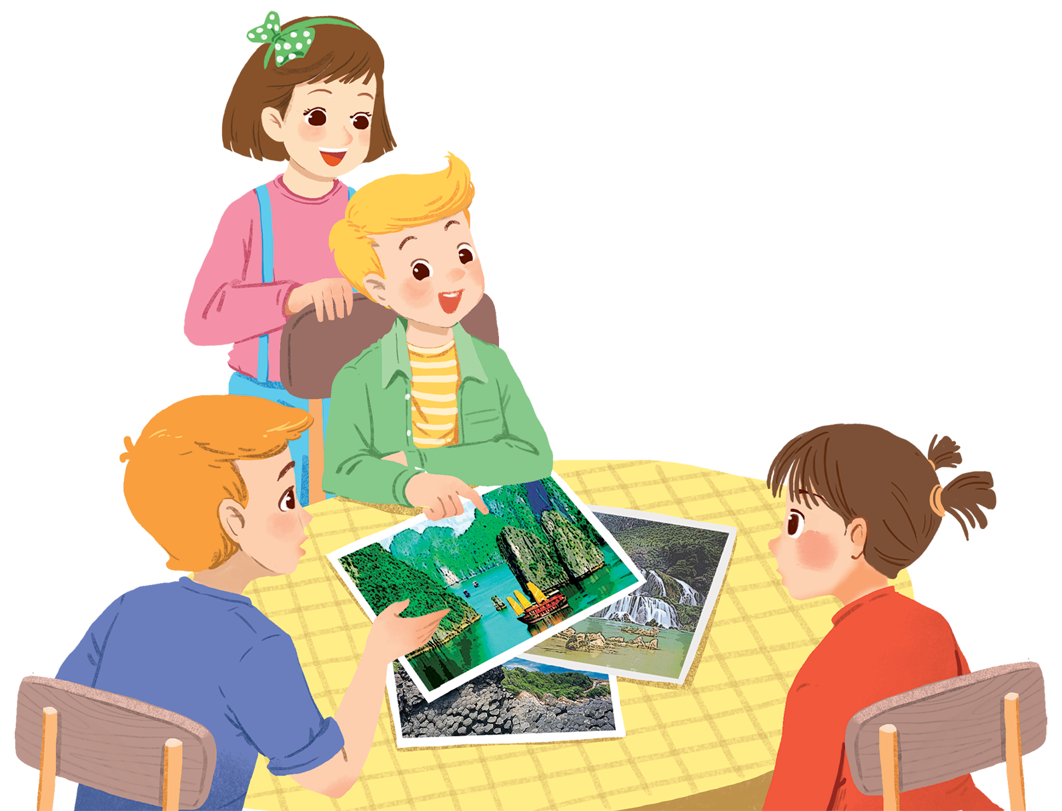

Look and guess.
Listen and check.
Alice
What club is it?
Nick
What are they talking about?
Tommy
Elena

Slide 5
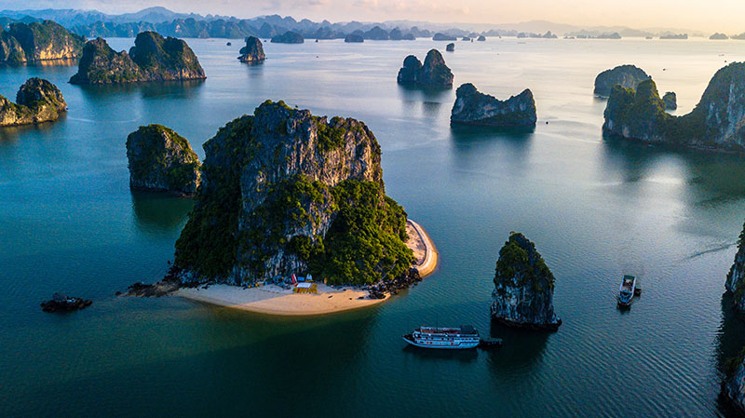
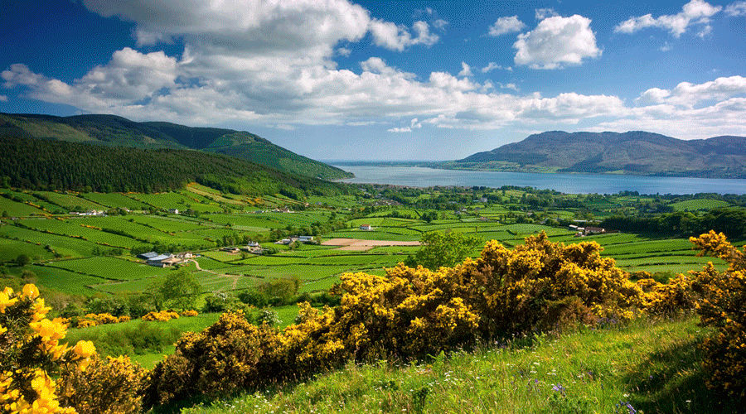
Ex2 (p.49) Complete the following sentences with the words from the box.
scenery natural wonders amazing islands
natural
natural not made by people
1. People didn't make Ganh Da Dia. They are _________ rocks.
2. Ha Long Bay has thousands of big and small _________.
3. The town is charming and the surrounding _________is wonderful.
4. It’s _________to visit Ban Gioc Waterfall in September.
5. There are many natural and man-made _________in Viet Nam.
islands
scenery
amazing
amazing very surprising
wonders

Slide 6


START
What’s behind the wall?
BRICKS DOWN
NATURAL WONDERS

Slide 7
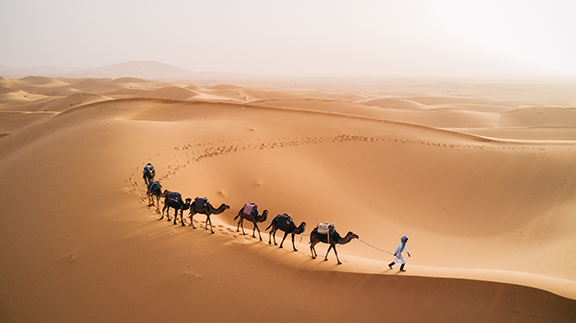
desert
NEXT
Click on the bricks
CHECK

Slide 8
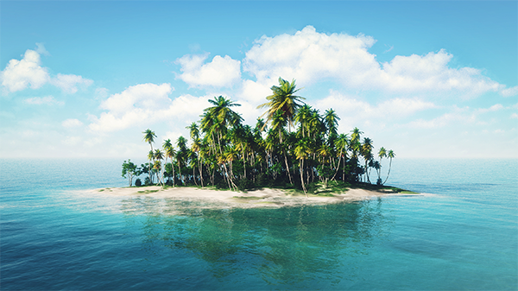
island
NEXT
Click on the bricks
CHECK

Slide 9
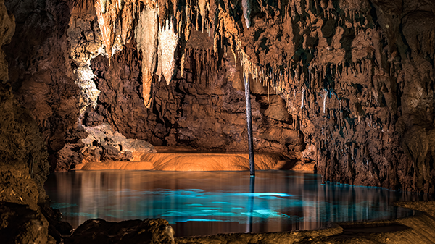
cave
NEXT
Click on the bricks
CHECK

Slide 10
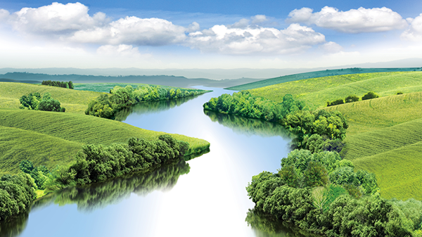
river
NEXT
Click on the bricks
CHECK

Slide 11
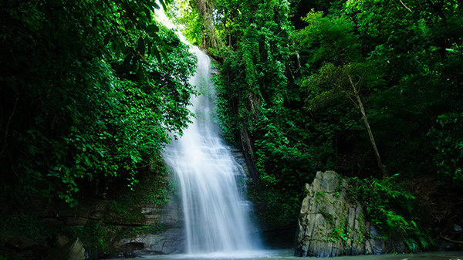
waterfall
NEXT
Click on the bricks
CHECK

Slide 12
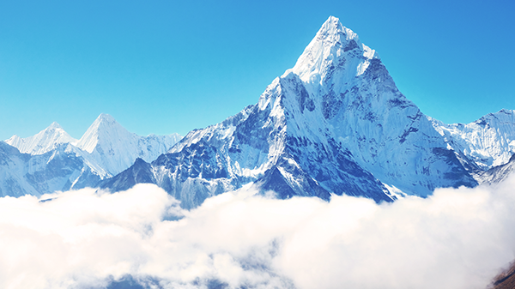
mountain
NEXT
Click on the bricks
CHECK

Slide 13
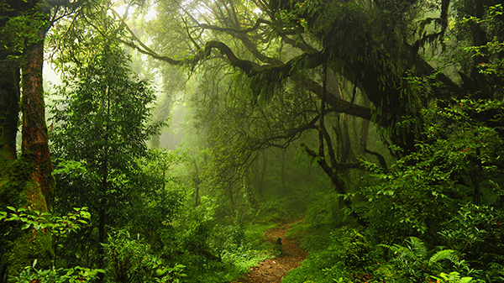
forest
NEXT
Click on the bricks
CHECK

Slide 14
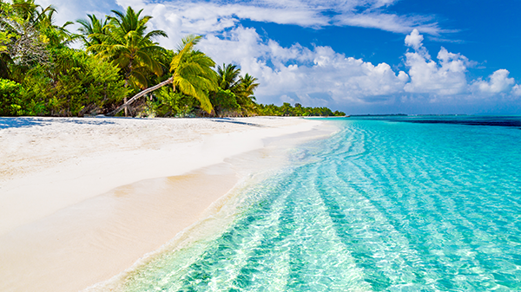
beach
NEXT
Click on the bricks
CHECK

Slide 15
1
2
3
4
desert
island
cave
river
5
6
7
8
waterfall
mountain
forest
beach

Slide 16

HOW WELL DO YOU KNOW?
1 min
Type the correct answer in the box chat
The fastest with 5 correct answers will get 1 bonus point.
1. Which is an island in Viet Nam?
A. Con Dao B. Son Doong
2. Where is Mount Fansipan?
A. In Lao Cai B. In Quang Binh
3. Which of the following is a national park?
A. Thong Nhat Park B. Cat Tien Park
4. Which of the following wonders is a cave?
A. Cuc Phuong B. Phong Nha
5. Which waterfall is in Cao Bang?
A. Giang Dien Waterfall B. Ban Gioc Waterfall

Slide 17
OBJECTIVES
By the end of the lesson, students will be able to:
☑ have an overview of the topic: Natural wonders of Vietnam
☑ Know more nouns for things in nature through pictures and listening exercise.

Slide 18
Thanks for your attention

Slide 19
Fonts & colors used
This presentation has been made using the following fonts:
McLaren
(https://fonts.google.com/specimen/McLaren)
Livvic
(https://fonts.google.com/specimen/Livvic)
#52b770
#4a975f
#3e4e41
#62d985
#a3f8bc
#ffffffff

