Slide 1
Lesson objectives
Main aim
By the end of the lesson, students will be able to:
Sub-aim
Have an overview of the unit topic: Tet holiday
Listen to a short dialogue for gist
Read a short dialogue for specific details

Slide 2
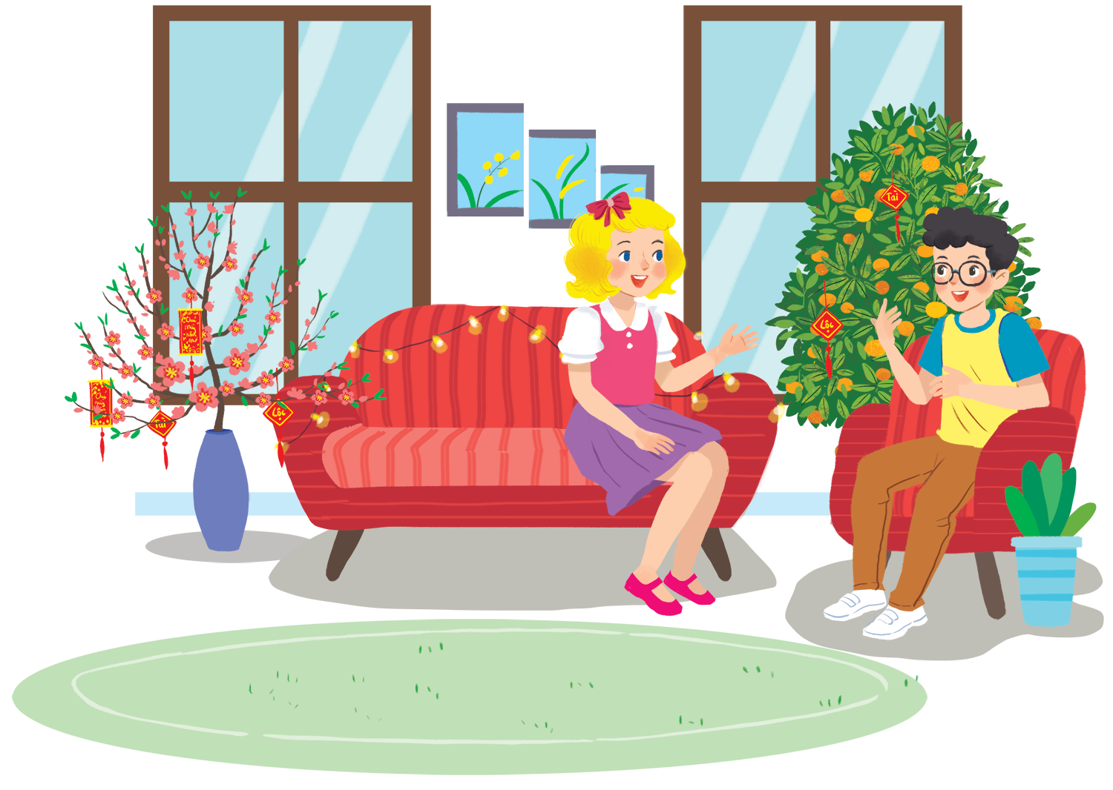
Look and answer
1. What kind of trees are in the room?
→ Peach blossom and kumquat tree
2. What are Linda and Phong talking about?
A. New Years in the world
B. Tet in Vietnam
C. What to eat and wear during Tet

Slide 3

Listen and check
Linda: Phong, does Viet Nam celebrate New Years?
Phong: Yes, we do. We have Tet.
What are Linda and Phong talking about?
A. New Years in the world
B. Tet in Vietnam
C. What to eat and wear during Tet

Slide 4
OUR TET HOLIDAY
LESSON 1: GETTING STARTED

Slide 5
Check your memory
Write the missing words in pairs
1. This year Tet is in _________.
2. We decorate our _________.
3. Tet is a time for family _________.
4. Children get _______ ________.
5. People shouldn’t ________ anything.

Slide 6
Silent read and check with your partner (Act 3 p.59)
Happy New Year!
Linda: Phong, does Viet Nam celebrate New Years?
Phong: Yes, we do. We have Tet.
Linda: When is Tet?
Phong: At different times. This year, it’s in January.
Linda: What do you do at Tet?
Phong: We clean our homes and decorate them with flowers.
Linda: Is Tet a time for family gatherings?
Phong: Yes. It’s a happy time for everybody.
Linda: Great. Phong: Yes, and another good thing about Tet is that children get lucky money.
Linda: That sounds interesting. Is there anything special people should do?
Phong: We should say "Happy New Year" when we meet people, and we shouldn't break anything.
Underline the keywords!

Slide 7
Swap your answers with another pair and mark them
Happy New Year!
Linda: Phong, does Viet Nam celebrate New Years?
Phong: Yes, we do. We have Tet.
Linda: When is Tet?
Phong: At different times. This year, it’s in January.
Linda: What do you do at Tet?
Phong: We clean our homes and decorate them with flowers.
Linda: Is Tet a time for family gatherings?
Phong: Yes. It’s a happy time for everybody.
Linda: Great. Phong: Yes, and another good thing about Tet is that children get lucky money.
Linda: That sounds interesting. Is there anything special people should do?
Phong: We should say "Happy New Year" when we meet people, and we shouldn't break anything.
1. This year Tet is
in _________.
January

Slide 8
Marking time
Happy New Year!
Linda: Phong, does Viet Nam celebrate New Years?
Phong: Yes, we do. We have Tet.
Linda: When is Tet?
Phong: At different times. This year, it’s in January.
Linda: What do you do at Tet?
Phong: We clean our homes and decorate them with flowers.
Linda: Is Tet a time for family gatherings?
Phong: Yes. It’s a happy time for everybody.
Linda: Great. Phong: Yes, and another good thing about Tet is that children get lucky money.
Linda: That sounds interesting. Is there anything special people should do?
Phong: We should say "Happy New Year" when we meet people, and we shouldn't break anything.
2. We decorate
our _________.
homes

Slide 9
Marking time
Happy New Year!
Linda: Phong, does Viet Nam celebrate New Years?
Phong: Yes, we do. We have Tet.
Linda: When is Tet?
Phong: At different times. This year, it’s in January.
Linda: What do you do at Tet?
Phong: We clean our homes and decorate them with flowers.
Linda: Is Tet a time for family gatherings?
Phong: Yes. It’s a happy time for everybody.
Linda: Great. Phong: Yes, and another good thing about Tet is that children get lucky money.
Linda: That sounds interesting. Is there anything special people should do?
Phong: We should say "Happy New Year" when we meet people, and we shouldn't break anything.
3. Tet is a time for family __________.
gatherings

Slide 10
Marking time
Happy New Year!
Linda: Phong, does Viet Nam celebrate New Years?
Phong: Yes, we do. We have Tet.
Linda: When is Tet?
Phong: At different times. This year, it’s in January.
Linda: What do you do at Tet?
Phong: We clean our homes and decorate them with flowers.
Linda: Is Tet a time for family gatherings?
Phong: Yes. It’s a happy time for everybody.
Linda: Great. Phong: Yes, and another good thing about Tet is that children get lucky money.
Linda: That sounds interesting. Is there anything special people should do?
Phong: We should say "Happy New Year" when we meet people, and we shouldn't break anything.
4. Children get
_______ ________.
lucky money

Slide 11
Marking time
Happy New Year!
Linda: Phong, does Viet Nam celebrate New Years?
Phong: Yes, we do. We have Tet.
Linda: When is Tet?
Phong: At different times. This year, it’s in January.
Linda: What do you do at Tet?
Phong: We clean our homes and decorate them with flowers.
Linda: Is Tet a time for family gatherings?
Phong: Yes. It’s a happy time for everybody.
Linda: Great. Phong: Yes, and another good thing about Tet is that children get lucky money.
Linda: That sounds interesting. Is there anything special people should do?
Phong: We should say "Happy New Year" when we meet people, and we shouldn't break anything.
5. People shouldn’t ________ anything.
break

Slide 12
Return the answers
Key:
1. This year Tet is in _________.
2. We decorate our _________.
3. Tet is a time for family _________.
4. Children get _______ ________.
5. People shouldn’t ________ anything.
January
homes
gatherings
lucky money
break
Notes:
=> Next: That’s what Phong knows about Tet. What about you?

Slide 13
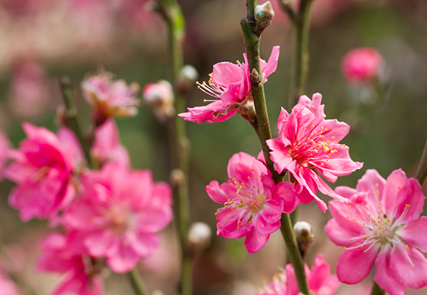
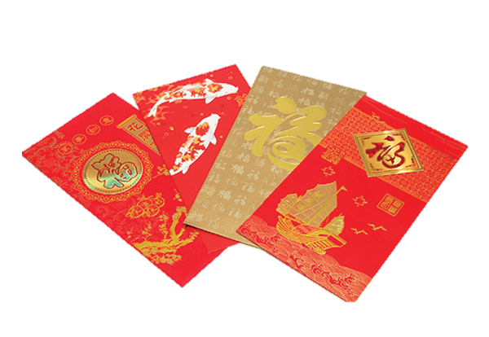
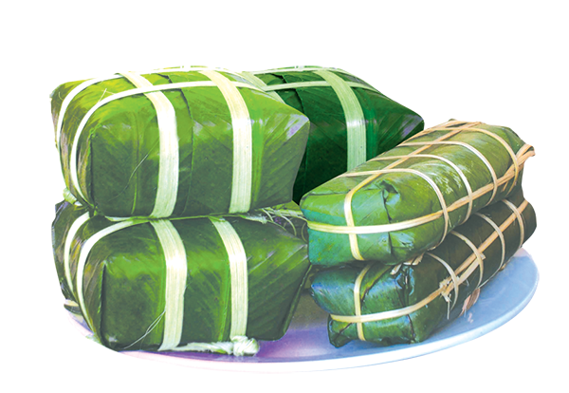
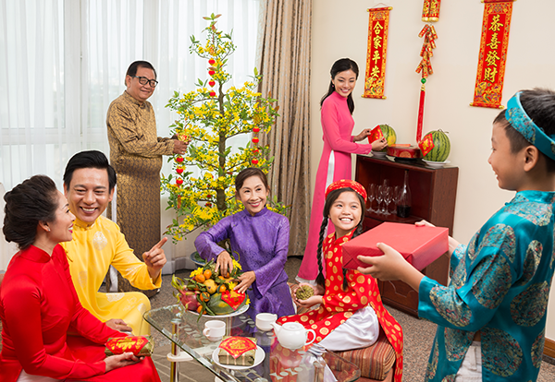
Look and say the words

Slide 14
Look and match (Act 4 p.59)
a. lucky money
b. peach flower
c. banh chung and banh tet
d. family gathering
Notes:
Chung cake/Tet Cake

Slide 15

Do you know more words about Tet?
Let’s work in groups of 6 and write as many words about Tet as you can!

Slide 16

Step 1: Write words about Tet with your group

Slide 17
Step 2: Post your group’s paper around the class
(1 min)

Slide 18


Step 3: Go around the class and check their answers
(5 mins)

Slide 19
What have we learned today?

