Slide 1
UNIT 9:
Cities of the world
LESSON 2: A CLOSER LOOK 1

Slide 2

Stop the bus!
Work in groups of 3
Think of one item for each category beginning with the set letter.
The first team to finish shouts 'Stop the Bus!'.
Letter | Continent | Country | Capital/ City
A
Africa
Australia
Amsterdam
E
Europe
England
Edinburgh
N
North America
Norway
New Delhi
S
South America
Spain
Stockholm

Slide 3
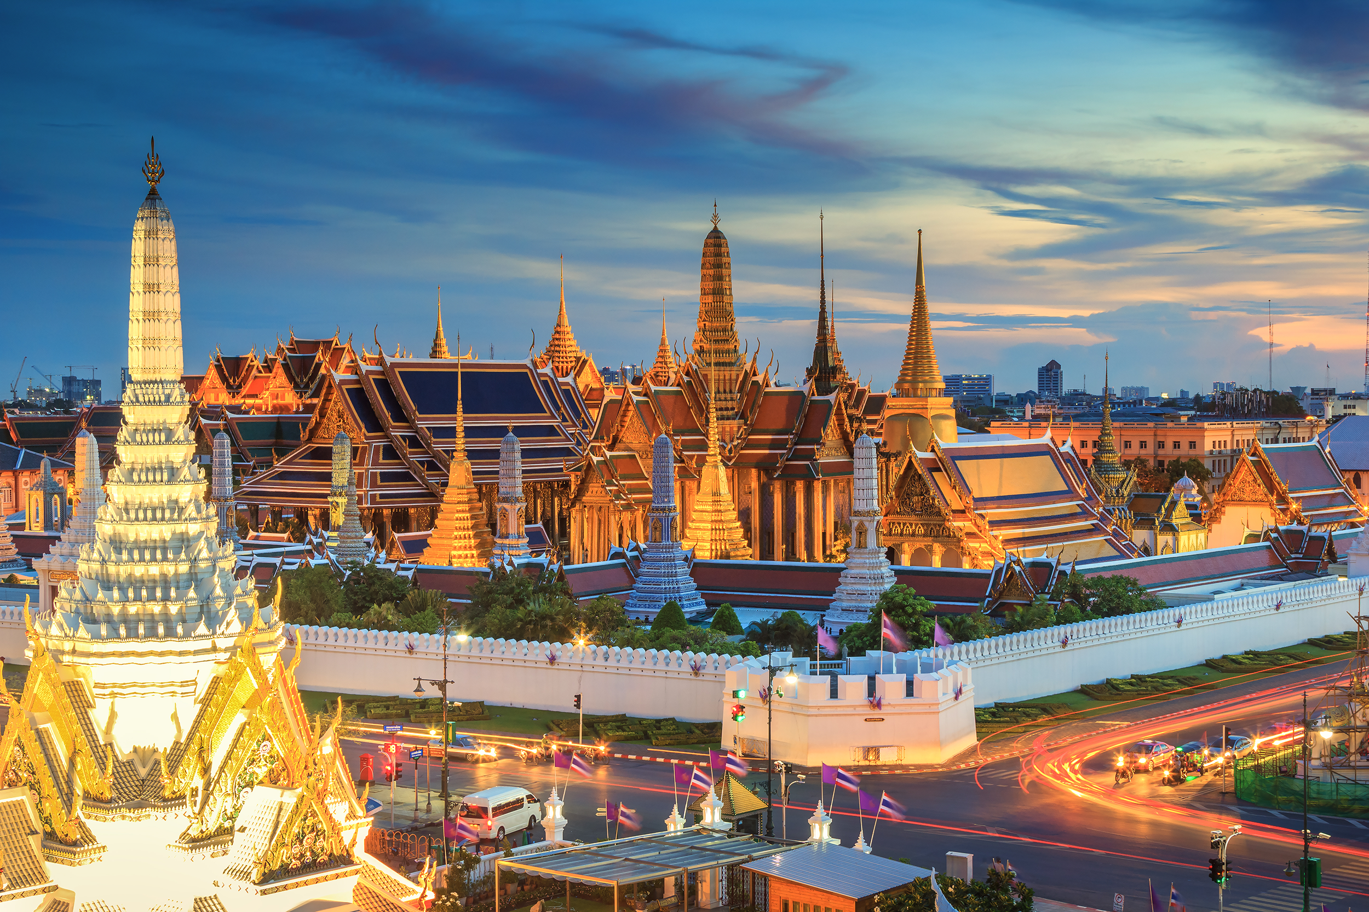
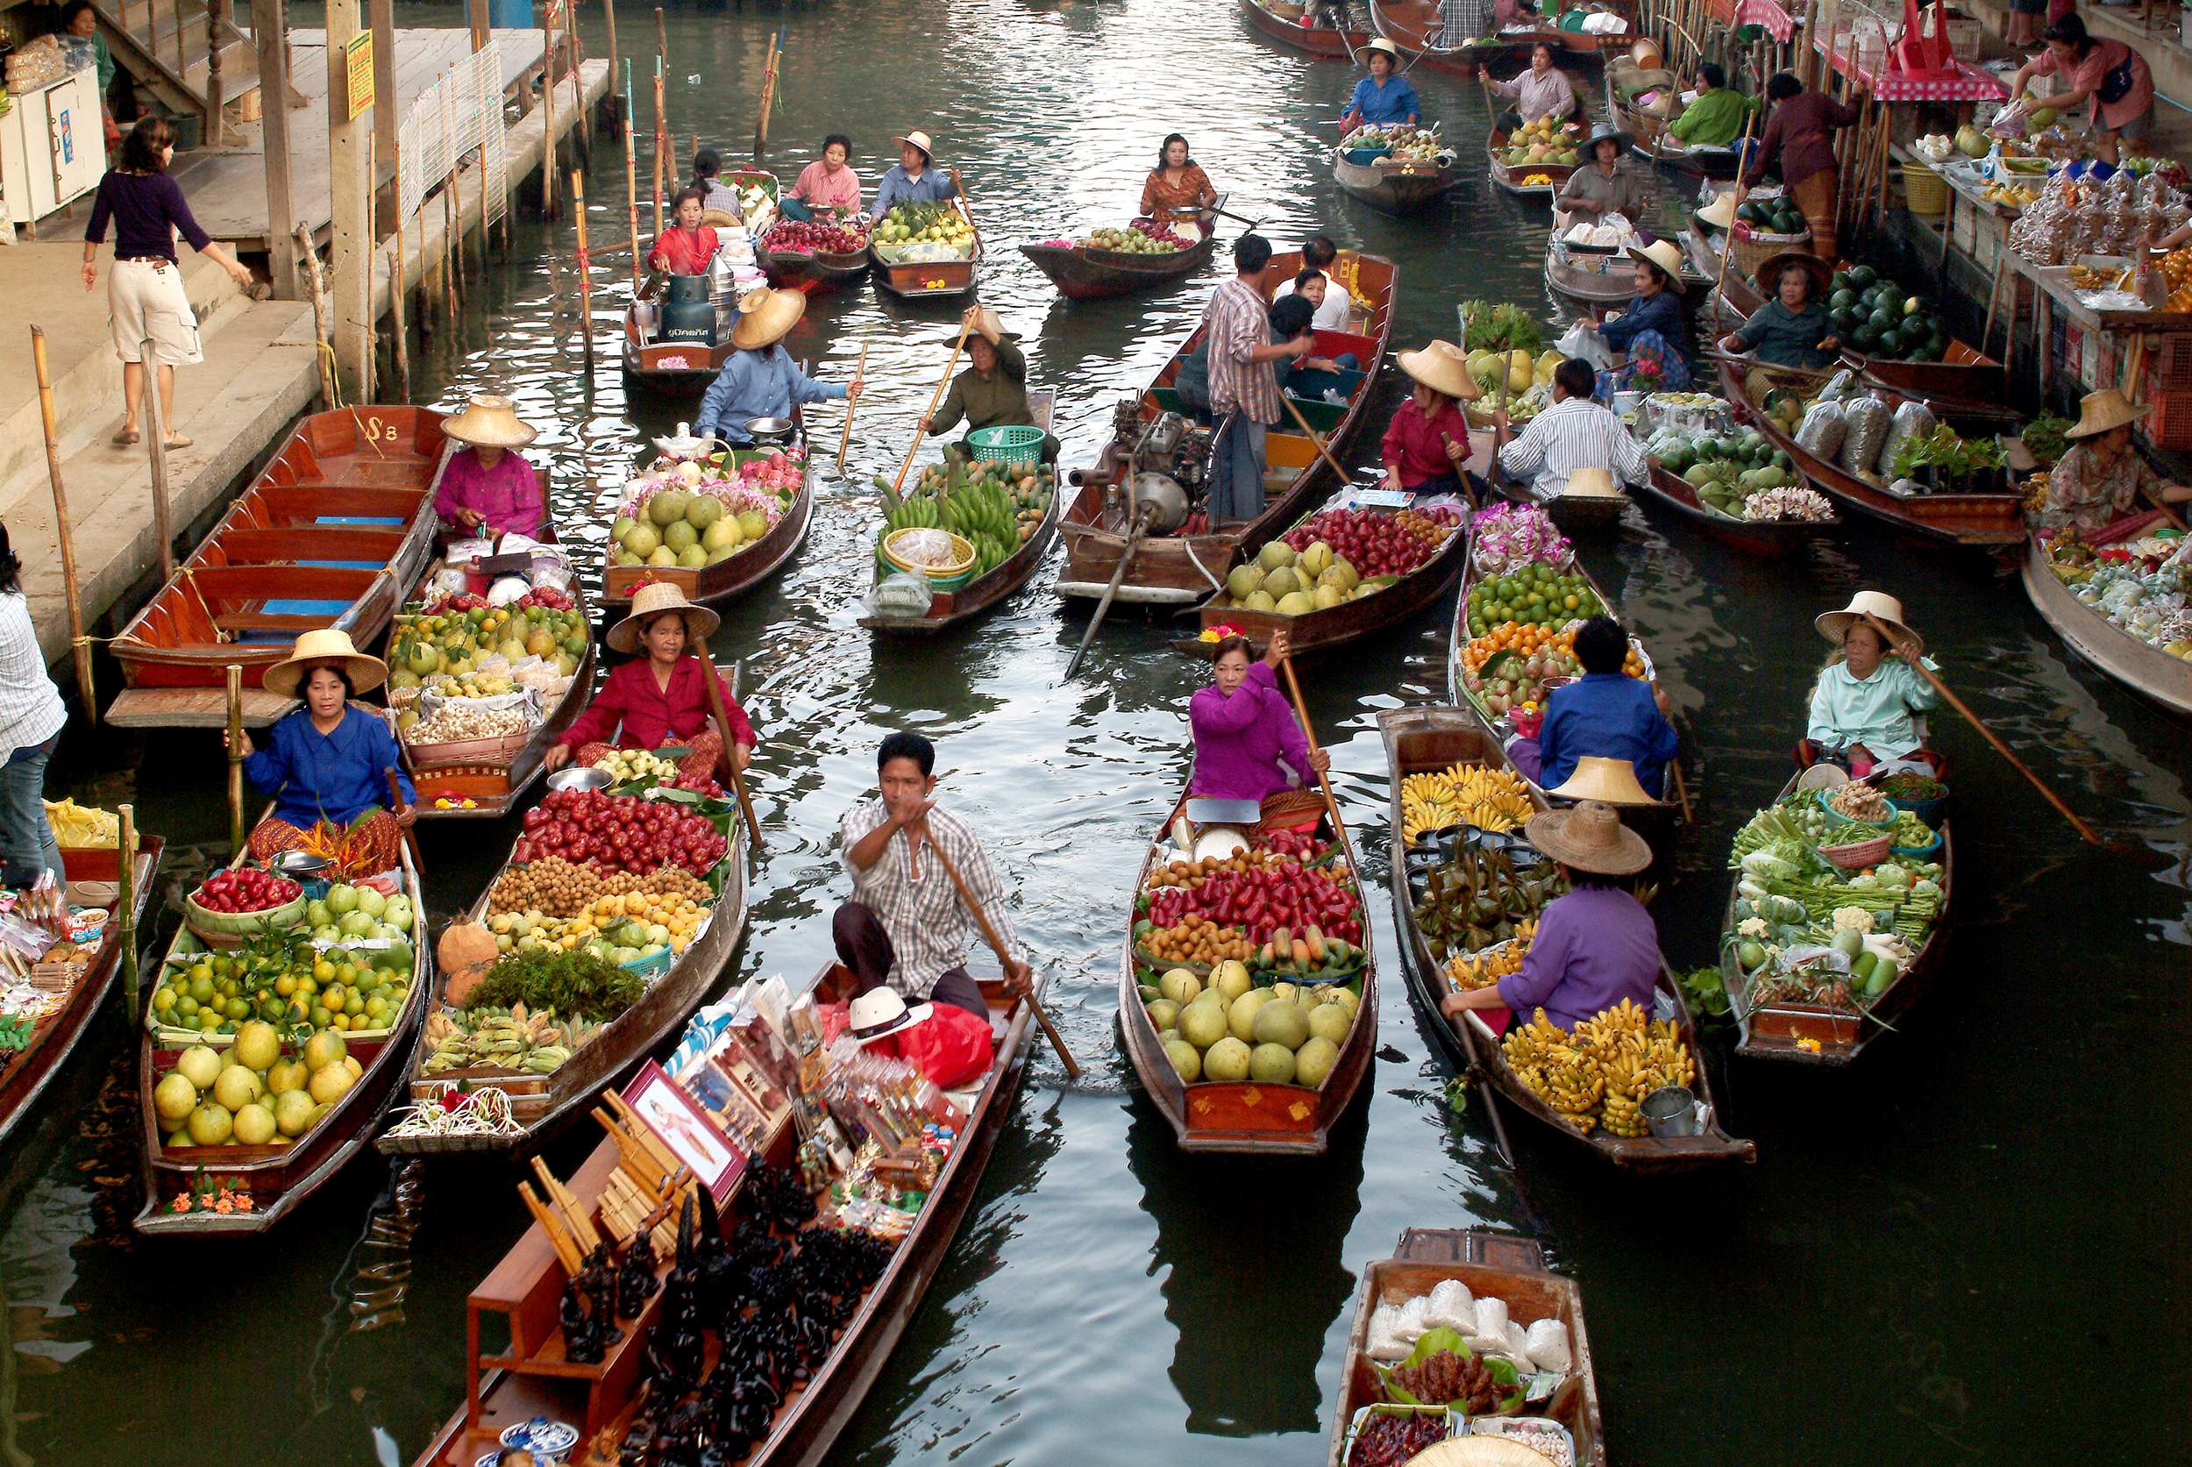
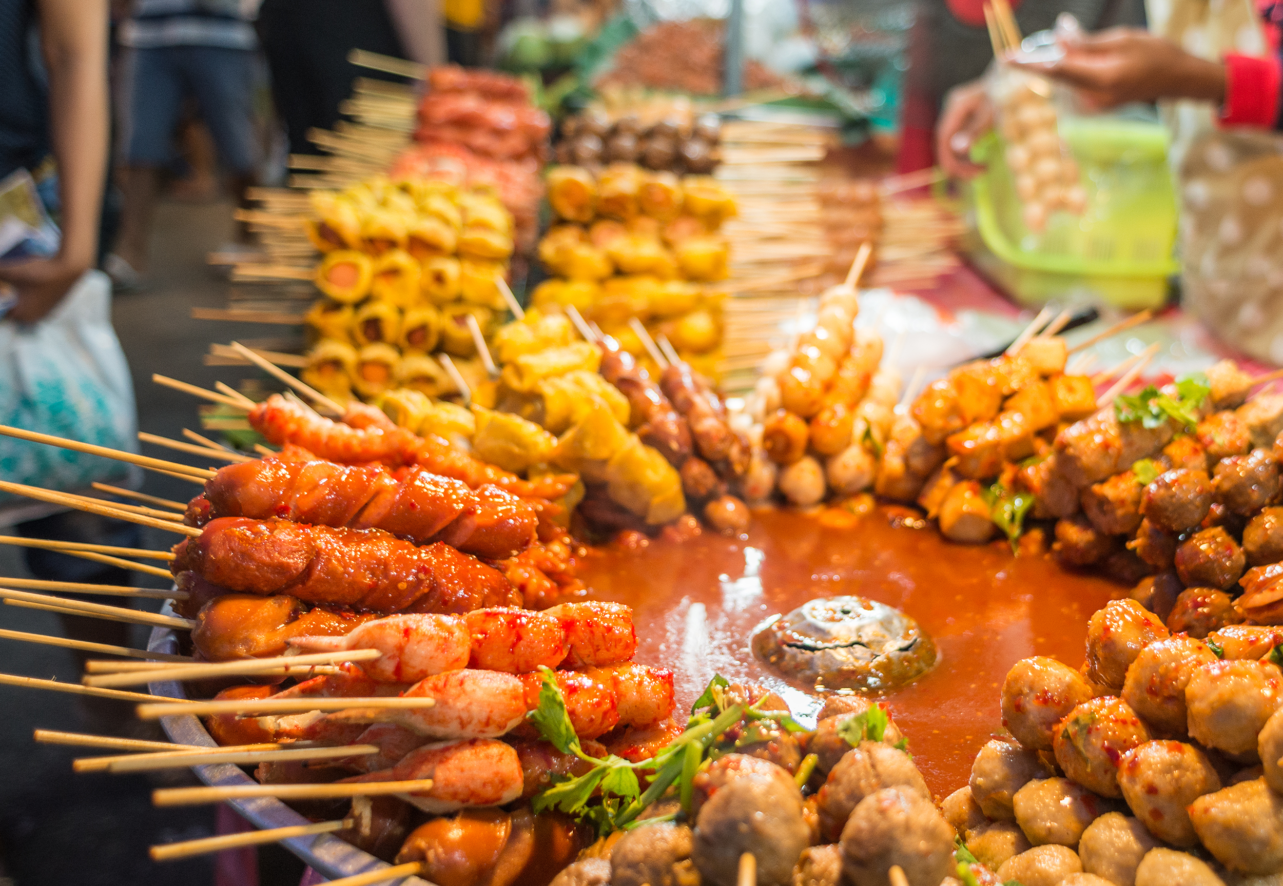
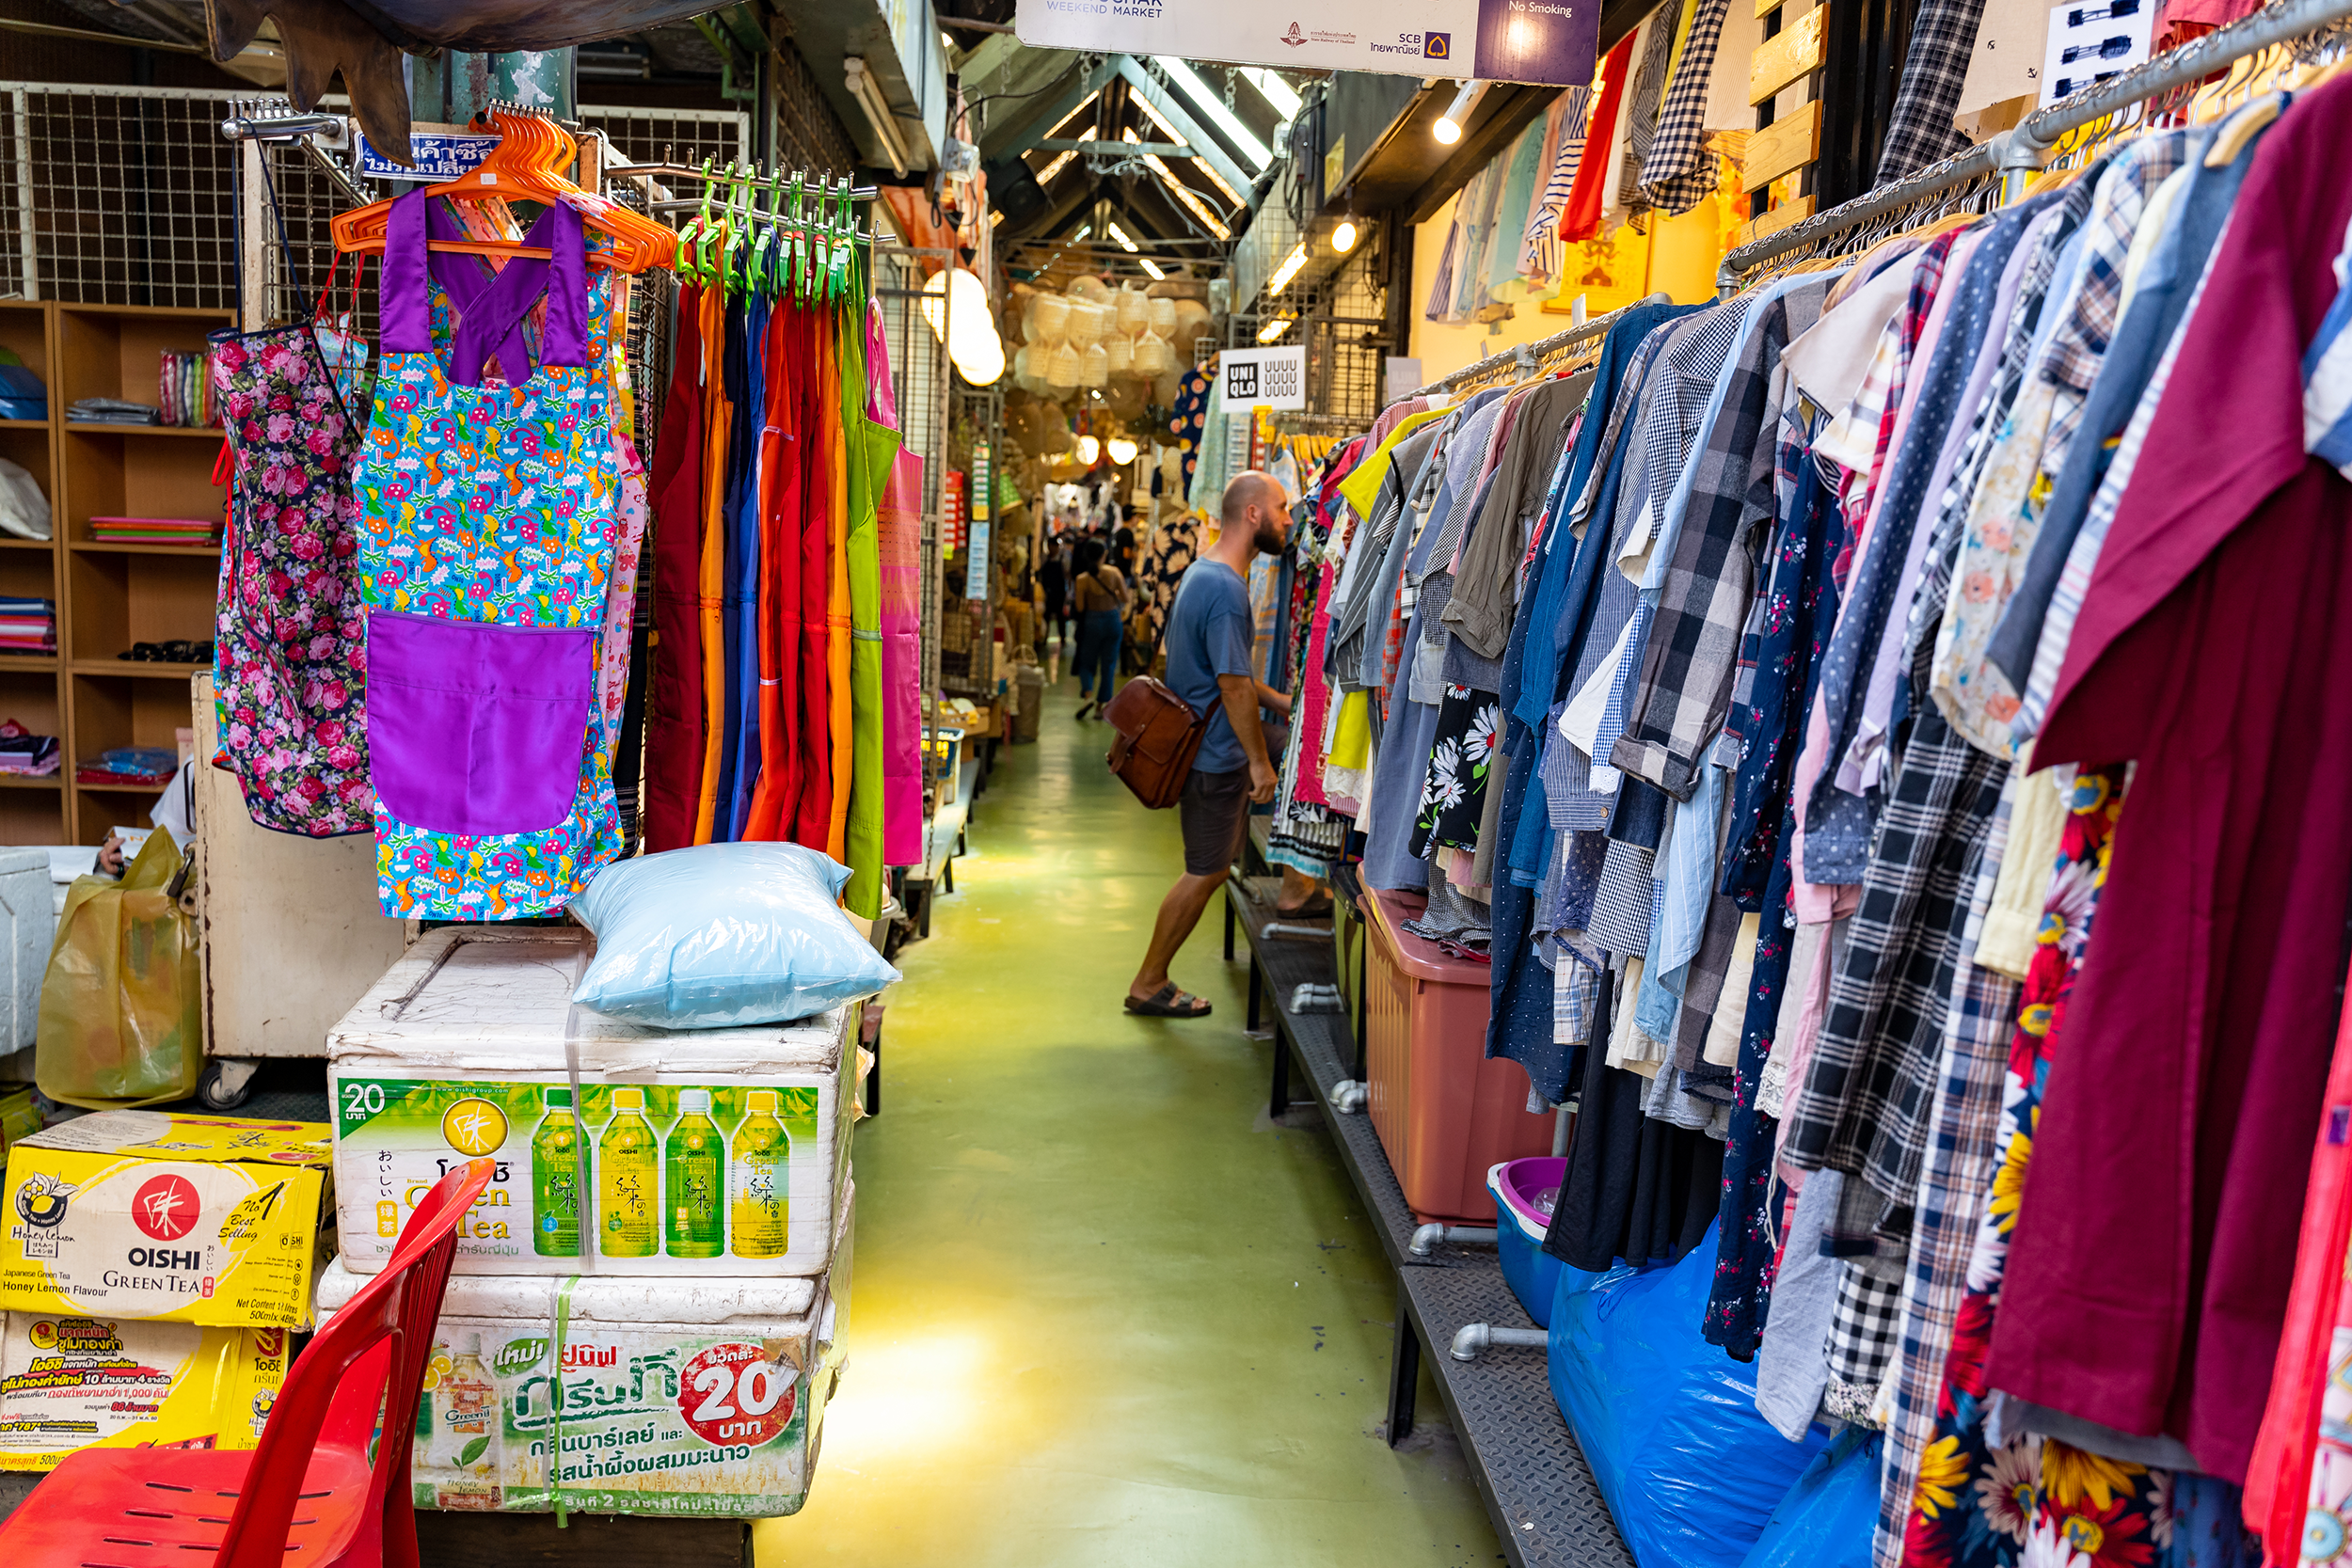
Ex 3: Write the words/ phrases below under the correct pictures. (p.28)
1
2
stall
palace
street food
palace
floating market
3
4
floating market
How can you describe these places?
street food
stall

Slide 4
Ex 1: Fill each box with an adjective. (p.28)
Vocabulary
old
exciting
City
rainy
old
delicious
Food
tasty
delicious
friendly
friendly
People
helpful
exciting
sunny
tasty
rainy
Weather
sunny
helpful

Slide 5
Ex 2: Complete the sentences with the words in 1.
1. – What's the weather like in Sydney in summer?
– It’s ___________ and dry.
2. I love the ___________ buildings in Edinburgh. I feel that they can tell stories.
3. There are so many things to do in New York. It's very ___________.
4. The people in my city are ___________ and helpful.
5. Ha Noi is famous for its ___________ street food.
old
City
exciting
sunny
old
Food
delicious
tasty
friendly
People
helpful
exciting
friendly
rainy
Weather
sunny
tasty
delicious

Slide 6
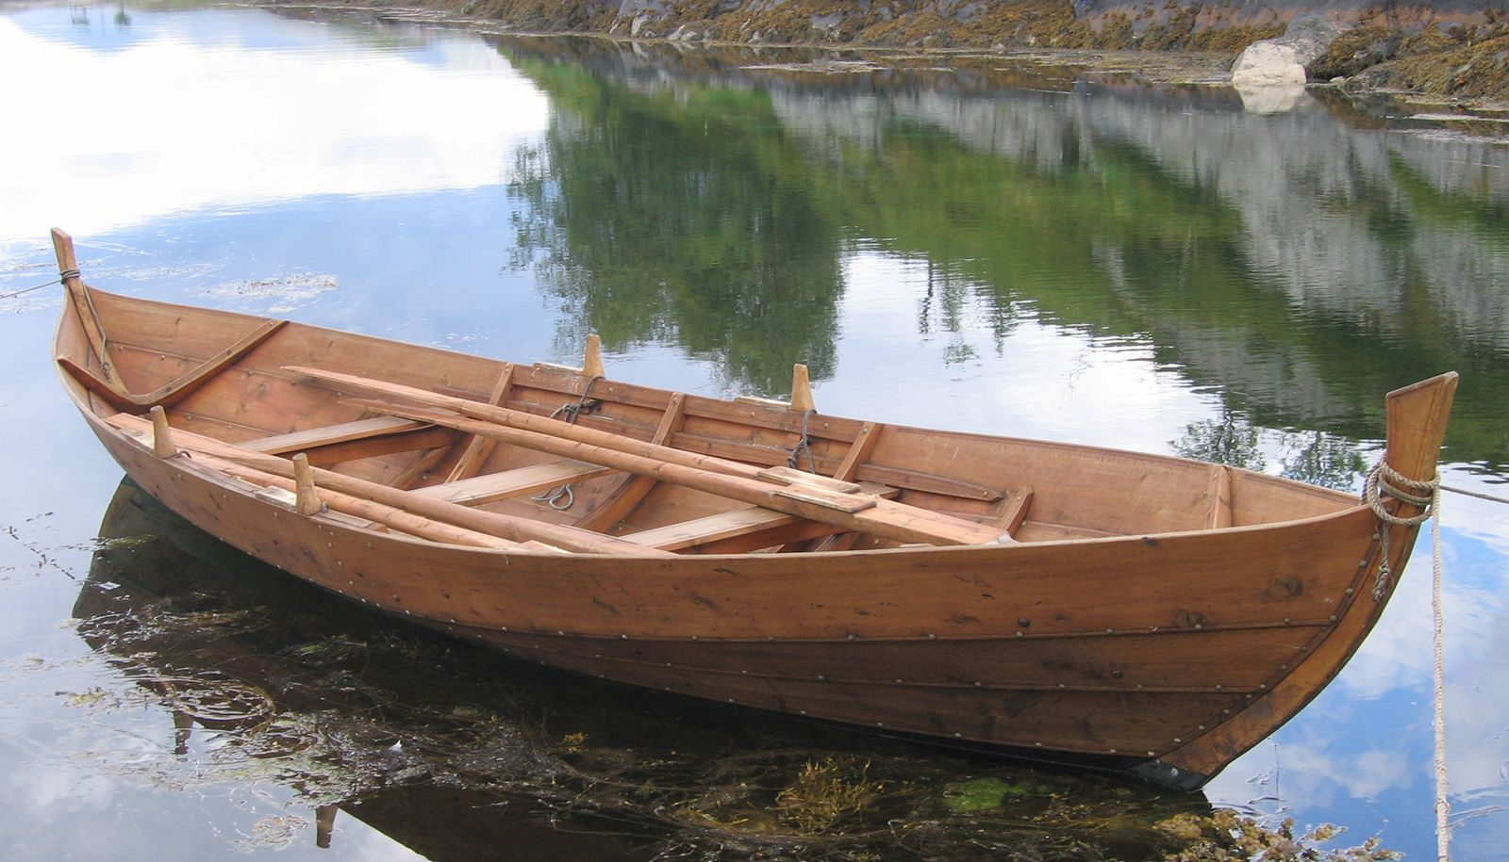


Can you guess the words?
Listen and guess the sounds
boat
house
/bəʊt/
/haʊs/

Slide 7
PRONUNCIATION
/əʊ/ and /aʊ/

Slide 8
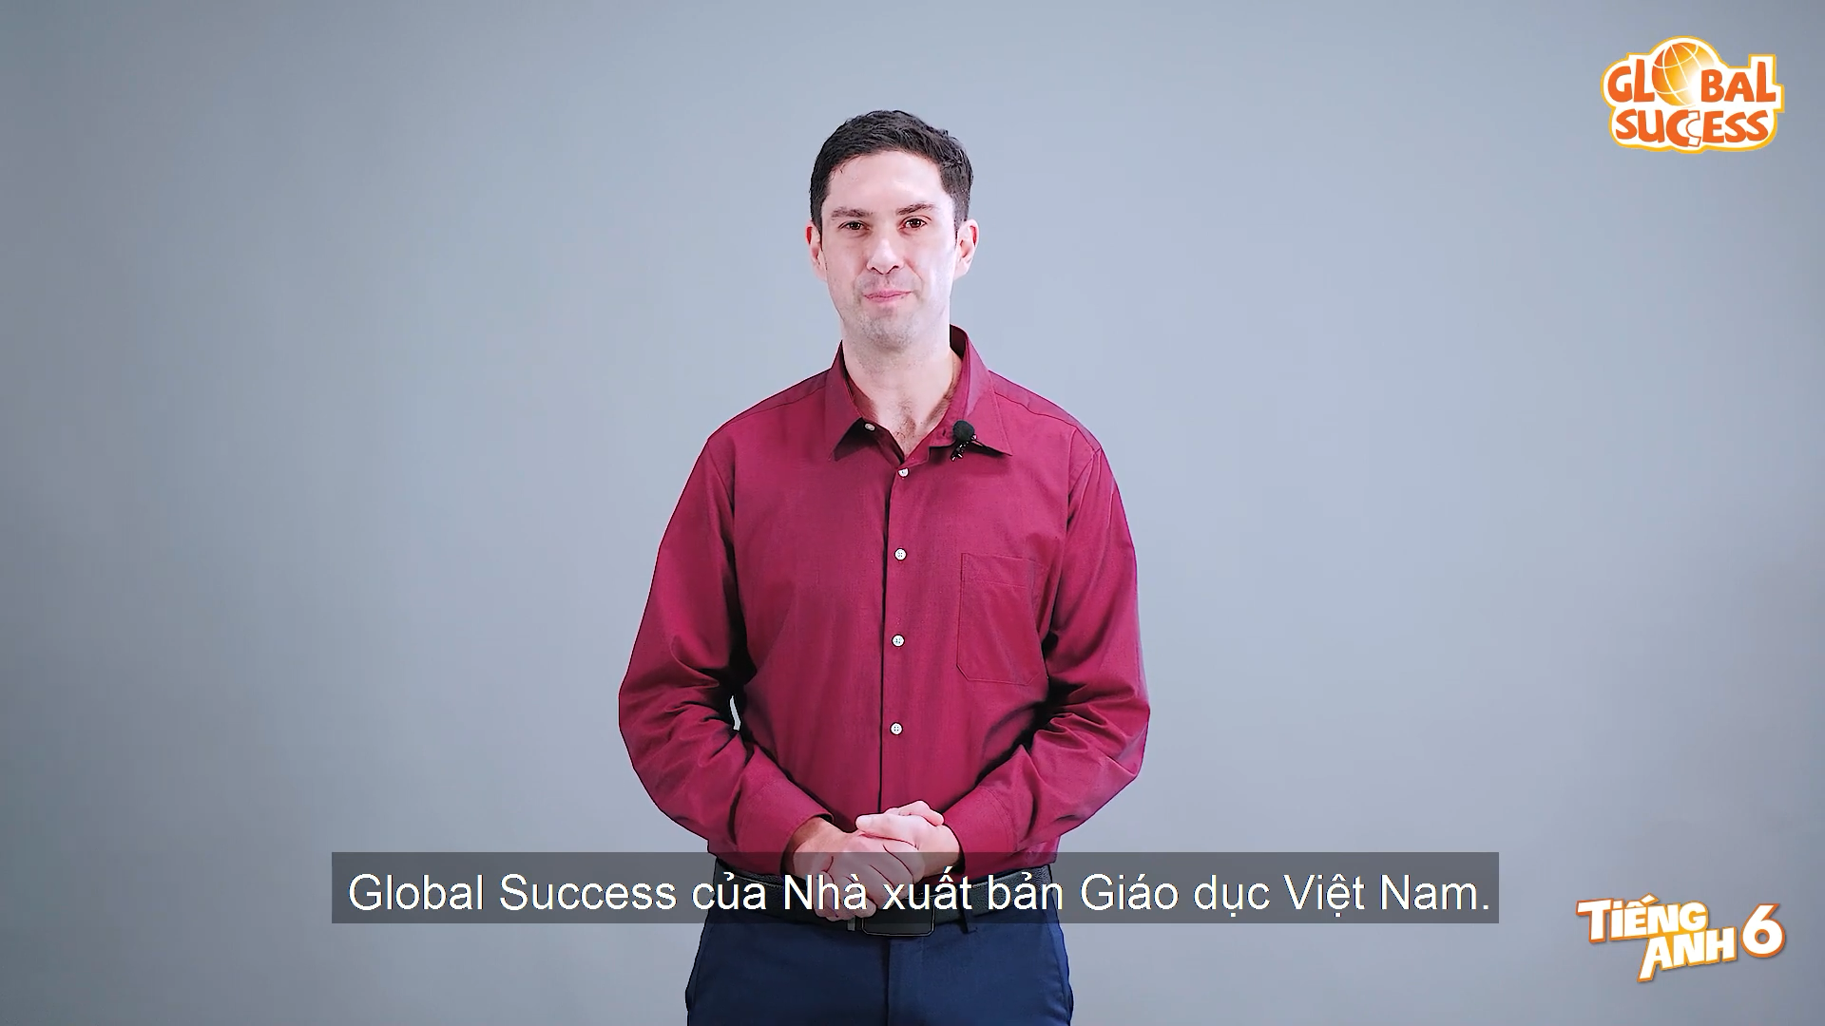
/əʊ/ and /aʊ/
Watch and pay attention to two sounds

Slide 9


/əʊ/ and /aʊ/

Slide 10
Ex 4: Listen and write the words in the correct column.
Then listen and repeat. (P.28)
boat
house
town
tower
postcard
crowded
coast
pagoda
/əʊ/
/aʊ/
boat
house
postcard
crowded
coast
town
pagoda
tower

Slide 11
Ex. 5: Listen and repeat. Pay attention to the underlined words.
1. The town is crowded at the weekend.
2. There's lots of snow in Tokyo in winter.
3. It's very cold on the boat.
4. He's running around the house.
/aʊ/
/aʊ/
/əʊ/
/əʊ/
/əʊ/
/əʊ/
/aʊ/
/aʊ/

Slide 12
TONGUE TWISTER!
Try to pronounce quickly!
Clowns around town never frown even when
they're down. Want to be a clown around town?
Then never sound down and never frown.

Slide 13
TONGUE TWISTER!
Try to pronounce quickly!
If a big old toad jumps on the boat as we row across the moat, the boat won't float.
So don't row close to the big old toads as you row across the moat, and the boat will float.

Slide 14
THANKS!
Please keep this slide for attribution

