Slide 1

GUESS THE EMOJI

Slide 2
Unit 9
Cities around the world
Lesson 4 | Communication

Slide 3

Objectives
After this lesson, students will be able to:
01
recognize exclamation with What
02
practice making exclamations with What

Slide 4

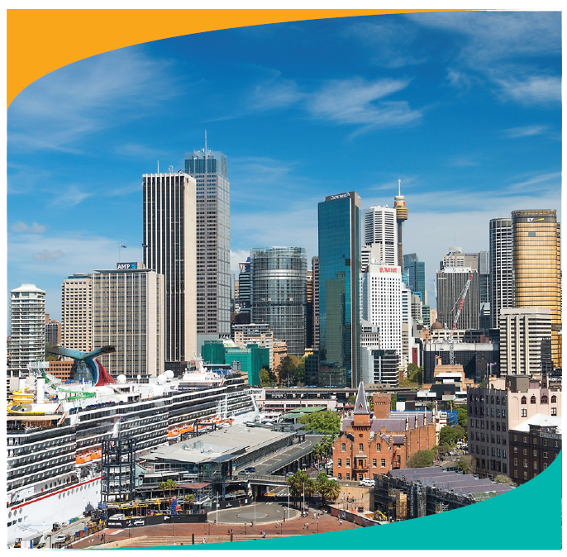
Ex 1 (pg. 30) Listen and write
What a nice city!
1
What a clear sky!
2
3
What tall buildings!

Slide 5
Exclamation
What a nice city!
What + a/an + adjective + noun!
What a clear sky!
What tall buildings!
What + adjective + plural noun!

Slide 6
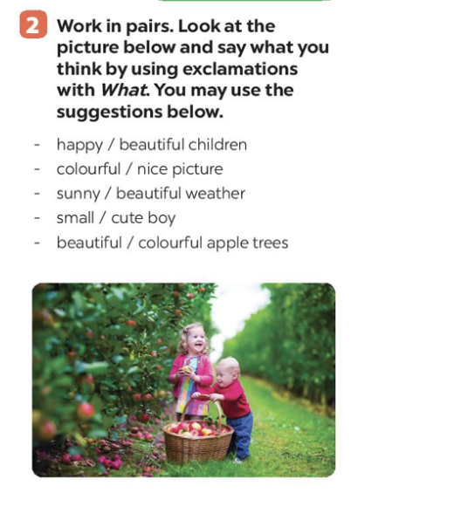
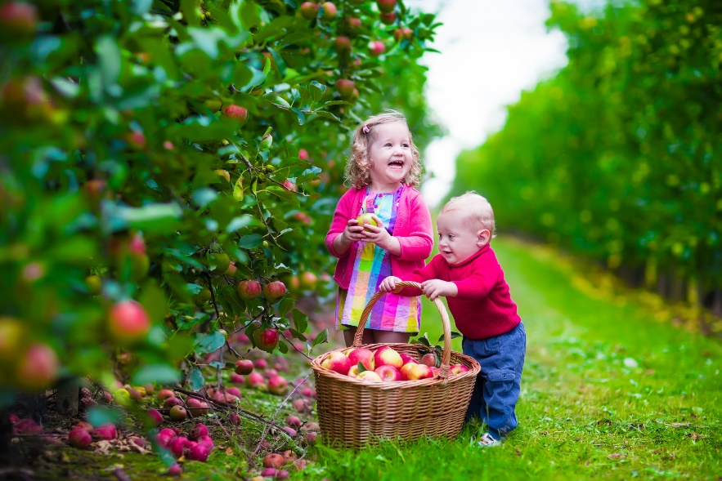
Ex 2 (pg 30). Work in pairs. Look at the picture below and say what you think by using exclaimations with What.
Example:
happy/children
What happy children!
1
2
3
0

Slide 7

GAME: Pass the mic!
- Teacher passes the mic randomly.
- Students make a sentence using What
happy / beautiful children
colourful / nice picture
sunny / beautiful weather
small / cute boy
beautiful / colourful apple trees

Slide 8

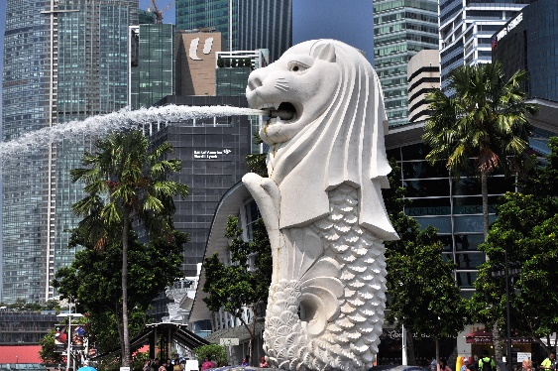
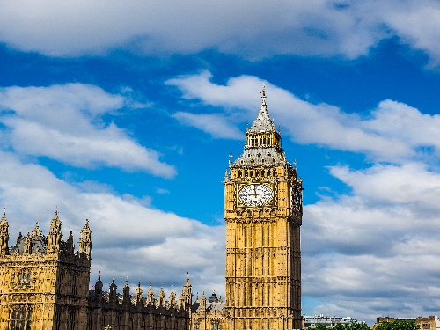
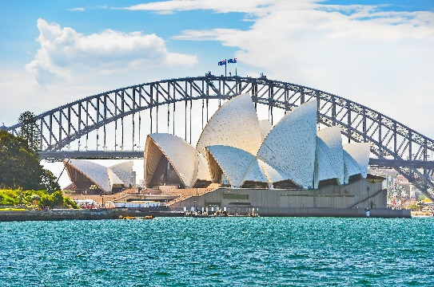
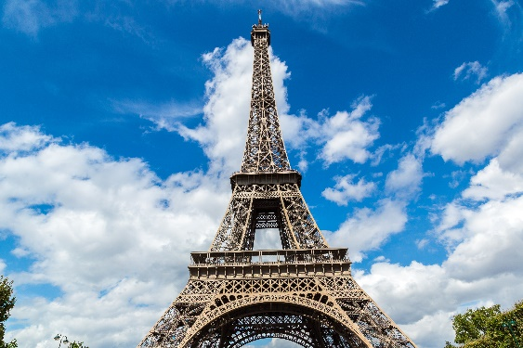
(pg. 31) Match the pictures with their names
1. Eiffel tower
2. Big Ben
4. Merlion
2. Big Ben
3. Sydney opera house
LANDMARKS
4. Merlion
3. Sydney opera house
1. Eiffel tower

Slide 9



Pick a box
Answer the question
Get a random prize below
The winning team has the most points
100
Blow friend’s point
Swap point
Your point

Slide 10

PICK A BOX
1
2
3
2
A
1
3
2
B

Slide 11
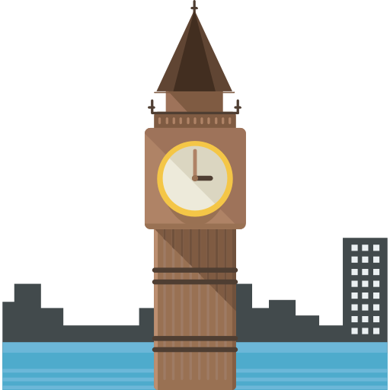
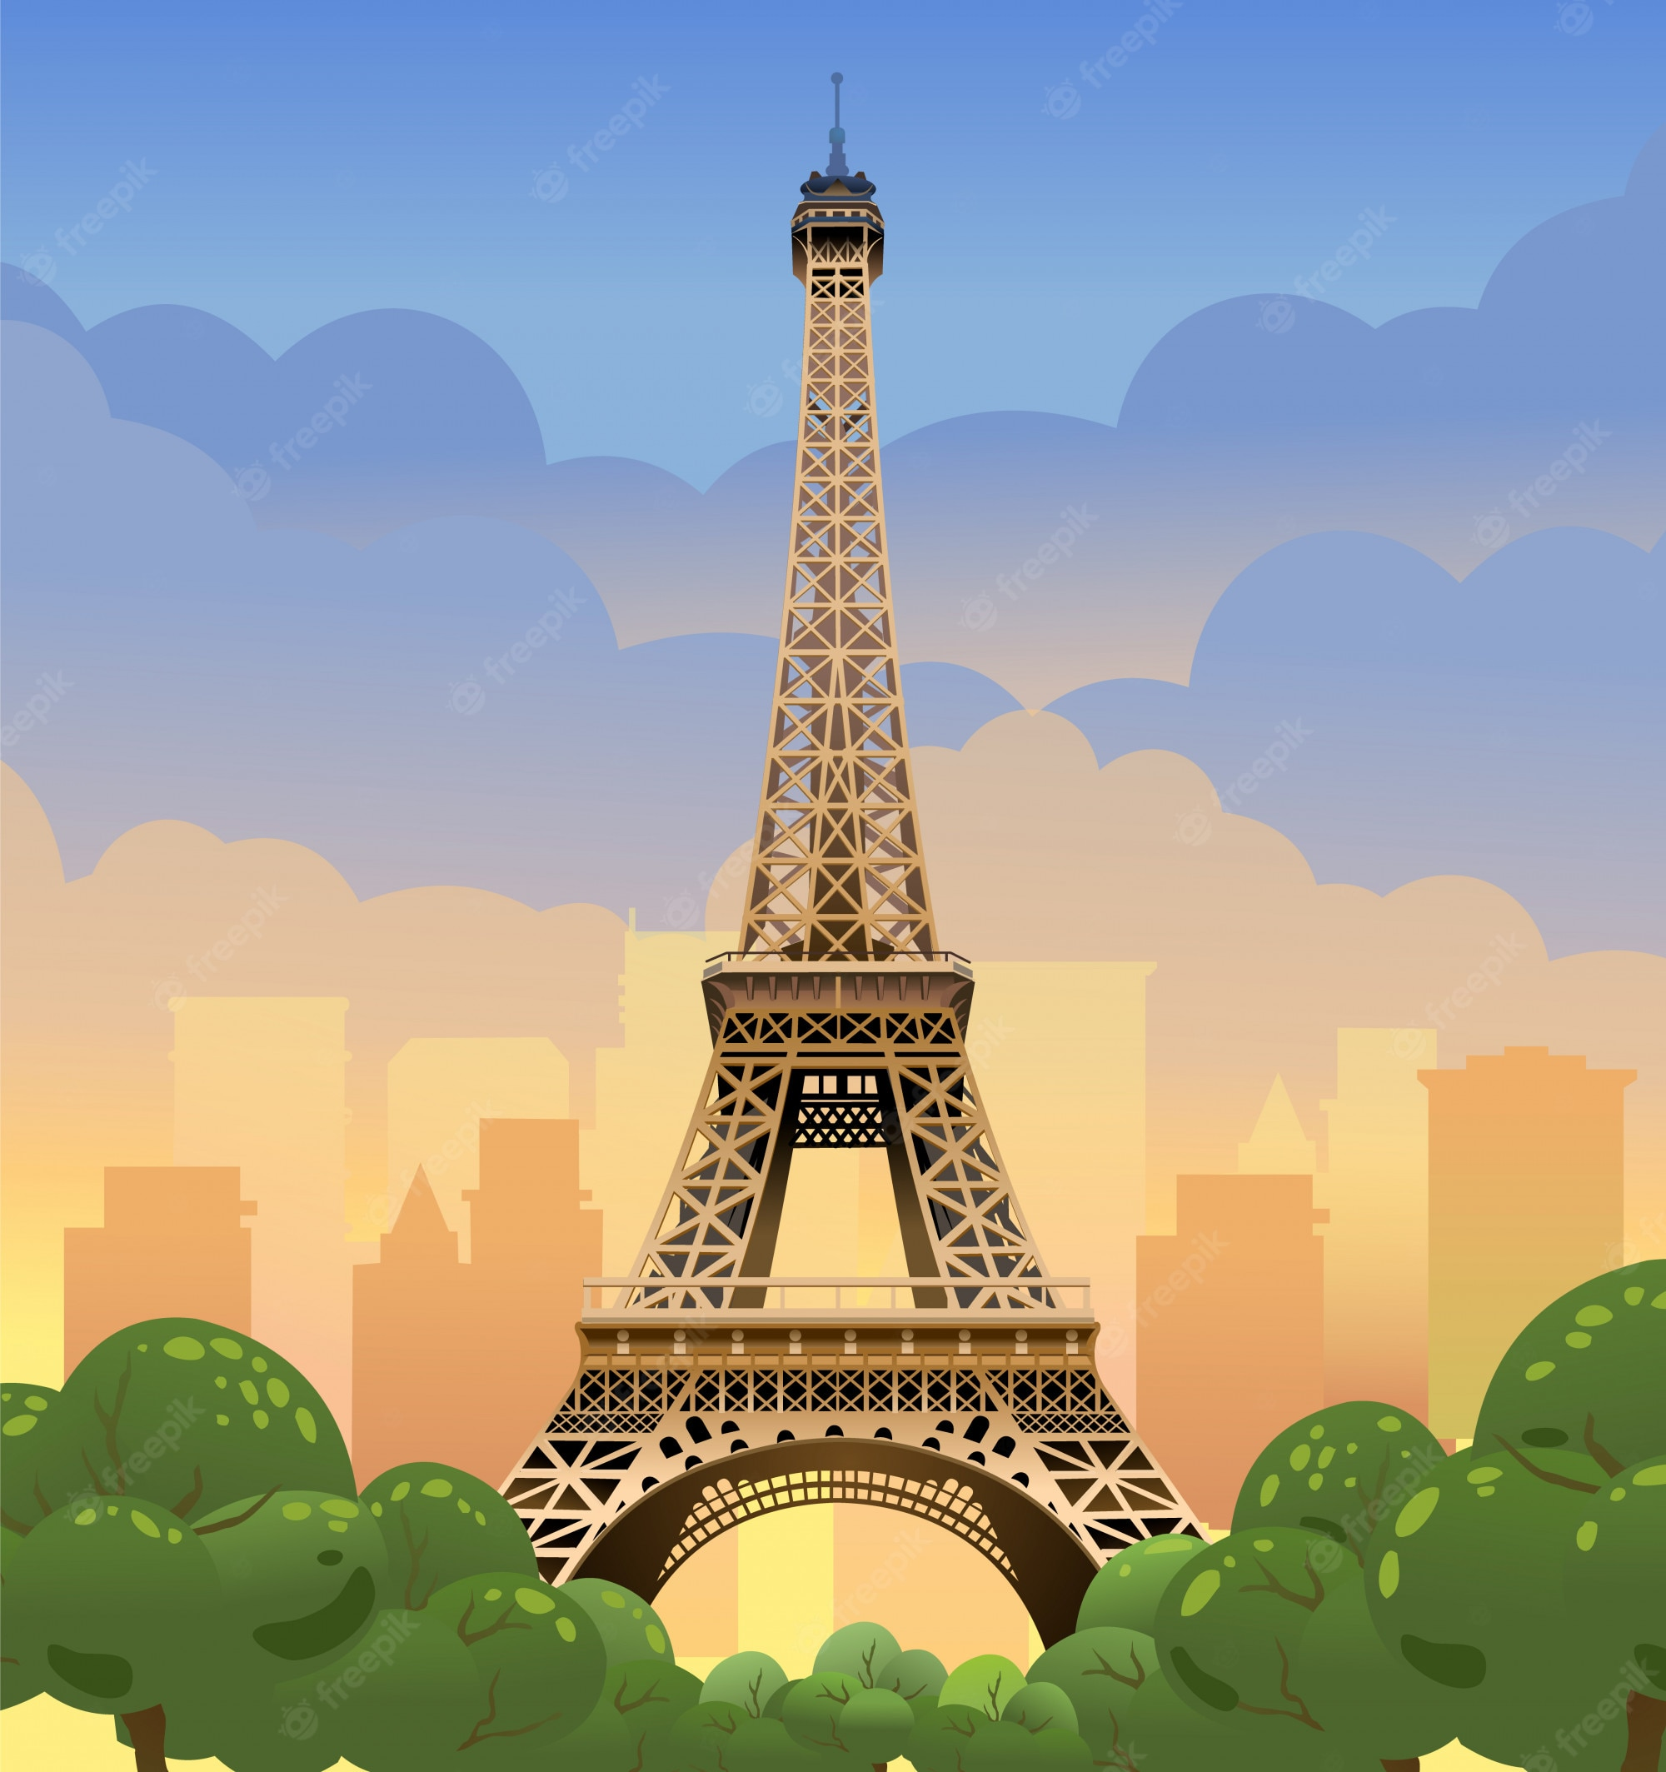

Where is it?
This tower is on the bank of the River Thames in London. In the tower, there's a big clock and a bell.
Big Ben

Slide 12
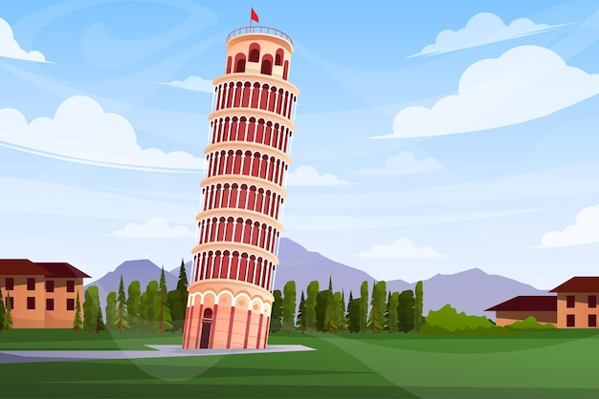
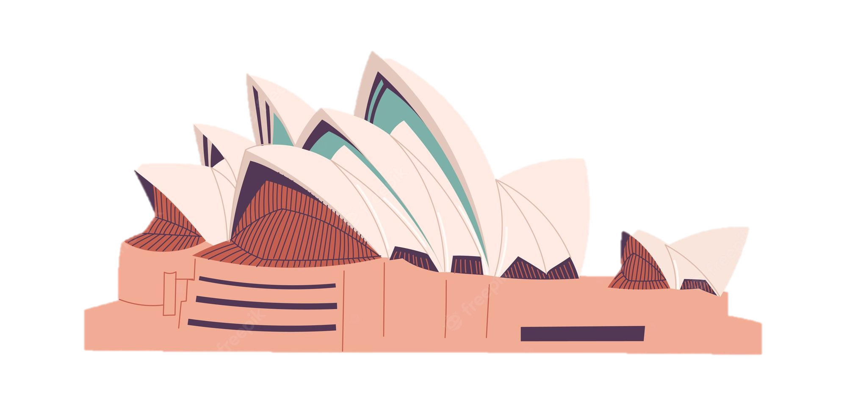
Where is it?
It's a theatre on Sydney Harbour. Its roofs are white and look like shells. Visitors from all over the world come to see it.
Sydney Opera House

Slide 13
Where is it?
This famous tower is in Paris. Every year, millions of visitors climb to its top to see the whole view of Paris.
Eiffel Tower

Slide 14
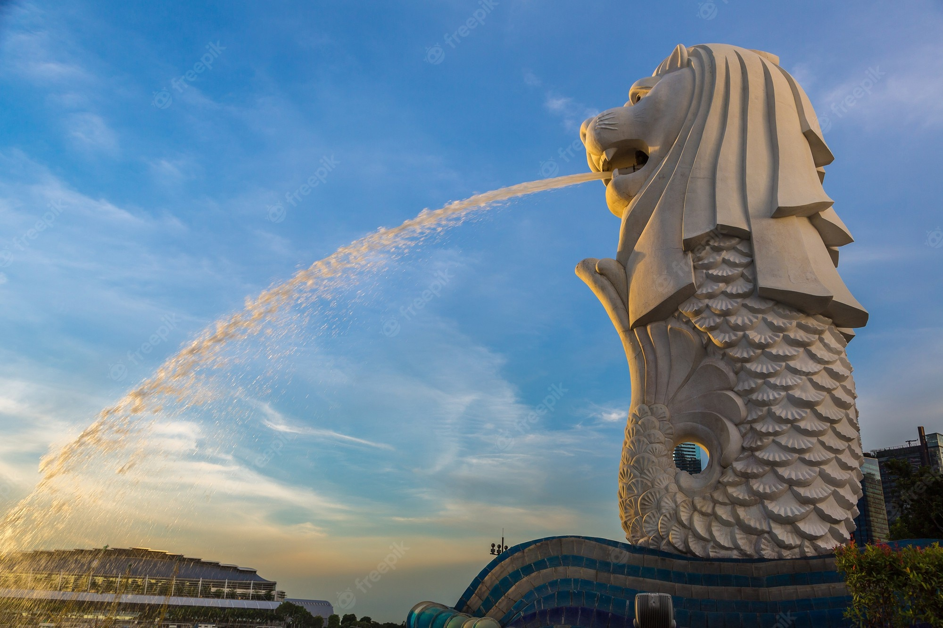
Where is it?
It has the head of a lion and the body of a fish.
It's a famous landmark in Singapore.
Merlion

Slide 15
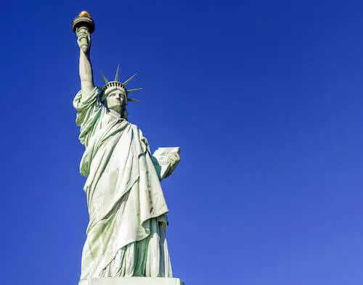
Where is it?
It is located on Liberty Island, the statue is in the form of a woman. She holds a torch in her raised right hand and
a tablet in her left.
Statue of Liberty

Slide 16
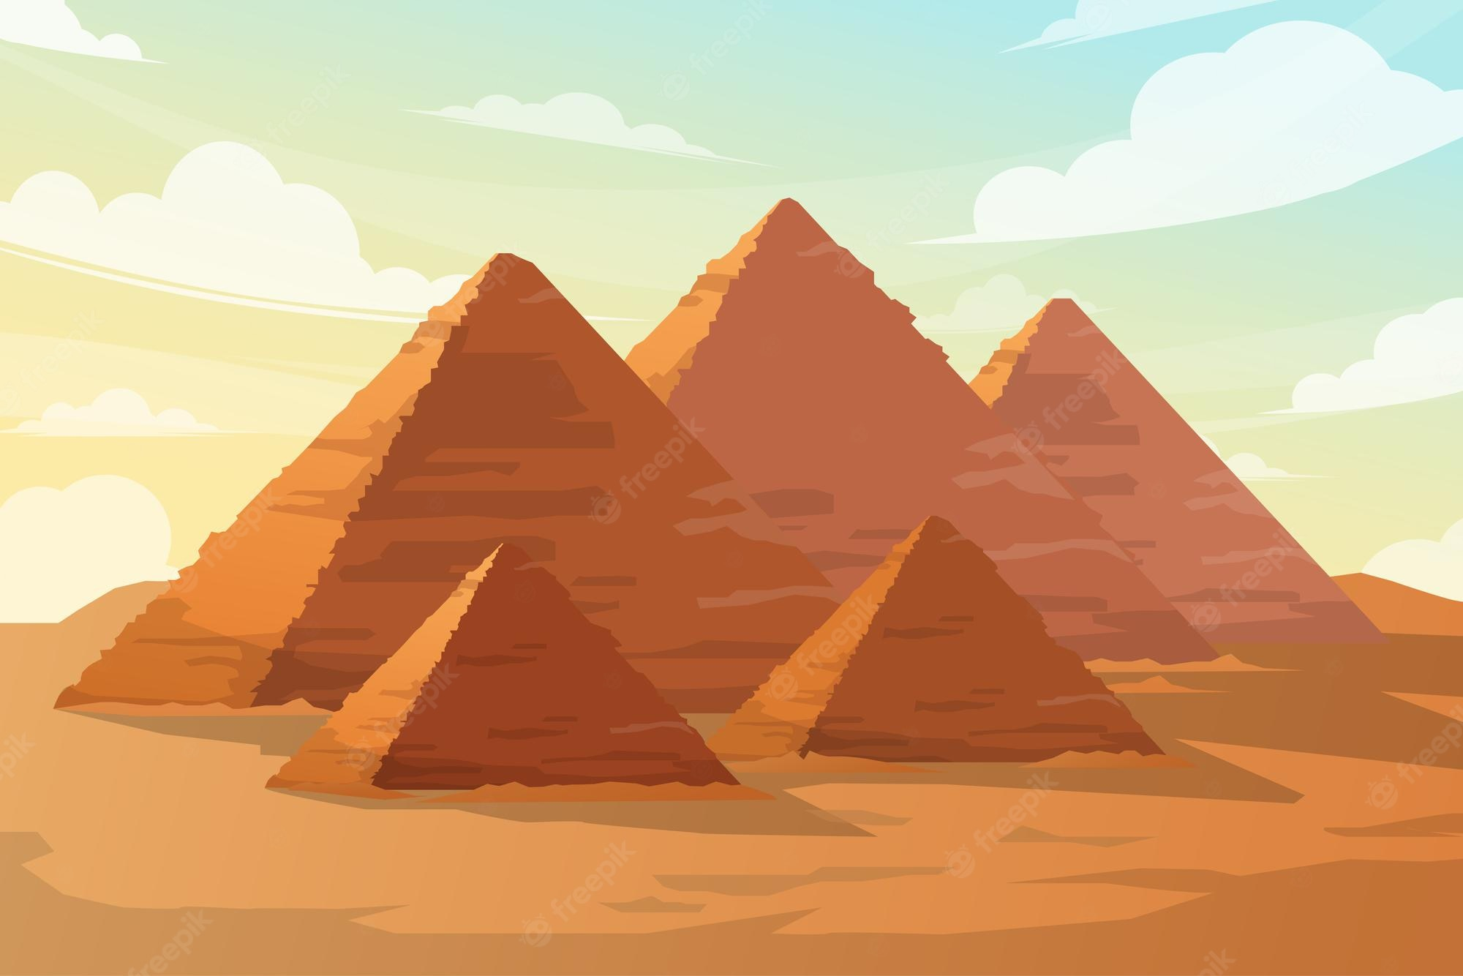
Where is it?
It is a popular attractions,
it was originally built for pharaoh Khufu.
The great Pyramid of Giza

Slide 17





Ex 5 (pg. 31) Work in pairs.
Read the questions and circle the correct answers.
QUIZ TIME
1. Which city is nearer to Ha Noi than the others?
A. Berlin B. Bangkok C. Tokyo
2. The people of Quang Nam are proud of their ancient town, _____.
A. Hoi An B. Sa Pa C. Bach Ma
3. Phnom Penh is the capital city of _____.
A. Indonesia B. the Philippines C. Cambodia
4. For children, California is famous for its _____.
A. Disneyland Park
B. Golden Gate Bridge
C. national parks

Slide 18
CHECK YOUR ANSWER
1. Which city is nearer to Ha Noi than the others?
A. Berlin B. Bangkok C. Tokyo
2. The people of Quang Nam are proud of their ancient town, _____.
A. Hoi An B. Sa Pa C. Bach Ma
3. Phnom Penh is the capital city of _____.
A. Indonesia B. the Philippines C. Cambodia
4. For children, California is famous for its _____.
A. Disneyland Park
B. Golden Gate Bridge
C. national parks
near (adj) gần hơn
ancient (adj)
cổ kính
capital city (noun)
thủ đô
famous for (adj)
Nổi tiếng vì thứ gì

Slide 19
Recap
1. What is a correct exclamation?
2. Odd one out
A. What beautiful photos.
B. This is a very good place.
C. How are you?
A. Merlion B. Big Ben C. Eiffel
D. Sydney Opera house E. Viet Nam

Slide 20
Thanks!
Do you have any questions?
Please keep this slide for attribution

