Slide 1
Unit 1:
Hobbies
Lesson 7: Looking back

Slide 2
OBJECTIVES
Don't forget
...
Review the vocabulary and grammar of Unit 1

Slide 3
Vocabulary
play sports, listen to music, watch movies, read books, visit friends, go for a walk, take photos, etc.
Hobbies:
Verbs of liking or disliking:
love, hate, like, dislike, fancy, adore, enjoy, detest, etc.

Slide 4
Pronunciation
/ɜ:/ | /ə/
Prefer, reserve, term, research, learn, first, sir, bird, turn, work, verb.
About, affect, acoustic, photography,
geography, entertainment, label, stranger, absence

Slide 5
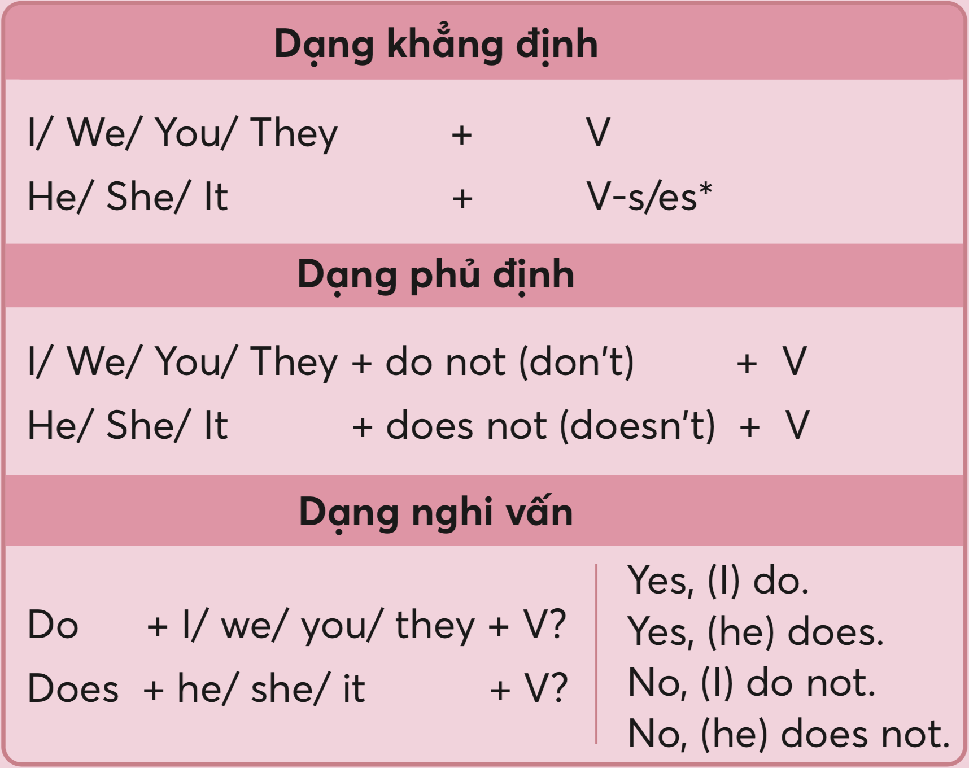
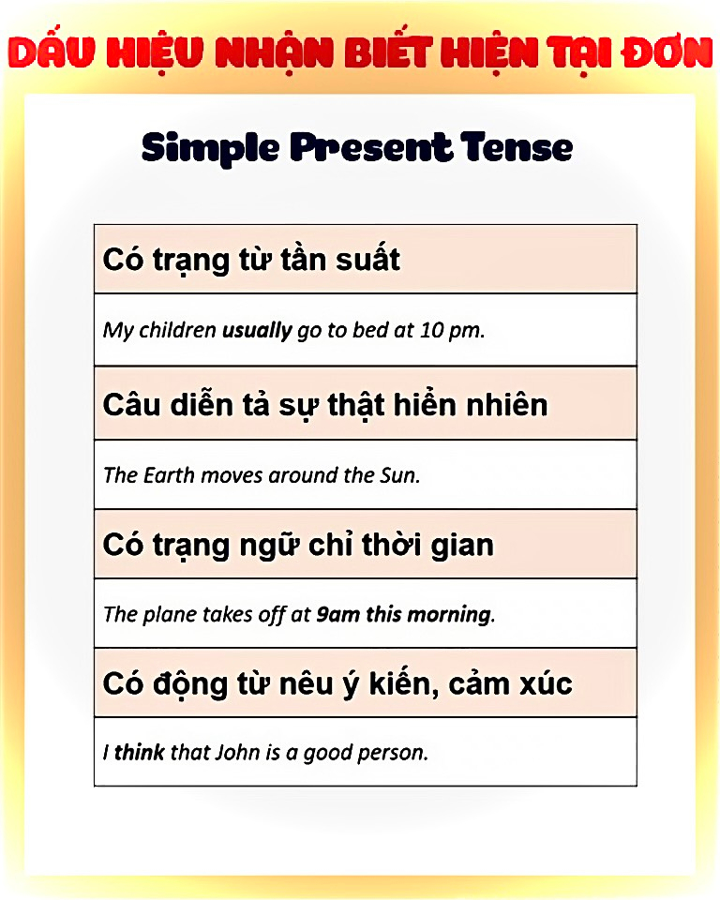
Grammar:
Present Simple

Slide 6
01
VOCABULARY
REVIEW

Slide 7
Ex1: Complete the sentences with appropriate hobbies.(p.16)
a lot of coins
1. I have from different countries. My hobby is _________________.
2. She loves and goes to every weekend. Her hobby is ____________.
3. He loves of small cars and planes. His hobby is ________________.
4. My sister spends one hour every day. Her hobby is ______________.
5. Minh is . He with his friends every day.
His hobby is ________________.
collecting coins
judo
the judo club
doing judo
making models
making models
in the garden
gardening
a good footballer
plays football
playing football

Slide 8

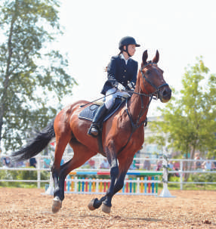
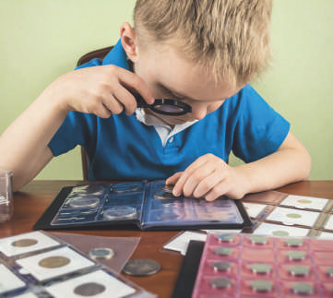
Ex2: Write true sentences about you and your family members.(p.16)
1. I like __________________.
2. My dad enjoys __________________.
3. My mum doesn’t like __________________.
4. My grandmother loves __________________.
5. My grandfather hates __________________.

Slide 9
02
GRAMMAR
REVIEW

Slide 10
Ex3:Use the present simple form of each verb to complete the passage.(p.16)
Each of my best friends has his or her own hobby. Mi (1.love) ______ drawing. She can spend hours drawing pictures every day. Mark (2.have) _____ a different hobby. He(3.enjoy) ________ playing sport. I (4.not like) ___________ playing sport. I like reading books because I can learn many things from them. However, there (5. be)____ one hobby we share. It (6.be) ____ cooking. We all (7.go) ____ to the same cooking class. Our class (8.begin) ________ at 9 a.m. on Sundays.

Slide 11
Ex3:Use the present simple form of each verb to complete the passage.(p.16)
Each of my best friends has his or her own hobby. Mi (1.love) ______ drawing. She can spend hours drawing pictures every day. Mark (2.have) _____ a different hobby. He(3.enjoy) ________ playing sport. I (4.not like) ___________ playing sport. I like reading books because I can learn many things from them. However, there (5. be)____ one hobby we share. It (6.be) ____ cooking. We all (7.go) ____ to the same cooking class. Our class (8.begin) ________ at 9 a.m. on Sundays.
loves
1. She + Vs/es
has
2. He + Vs/es
enjoys
3. He + Vs/es
don’t like
4. I + do (not) +V
5. There + is/are
is
6. It + is
is
go
7. We + V
begins
8. Our class + Vs/es

Slide 12
Ex4:Change the following sentences into questions and negative ones.(p.16)
1. This river runs through my home town.
2. My drawing class starts at 8 a.m. every Sunday
(?) Does this river run through your home town?
(-) This river doesn’t / does not run through my home town.
(?) Does your drawing class start at 8 a.m. every Sunday?
(-) My drawing class doesn’t / does not start at 8 a.m. every Sunday.
Do they enjoy collecting stamps?
They don’t / do not enjoy collecting stamps.

Slide 13
Ex4:Change the following sentences into questions and negative ones.(p.16)
3. They enjoy collecting stamps.
4. I do judo every Tuesday.
5. My brother loves making model cars.
(?) Do they enjoy collecting stamps?
(-) They don’t / do not enjoy collecting stamps.
(?) Do you do judo every Tuesday?
(-) I don’t / do not do judo every Tuesday.
(?) Does your brother love making model cars?
(-) My brother doesn’t / does not love making model cars.

Slide 14
Thank you!
See you next time

