Slide 1
Kim’s game
- Work in pairs
- 30 seconds
– Look and remember the words
- Write down in your notebook

Slide 2
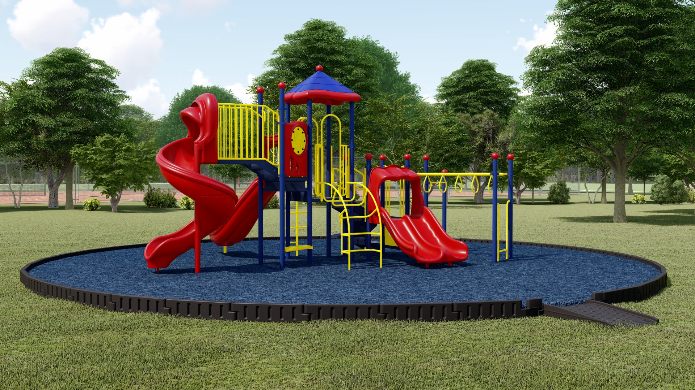
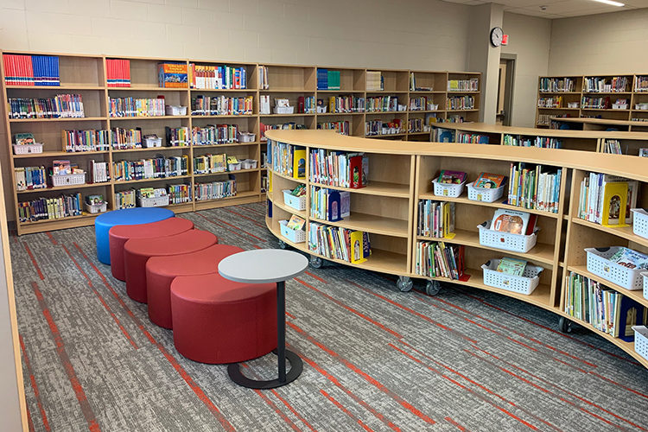

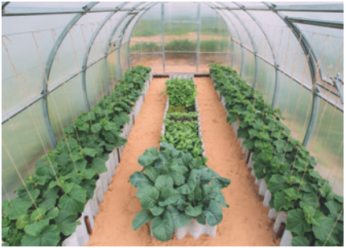
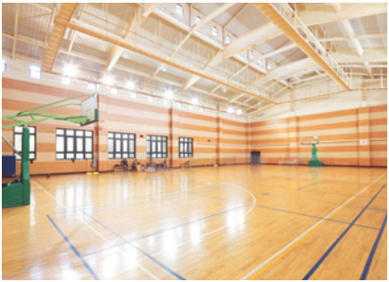


Slide 3

Check your answer
playground
school library
computer room
garden
gym

Slide 4
Unit 6
A day to a school
Lesson 2: A closer look 2

Slide 5
Ex 1. Match the words in A with B to form phrases. (p. 61)
A
1. entrance
2. school
3. outdoor
4. midterm
5. gifted
B
a. students
b. activities
c. facilities
d. examination
e. test
d. examination
c. facilities
b. activities
e. test
a. students

Slide 6
Ex 2. Complete the sentences with the phrases in Task 1.
entrance examination
school facilities
outdoor activities
midterm test
gifted students
1. Binh Minh Lower Secondary School is for __________________ in the city.
2. Our _______________ usually covers the first three units.
3. Students in my school take part in many ___________________ during the school year.
4. Our school has a lot of modern ________________.
5. In order to study in Quoc Hoc – Hue you have to pass a(n) _______________.
gifted students
midterm test
outdoor acitivities
school facilities
entrance
examination

Slide 7

DISCUSSING
1. Can you name some gifted student in your school?
2. When does the first-term test take place?
3. Do you have to take an entrance examination to study at your school?
4. What kind of facilities does your school have?
5. What types of outdoor activities do you like to take part in?
1
Groups of 4-5 students
2
5 minutes
3
Brainstorm the questions
4
Present ideas in class

Slide 8

Pronunciation
/tʃ/ and /dʒ/

Slide 9
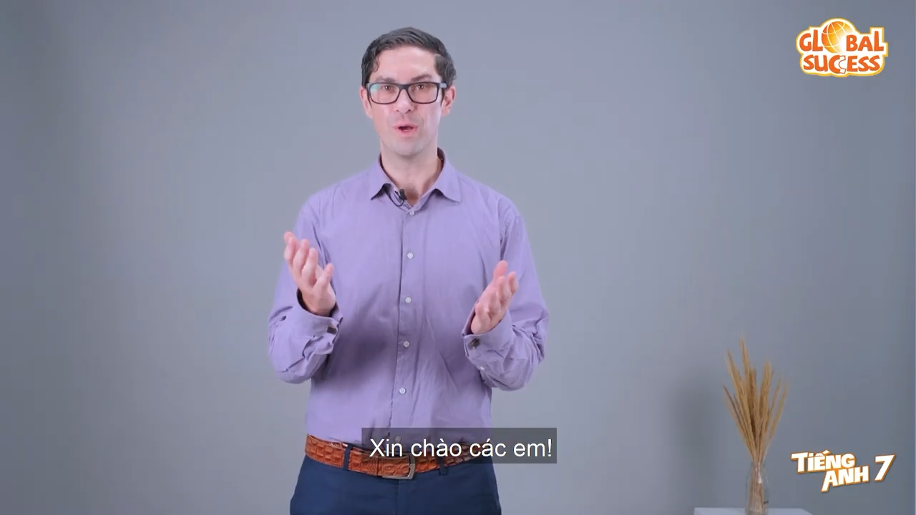
Watch a video and repeat

Slide 10
Ex 4. Listen and repeat the words. Pay attention to /dʒ/ sound.
/tʃ/ | /dʒ/
cherry cheaper children lunch teacher | jam gym juice large project intelligent
/tʃ/ | /dʒ/
cherry cheaper children lunch teacher | jam gym juice large project intelligent
/ˈtʃeri/
/dʒæm/
/ˈtʃiːpə(r)/
/ˈdʒɪm/
/ˈtʃɪldrən/
/ˈdʒuːs/
/ˈlʌntʃ/
/ˈlɑːdʒ/
/ˈtiːtʃə/
/ˈprɒdʒekt/
/ɪnˈtelədʒənt/

Slide 11
Ex 4. Listen and repeat the words. Pay attention to /dʒ/ sound.
/tʃ/
cherry
cheaper
children
/ˈtʃeri/
/ˈtʃiːpə(r)/
/ˈtʃɪldrən/
lunch
teacher
/ˈlʌntʃ/
/ˈtiːtʃə/
/dʒ/
jam
gym
juice
/dʒæm/
/ˈdʒɪm/
/ˈdʒuːs/
large
project
intelligent
/ˈlɑːdʒ/
/ˈprɒdʒekt/
/ɪnˈtelədʒənt/
Notes:
Các thầy/cô bấm vào từng từ, sẽ ra âm thanh và phiên âm của từng chữ

Slide 12

GAME: UP or DOWN
How to play
- Whole class stand up
- Sit down if it’s /tʃ/ and stand up if it’s /dʒ/
- The last student who survives will get a present.
/tʃ/ | /dʒ/
maturity
teenager
exchange
project
chapped
jogging
kitchen
originate
picture
jeep

Slide 13
Wrap up
Translate the vocabulary
1. Bài thi đầu vào
entrance exam
2. Cơ sở vật chất
school facility
3. Hoạt động ngoài trời
outdoor activitiy
4. Bài thi giữa kì
midterm test
5. Trường chuyên
gifted school

Slide 14
Wrap up
Find the different sound
/dʒəˈrɑːf/
A. giraffe
B. geography
/dʒiˈɒɡrəfi/
C. goggles
/ˈɡɒɡəl/

Slide 15
Great work!
See you next time

