Slide 1
BINGO!
Get a piece of paper, draws a table with 3 rows and 3 columns
Fill in the table with names of some festivals randomly.
Teacher calls out the names of some festivals.
Students search for the right square on their paper and mark.
The student who has 3 words highlighted in a row yells “Bingo” and wins.

Slide 2
Put the festivals randomly in your 3x3 table!
La Tomatina
Thanks-
giving
Easter
Christmas
Tet holiday
Tulip festival
Hallo-ween
Ghost day
Cannes festival

Slide 3
Unit 9
Festivals around the world!
Lesson 6: Skills 2

Slide 4
LISTENING
This can be the part of the presentation where you introduce yourself, write your email…

Slide 5
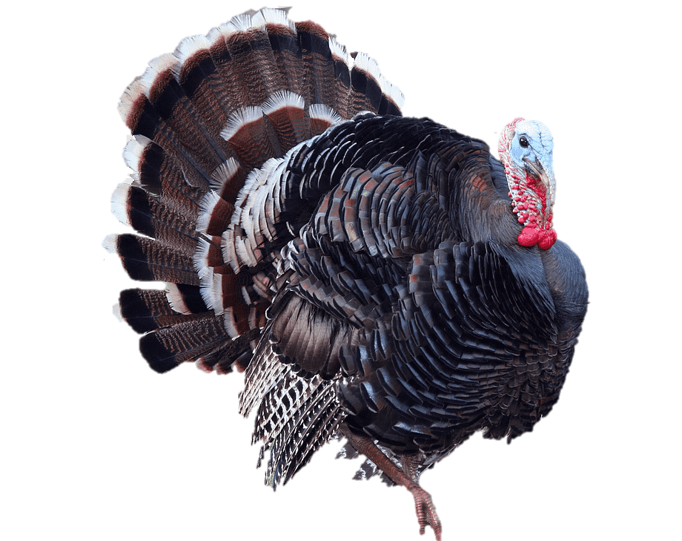
Ex 1. (pg 99). Look and discuss
1. What animal is it?
2. What festival is it a part of?

Slide 6


Ex 2. (pg 99). Listen and check
1. What animal is it?
2. What festival is it a part of?
Listen and check

Slide 7
Ex 2. (pg 99). Listen and check
1. What animal is it?
2. What festival is it a part of?
→ A turkey
→ Thanksgiving

Slide 8
Ex 3 (pg.99) Listen again and decide if the statements are true (T) or false (F).
 | True | False
1. Only people from the USA celebrate Thanksgiving.
2. People celebrate it on the third Thursday of November.
3. Family members and friends usually gather to have a feast.
4. In his family, only adults prepare the feast.
5. Cornbread is one of the traditional dishes.
6. After the feast, they play board games.

Slide 9

Ex 3 (pg.99) Listen again and decide if the statements are true (T) or false (F).
 | True | False
1. Only people from the USA celebrate Thanksgiving.
Today I'm going to talk about Thanksgiving, or Turkey Day. It's a national holiday.People from Canada and the USA celebrate it every year to be thankful for successful harvests.

Slide 10
Ex 3 (pg.99) Listen again and decide if the statements are true (T) or false (F).
 | True | False
2. People celebrate it on the third Thursday of November.
In the USA, we celebrate it on
the fourth Thursday of November.

Slide 11
Ex 3 (pg.99) Listen again and decide if the statements are true (T) or false (F).
 | True | False
3. Family members and friends usually gather to have a feast.
We usually prepare a feast for family and friends. Both adults and children take part in the food preparation.

Slide 12
Ex 3 (pg.99) Listen again and decide if the statements are true (T) or false (F).
 | True | False
4. In his family, only adults prepare the feast.
We usually prepare a feast for family and friends. Both adults and children take part in the food preparation.

Slide 13
Ex 3 (pg.99) Listen again and decide if the statements are true (T) or false (F).
 | True | False
5. Cornbread is one of the traditional dishes.
Some of the traditional foods are turkey, sweet potatoes, and cornbread.

Slide 14
Ex 3 (pg.99) Listen again and decide if the statements are true (T) or false (F).
 | True | False
6. After the feast, they play board games.
After the meal, we play board games together.

Slide 15
Ex 3 (pg.99) Check your answers
 | True | False
1. Only people from the USA celebrate Thanksgiving.
2. People celebrate it on the third Thursday of November.
3. Family members and friends usually gather to have a feast.
4. In his family, only adults prepare the feast.
5. Cornbread is one of the traditional dishes.
6. After the feast, they play board games.

Slide 16
Listening script
Hello everyone. I'm Mark. Today I'm going to talk about Thanksgiving, or Turkey Day. It's a national holiday. People from Canada and the USA celebrate it every year to be thankful for successful harvests. In the USA, we celebrate it on the fourth Thursday of November. We usually prepare a feast for family and friends. Both adults and children take part in the food preparation. Some of the traditional foods are turkey, sweet potatoes, and cornbread. After the meal, we play board games together. My family usually takes this opportunity to help others. My parents volunteer to cook and serve food to homeless people. My sister and I read books to old people in a nursing home near our house.

Slide 17
WRITING
This can be the part of the presentation where you introduce yourself, write your email…

Slide 18
Ex 4 (pg. 33). Think about a festival that your family usually celebrates. Fill in the blanks with your answer.
What food does your family eat?
When do you celebrate it?
FESTIVAL IN YOUR COUNTRY
What activities does your family do?
Do you like the festivals? Why?

Slide 19
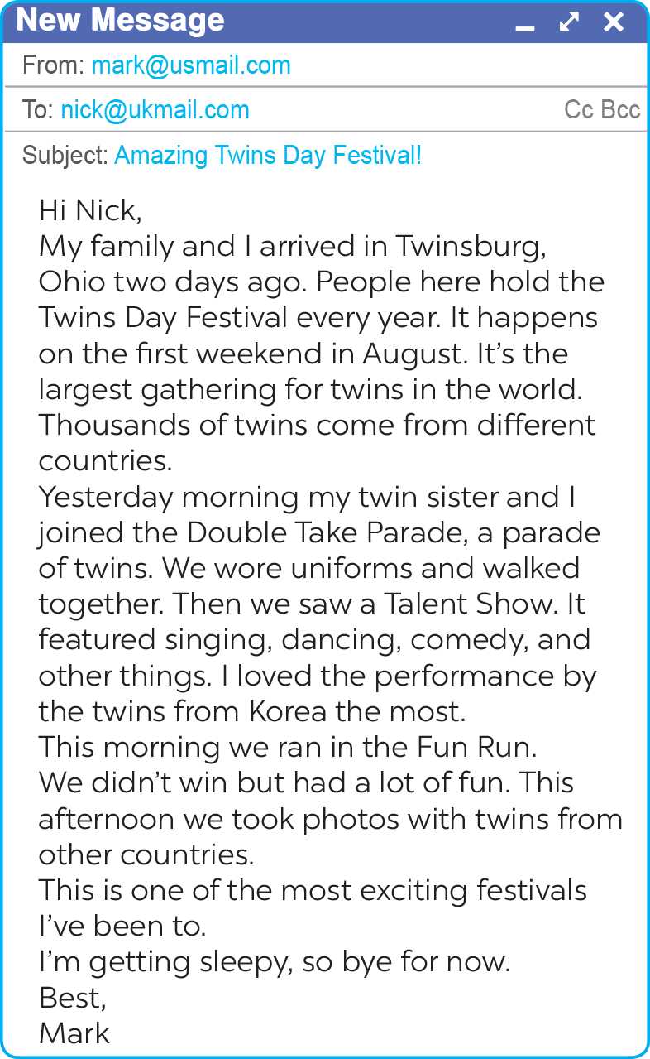

Ex 5 (pg. 99). Using this email to write an email of about 70 words to tell Mark about the festival. Use the notes in Ex 4.
When do you celebrate it?
What activities does your family do?
What food does your family eat?
Do you like the festivals? Why?

Slide 20
Peer check
Swap with your partner the check
 | Yes | No
1. Did he/she answer all the questions?
2. Did he/she have spelling mistakes? If NO, please underline.
3. Did he/she use correct grammar? If NO, please underline.
4. Did he/she follow a form of an e-mail?

Slide 21
RECAP
LISTENING
WRITING
listen for special information about a festival
write an email to describe a festival

Slide 22
Icon pack

Slide 23
Thanks!
Do you have any questions?
youremail@freepik.com
+34 654 321 432
yourwebsite.com
Please keep this slide for attribution

