Slide 1
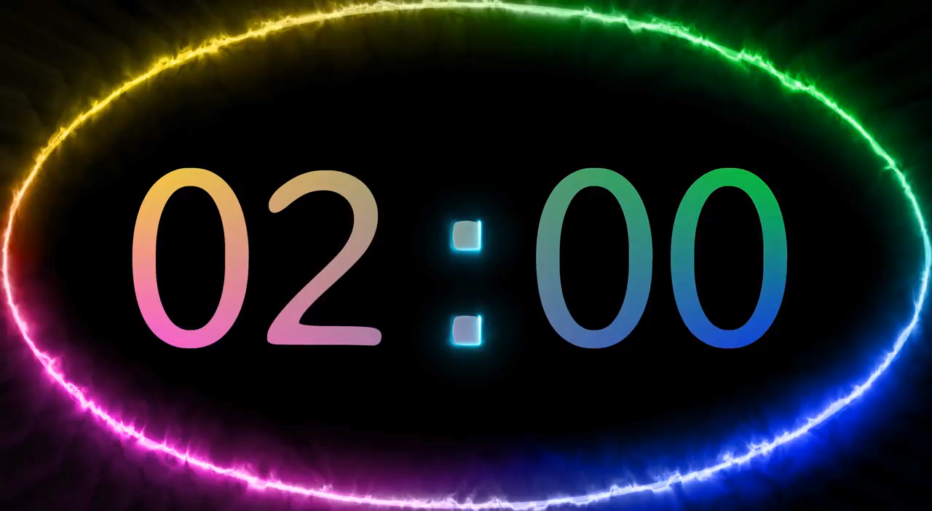

Warm - up
Memory Game

Slide 2
Keys
- Listening to music
- Playing the guitar
- Playing badminton
- Collecting coins
- (doing) gardening
- Painting/ drawing
- Skating
- (going) camping

Slide 3

UNIT 1: HOBBIES
Lesson 2: A closer look 1

Slide 4



Unit
1
HOBBIES
LESSON 2: A CLOSER LOOK 1
VOCABULARY
PRONUNCIATION
Unit
HOBBIES

Slide 5
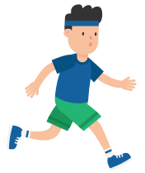

VOCABULARY
jogging (n)
/ˈdʒɒɡɪŋ /
đi/ chạy bộ thư giãn

Slide 6

VOCABULARY
coin (n)
/kɔɪn/
đồng xu

Slide 7
VOCABULARY
New words | Pronunciation | Meaning
1. jogging (n) | / ˈdʒɒɡɪŋ / | đi, chạy bộ thư giãn
2. coin (n) | / kɔɪn / | đồng xu

Slide 8
VOCABULARY
New words | Pronunciation | Meaning
1. jogging (n) | / ˈdʒɒɡɪŋ / | đi, chạy bộ thư giãn
2. coin (n) | / kɔɪn / | đồng xu

Slide 9
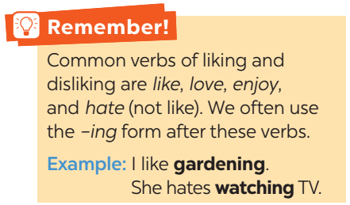
VOCABULARY

Slide 10
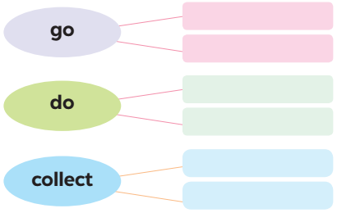
VOCABULARY
1
Complete the word webs below with the words from the box.
dolls
jogging
coins
judo
swimming
yoga

Slide 11
VOCABULARY
2
Complete the sentences, using the –ing form of the verbs from the box.
1. My dad has a big bookshelf because he loves _________ old books.
2. My sister likes _________ camping at the weekend.
3. My best friend hates _________ computer games.
4. Does your brother like _________ models?
5. My mum enjoys _________ yoga every day to keep fit.
collecting
going
playing
making
doing

Slide 12
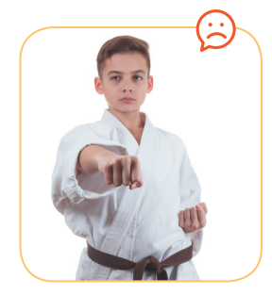
VOCABULARY
3
Look at the pictures and say the sentences. Use suitable verb of liking or disliking and the –ing form.
He hates / doesn’t like doing judo.

Slide 13
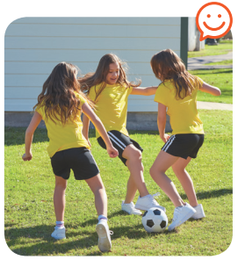
VOCABULARY
3
Look at the pictures and say the sentences. Use suitable verb of liking or disliking and the –ing form.
They like / love / enjoy playing football.

Slide 14
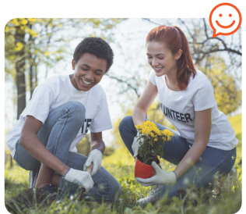
VOCABULARY
3
Look at the pictures and say the sentences. Use suitable verb of liking or disliking and the –ing form.
They love / like / enjoy gardening.

Slide 15
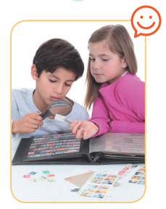
VOCABULARY
3
Look at the pictures and say the sentences. Use suitable verb of liking or disliking and the –ing form.
They enjoy / like / love collecting stamps.

Slide 16
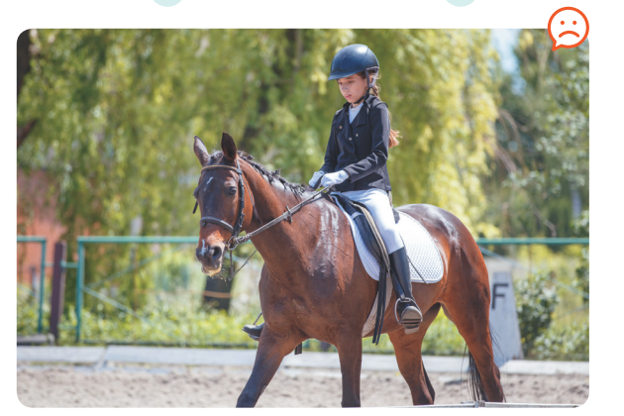
VOCABULARY
3
Look at the pictures and say the sentences. Use suitable verb of liking or disliking and the –ing form.
She hates / doesn’t like riding a horse / horse riding.

Slide 17
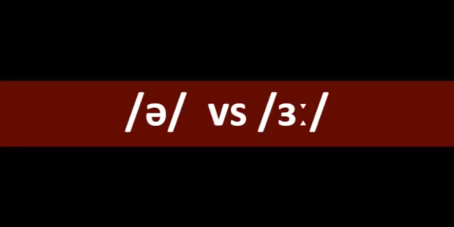
PRONUNCIATION
/ə/ and /ɜ:/

Slide 18
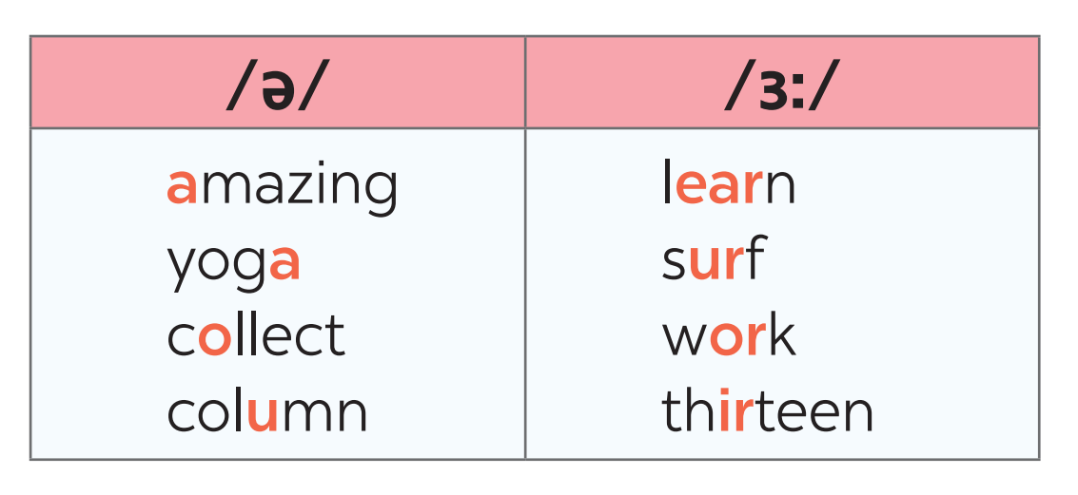
PRONUNCIATION
4
Listen and repeat. Pay attention to the sounds /ə/ and /ɜ:/.

Slide 19
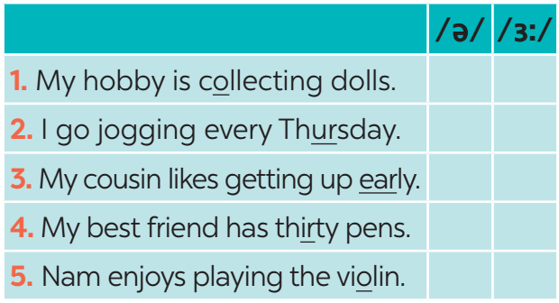

PRONUNCIATION
5
Listen to the sentences and pay attention to the underlined parts. Tick (✓) the appropriate sounds. Practise the sentences.
/ə/ and /ɜ:/
✔
✔
✔
✔
✔

Slide 20
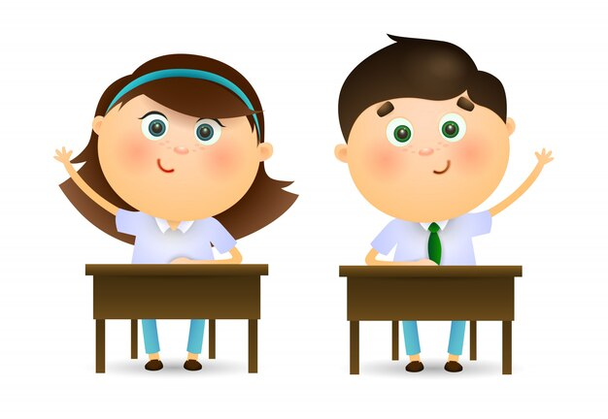
PRODUCTION
Game: Who is faster?
Work in groups of four
Write sentences including: hobbies and one of the sounds /ə/ and /ɜ:/
(e.g: Listening to music is a very common hobby.)
The group with the most correct sentences is the winner.

Slide 21
CONSOLIDATION
1
WRAP-UP
VOCABULARY
PRONUNCIATION

Slide 22

CONSOLIDATION
2
HOMEWORK
Find 3 more words relating to hobbies that have the sound /ə/ or /ɜ:/.

