Slide 1


Slide 2
STARTER
UNIT
Lesson 4
Vocabulary
Prepositions
and
Everyday objects

Slide 3
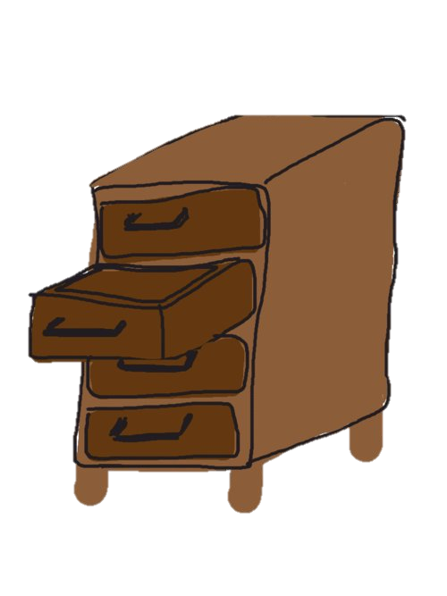

New words
Poster (n) /ˈpoʊ.stɚ/
Drawer (n) /drɑː/

Slide 4

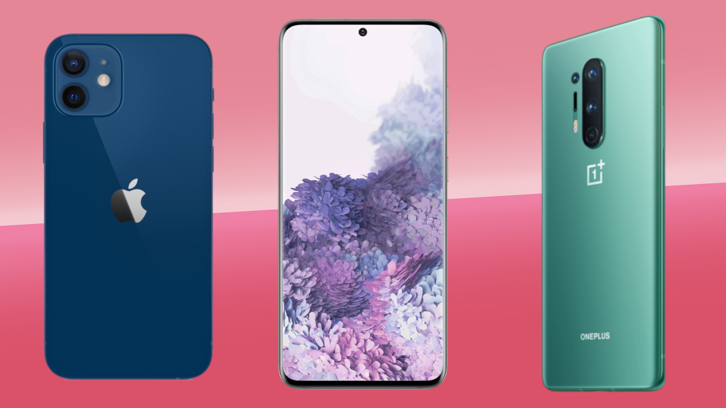
New words
Mobile phone (n)
/ˈmoʊ.bəl/ /foʊn/
Clock (n) /klɑːk/

Slide 5
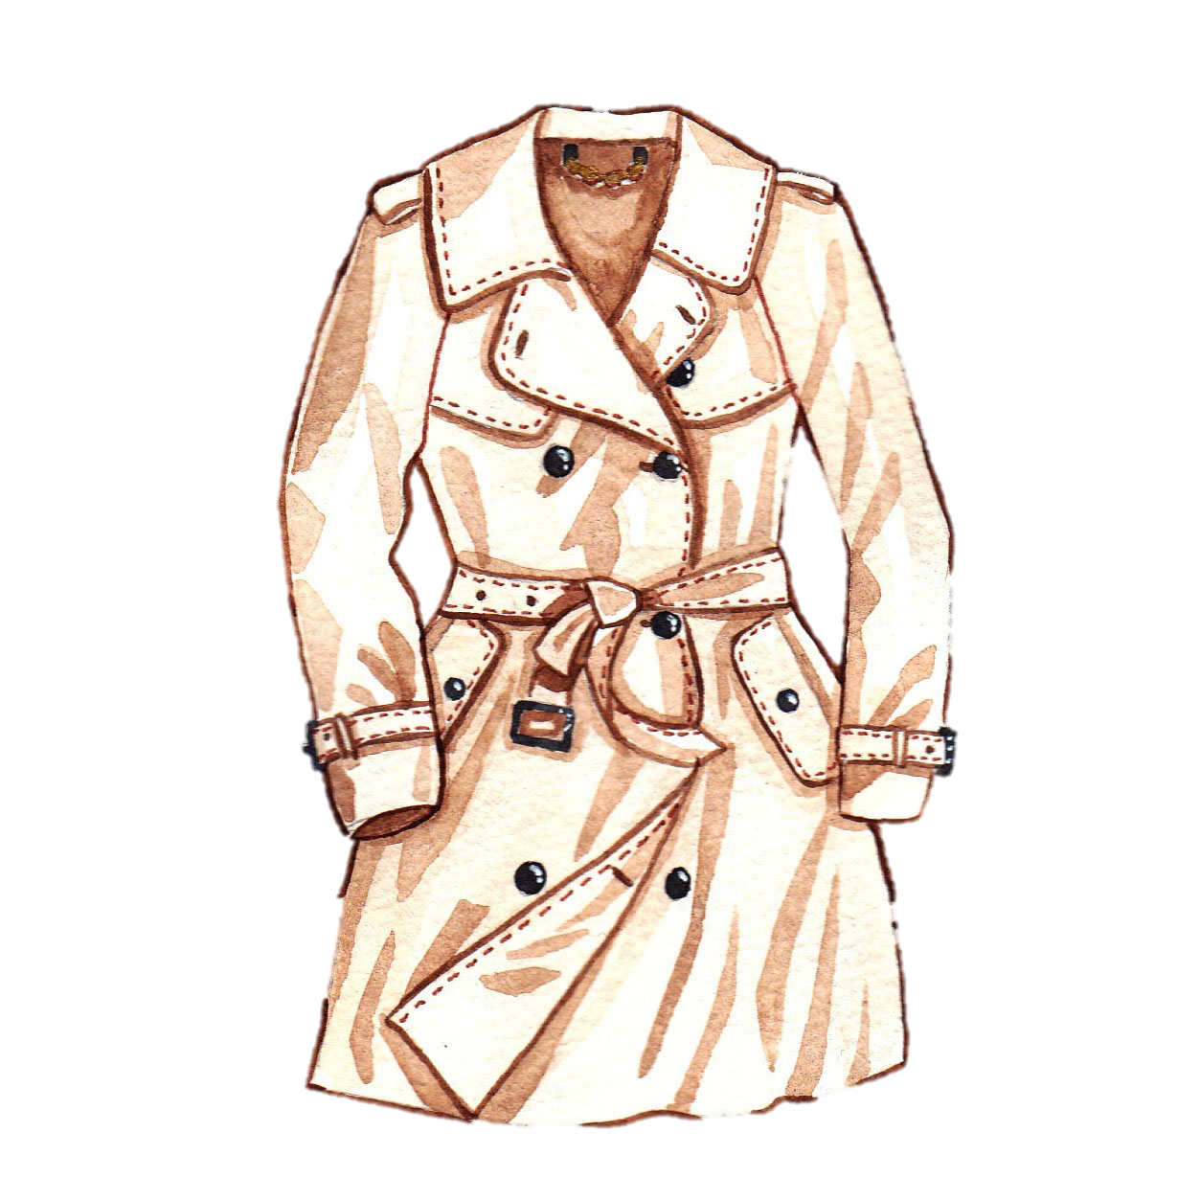

New words
Dictionary (n) /ˈdɪk.ʃən.er.i/
Coat (n) /koʊt/

Slide 6
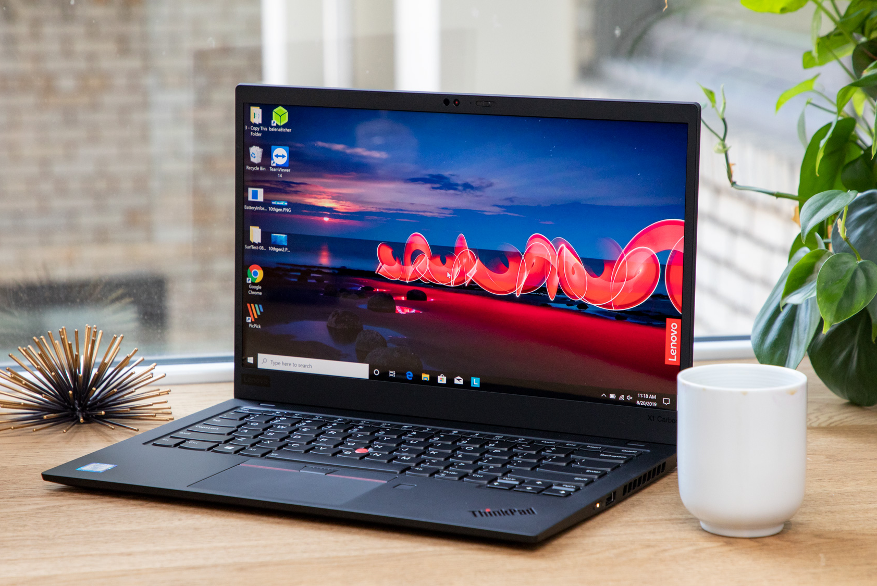
New words
laptop (n)
/ˈlæp.tɑːp/

Slide 7
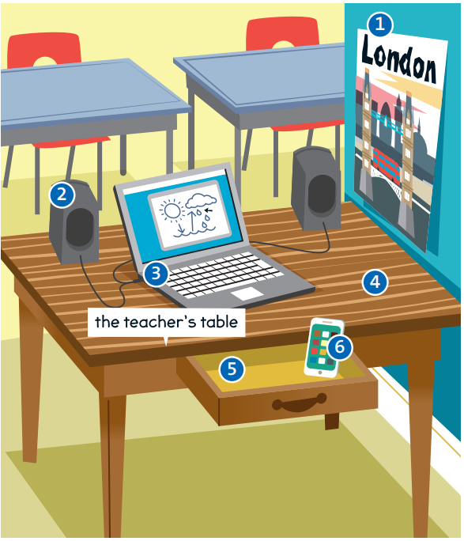
1. poster
2. speaker
4. table
3. laptop
6. mobile
phone
5. drawer

Slide 8
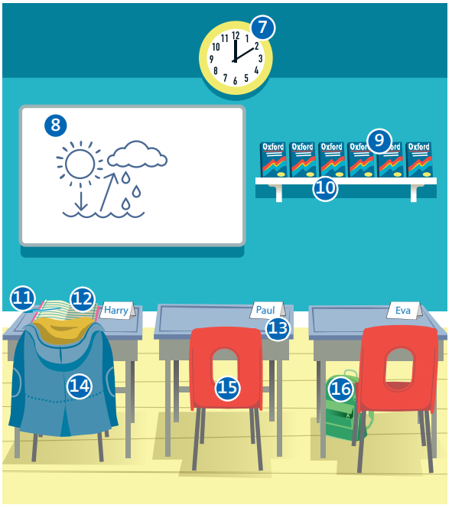
7. clock
8. board
9. dictionaries
10. shelf
11. pen
13. desk
12. notebook
14. coat
16. bag
15. chair

