Slide 1
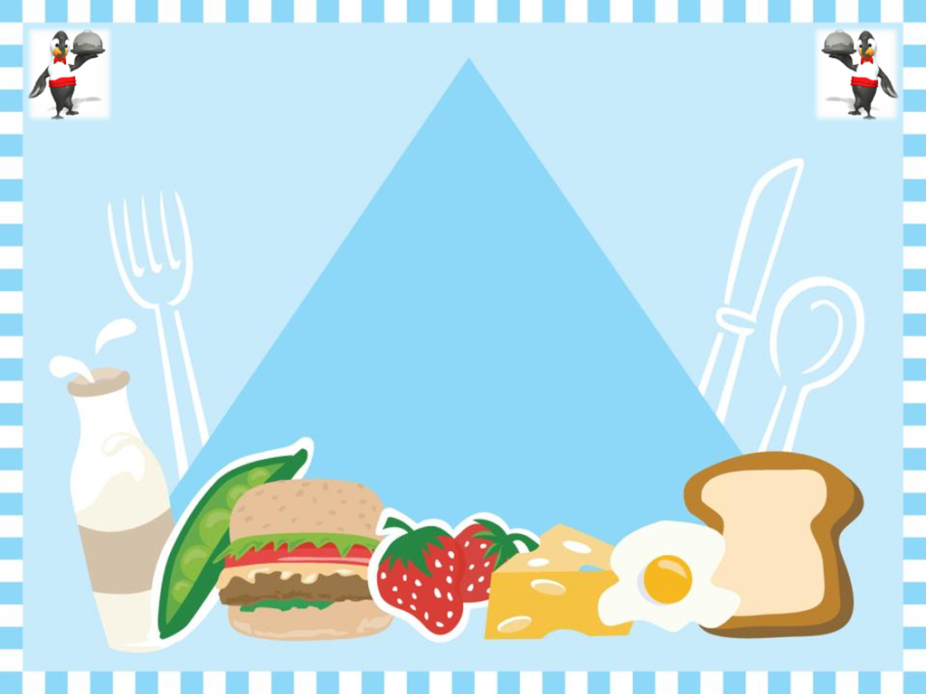
Unit 2 Writing
The food column
Class: 10A0
Teacher: Le Thanh Loan

Slide 2

Activity 1:
Build a list of foods from your experience that may give you
- allergies
- dị ứng
- bad breath
- hơi thở khó chịu
- stress
- căng thẳng
- sleeplessness
- chứng mất ngủ
- sleepiness
- chứng thèm ngủ
Then share and compare your list with your friends.

Slide 3
Activity 2:
Now, read the facts below. Do you have some of these foods on your list? Which one?
Allergies
Milk, Wheat, Eggs, Soya, Fish, Peanuts, Shellfish (including mussels, crab and shrimp)
Bad Breath
Onion, Garlic, Cabbage, Curry, Alcohol
Coffee, Cola, Tea, Alcohol, Chocolate, Refined sugar, White flour, Salt, Processed Foods (Junk Foods & Fast Foods
Stress
High-carbohydrate, low protein foods (cheese, milk, soya milk, tofu, nuts, honey, almonds, bananas, whole grains, beans, rice, avocados, sesame seeds, sunflowers seeds or payaya
Sleeplessness
Caffeine containing foods, alcohol, sugar, fatty or spicy food, food addiitves (seasonings, artificial colours, flavourings)
Sleepiness

Slide 4

Activity 3
Write a similar enquiry for advices on your diets and use the some writing samples as the models.
Dear Expert,
State your problem
Ask for the advices
  Could you….?
  I would be very grateful if you could…
  I would be very thankful if you could…
  I was wondering if you could…
Say thank you
Write your name

Slide 5

Activitiy 4
You are the food specialist and you are working on the newsletter’s next edition. Read the Scott’s enquiry.
Then write your own by responding to one of the other texts from 3 or your friends’

Slide 6
Activitiy 4
Outline of your writing:
Dear + Name of the person that you write to
Introduction (Paragraph 1):
  State the problem again : Taking an important exam is like running a marathon
  Lead-in: so it is advisable to take good care of what you eat.

Slide 7
Activitiy 4
Outline of your writing:
Main body (Paragraphs 2, 3 & 4): Give advices
  Imperative (Câu mệnh lệnh)
    Do sth: Eat breakfast, Drink a lot of water
    Don’t do sth: Don’t sleep too late
  Some useful structures to express advices:
    You should / shouldn’t + V
    You had better V / not V
    You ought to / ought not to V
    If I were you, I would + V

Slide 8
Activitiy 4
Outline of your writing:
Closing:
  Write your expectation or wish
    (I )hope you will + V: Hope you will do your best.
    I wish you + a noun phrase: I wish you a good health.
  Write the closing phrase: Regards, Best regards.

Slide 9


